Slide 1

Antonio Torralba, 2012
Lecture 2
Linear filters

Slide 2
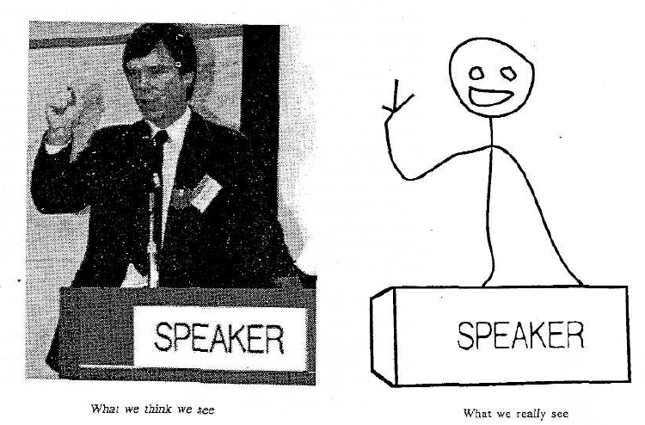
Proposition 1. The primary task of early vision is to deliver a small set of useful measurements about each observable location in the plenoptic function.
Proposition 2. The elemental operations of early vision involve the measurement of local change along various directions within the plenoptic function.
Goal: to transform the image into other representations (rather than pixel values) that makes scene information more explicit
Cavanagh, Perception 95

Slide 3
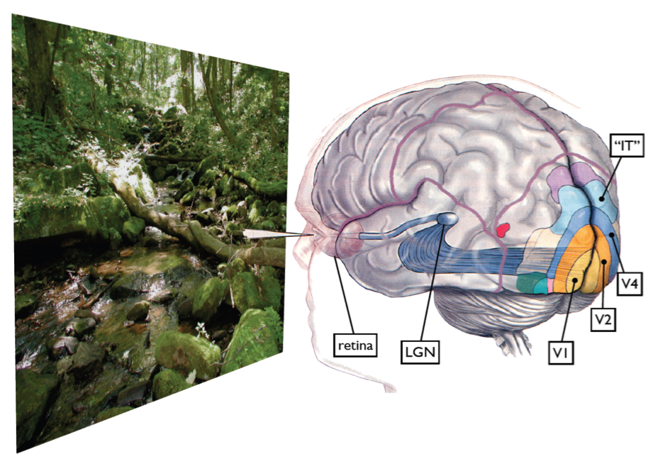
Some visual areas…
From M. Lewicky
Notes:
Slides from lewicki

Slide 4
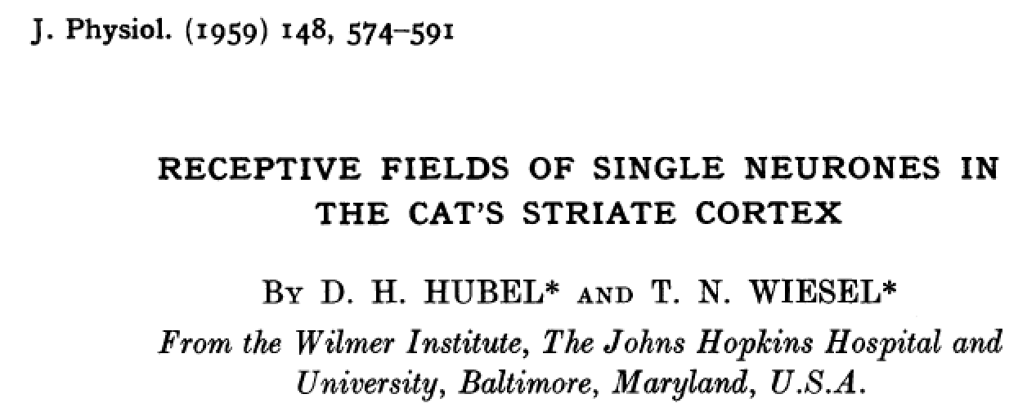
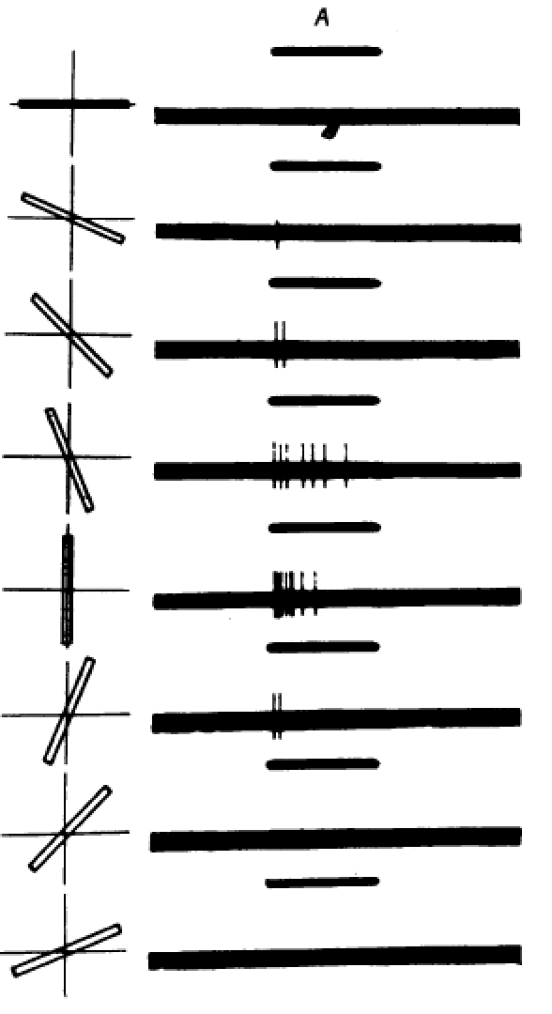
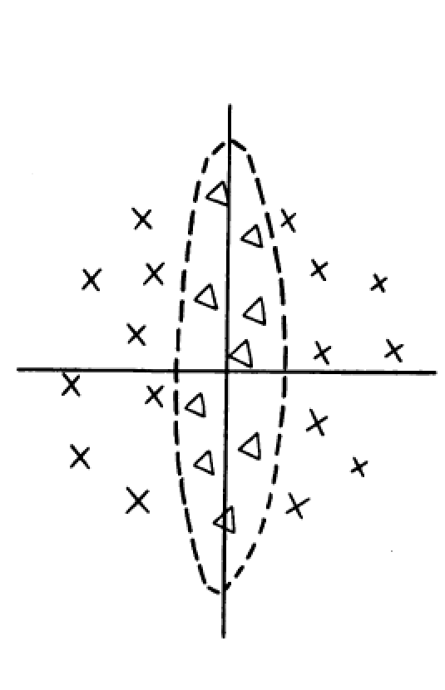
Receptive field
of a cell in the cat’s cortex
Responses to an oriented bar

Slide 5
Outline
Linear filtering
Fourier Transform
Human spatial frequency sensitivity
Phase
Sampling and Aliasing
Spatially localized analysis
5

Slide 6
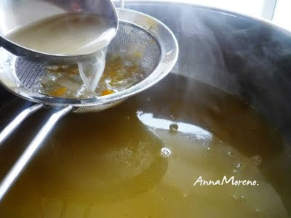
Filtering
g [m,n]
f [m,n]
We want to remove unwanted sources of variation, and keep the information relevant for whatever task we need to solve

Slide 7
Linear filtering
g [m,n]
f [m,n]
For a linear system, each output is a linear combination of all the input values:
In matrix form:
f = H g
=

Slide 8
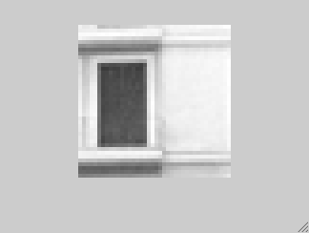
Linear filtering
g [m,n]
f [m,n]
In vision, many times, we are interested in operations that are spatially invariant.
For a linear spatially invariant system:
=

Slide 9
Linear filtering
Linear system:
2
Input:
2
2
2
2
g [m]
h [m]
0
1
1
1
0
0
1
2
0
1
2
3
2
-1
-1
Output?
h [-k]
0
1
2
f [m=0]=-2
-1
-1
2
h [1-k]
f [m=1]=-4
0
1
2
-1
-1
f [m=2]=0

Slide 10


Linear filtering
g [m,n]
f [m,n]
For a linear spatially invariant system
m=0 1 2 …
111 | 115 | 113 | 111 | 112 | 111 | 112 | 111
135 | 138 | 137 | 139 | 145 | 146 | 149 | 147
163 | 168 | 188 | 196 | 206 | 202 | 206 | 207
180 | 184 | 206 | 219 | 202 | 200 | 195 | 193
189 | 193 | 214 | 216 | 104 | 79 | 83 | 77
191 | 201 | 217 | 220 | 103 | 59 | 60 | 68
195 | 205 | 216 | 222 | 113 | 68 | 69 | 83
199 | 203 | 223 | 228 | 108 | 68 | 71 | 77
? | ? | ? | ? | ? | ? | ? | ?
? | -5 | 9 | -9 | 21 | -12 | 10 | ?
? | -29 | 18 | 24 | 4 | -7 | 5 | ?
? | -50 | 40 | 142 | -88 | -34 | 10 | ?
? | -41 | 41 | 264 | -175 | -71 | 0 | ?
? | -24 | 37 | 349 | -224 | -120 | -10 | ?
? | -23 | 33 | 360 | -217 | -134 | -23 | ?
? | ? | ? | ? | ? | ? | ? | ?
-1 | 2 | -1
-1 | 2 | -1
-1 | 2 | -1
=
h[m,n]
f[m,n]
g[m,n]

Slide 11
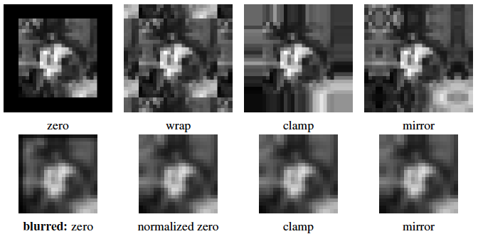
Borders
From Szeliski, Computer Vision, 2010

Slide 12
Impulse
0 | 0 | 0 | 0 | 0
0 | 0 | 0 | 0 | 0
0 | 0 | 1 | 0 | 0
0 | 0 | 0 | 0 | 0
0 | 0 | 0 | 0 | 0
=
h[m,n]
f[m,n]
g[m,n]

Slide 13
Shifts
2pixels
0 | 0 | 0 | 0 | 0
0 | 0 | 0 | 0 | 0
0 | 0 | 0 | 0 | 1
0 | 0 | 0 | 0 | 0
0 | 0 | 0 | 0 | 0
=
h[m,n]
f[m,n]
g[m,n]

Slide 14
Image rotation
?
=
h[m,n]
f[m,n]
g[m,n]
It is linear, but not a spatially invariant operation. There is not convolution.

Slide 15
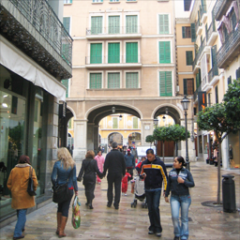
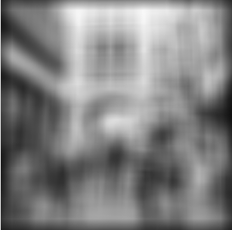
Rectangular filter
=
h[m,n]
f[m,n]
g[m,n]

Slide 16
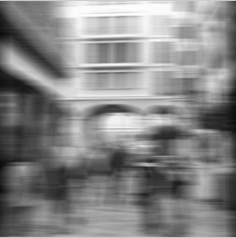
Rectangular filter
=
h[m,n]
f[m,n]
g[m,n]

Slide 17

Rectangular filter
=
h[m,n]
f[m,n]
g[m,n]

Slide 18
Sharpening
2.0
=
0.33
0
0
original
Sharpened original

Slide 19
Sharpening example
filter
result
1.7
11.2
8
8
*
=
coefficient
-2.5
-0.3
original
Sharpened
(differences are
accentuated; constant
areas are left untouched).

Slide 20
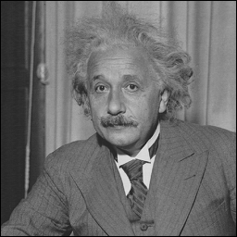
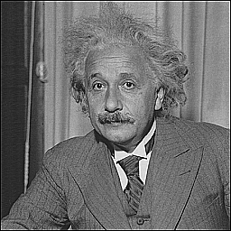
Sharpening
before
after

Slide 21
A taxonomy of useful filters
Impulse, Shifts,
Blur
  Rectangular blur (see artifacts)
  Gaussian
  Bilateral exponential
  Asymmetrical filter: motion blur
Edges
  [-1 1]
  Derivative filter
  Derivative of a gaussian
  Oriented filters
  Gabor filter
  Quadrature filters: phase and magnitude.
  Elongated edges: filling gaps…

Slide 23
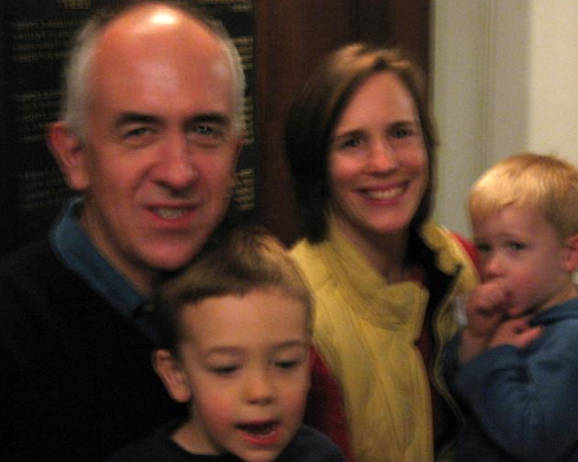
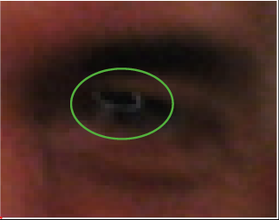
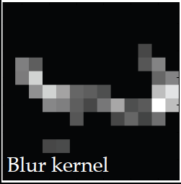
Linear blur occurs under many natural situations
(from Fergus et al, 2007)
This is not a Gaussian kernel...
Notes:
UPDATED IMAGE.

Slide 24

Linear blur occurs under many natural situations

Slide 25
Linear blur occurs under many natural situations

Slide 26
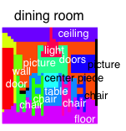
Linear blur occurs under many natural situations

Slide 27
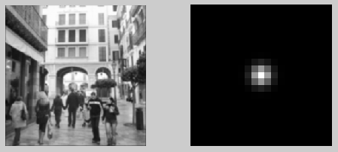

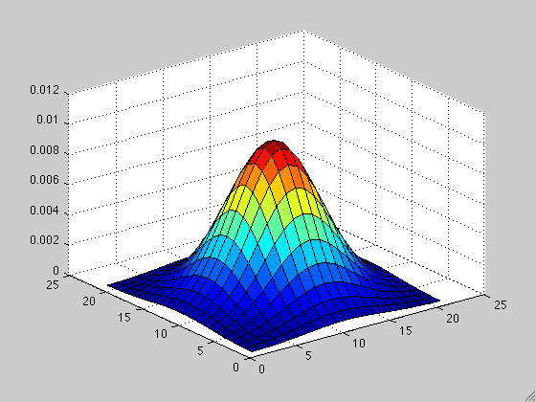
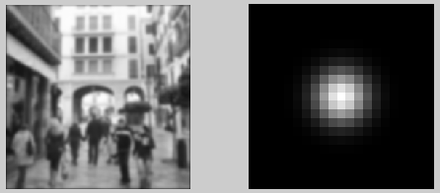
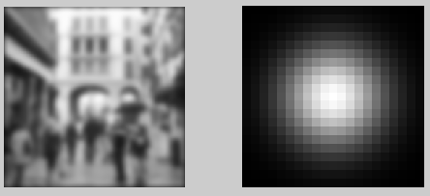
Gaussian filter
σ=1
σ=2
σ=4

Slide 28
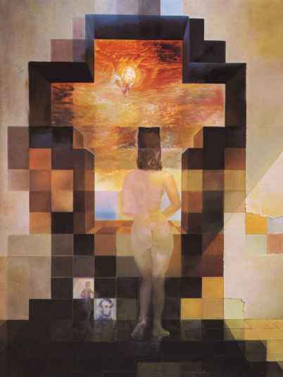

Gaussian filter
Dali

Slide 29
Some desirable properties for a blur kernel
Positivity: h(m) >= 0
Symmetry: h(m) = h(-m)
Unimodality: h(m) >= h(m+1) for m >= 0
Normalized: Σ h(m) = 1
Equal contribution: Σ h(2m) = Σ h(2m+1)
Some kernels that verify this are:
[½ ½]
[¼ ½ ¼]

Slide 30



Slide 31

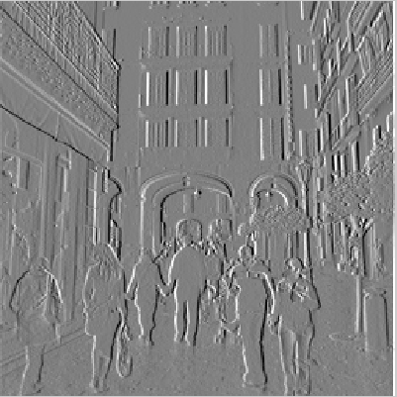
[-1 1]
[-1, 1]
=
h[m,n]
f[m,n]
g[m,n]

Slide 32
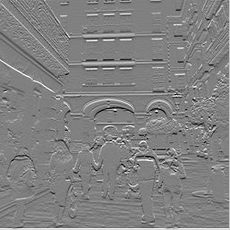
[-1 1]^{T}
[-1, 1]^{T}
=
h[m,n]
f[m,n]
g[m,n]

Slide 33
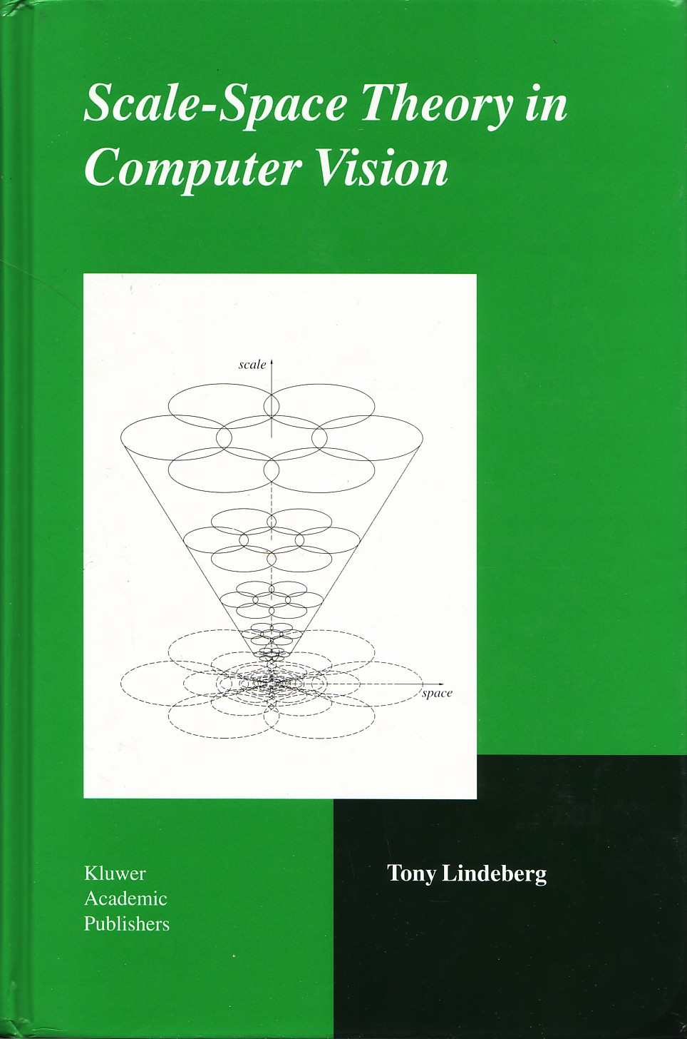
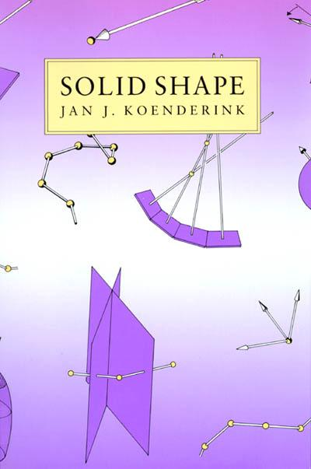
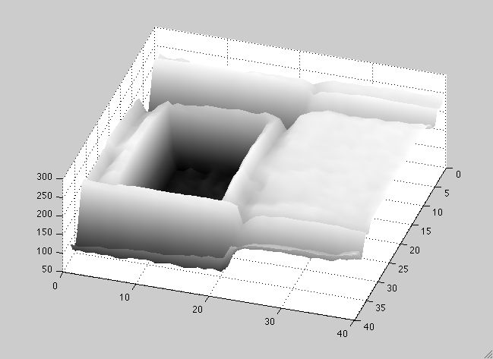
Differential Geometry Descriptors
I(x,y)

Slide 34
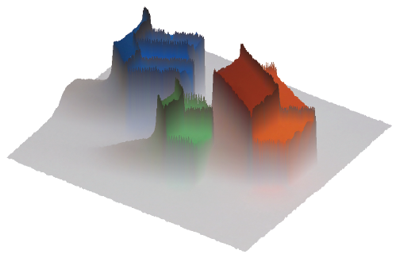




Finding edges in the image
Image gradient:
Approximation image derivative:
Edge strength
Edge orientation:
Edge normal:

Slide 35
Differential Geometry Descriptors
I(x,y)
If we think of the image as a continuous function
Image gradient:
Directional gradient:
|u|=1
Laplacian:

Slide 36
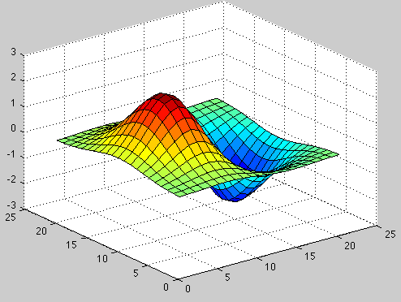
Gaussian derivative

Slide 38
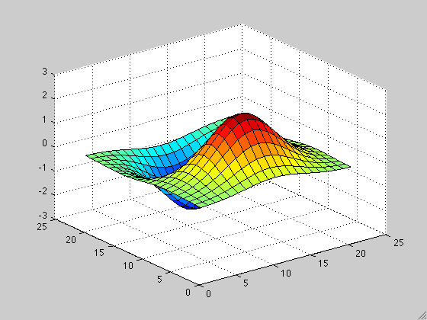
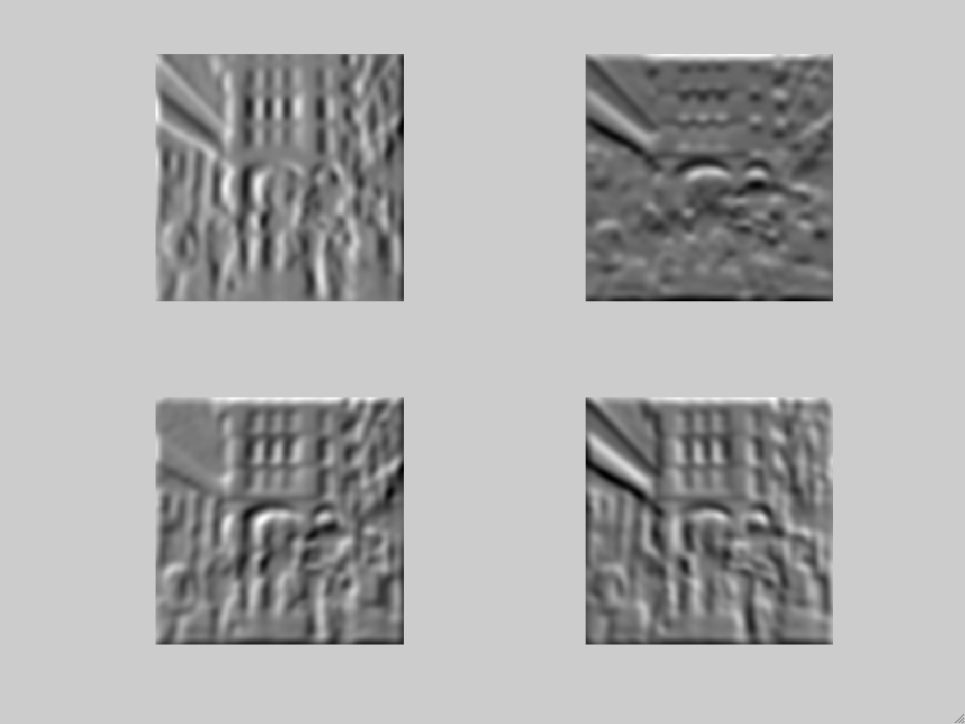
The smoothed directional gradient is a linear combination of two kernels
Any orientation can be computed as a linear combination of two filtered images
= cos(α)
+sin(α)
=
Steereability of gaussian derivatives, Freeman & Adelson 92

Slide 39
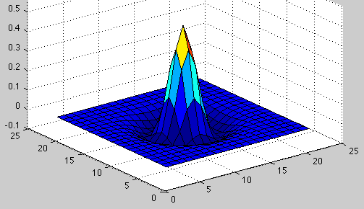
Laplacian

Slide 40
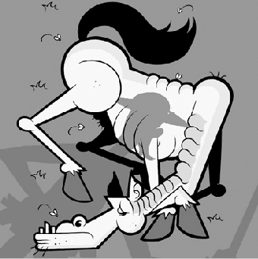
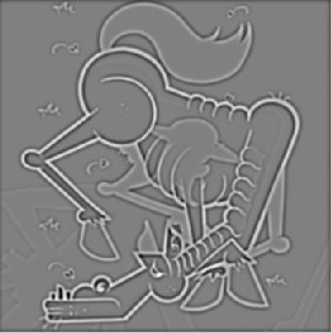
Laplacian

Slide 41
Outline
Linear filtering
Fourier Transform
Human spatial frequency sensitivity
Phase
Sampling and Aliasing
Spatially localized analysis
41

Slide 42
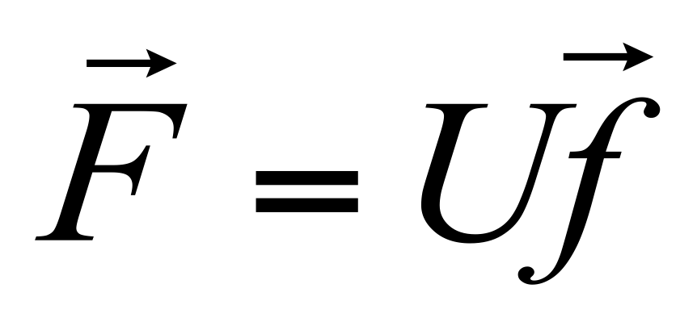
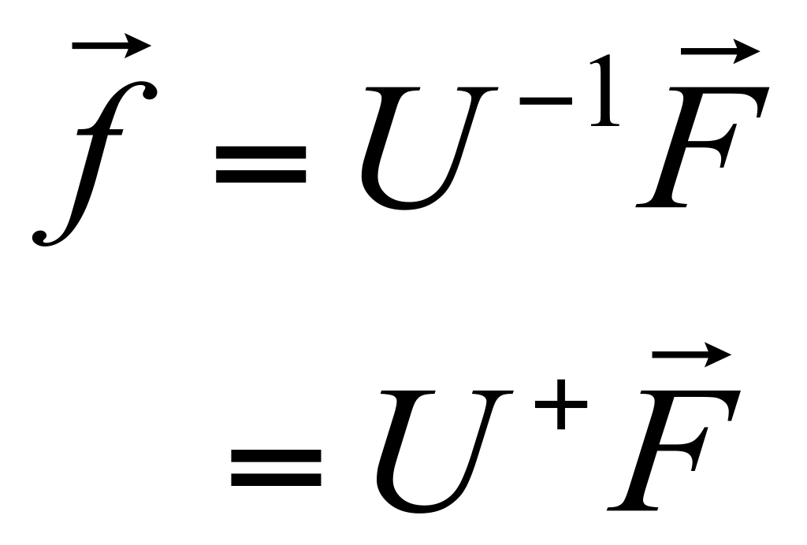
Linear image transformations
In analyzing images, it’s often useful to make a change of basis.
Transformed image
Vectorized image
Fourier transform, or
Wavelet transform, or
Steerable pyramid transform
=

Slide 43
Self-inverting transforms
Same basis functions are used for the inverse transform
U transpose and complex conjugate

Slide 44
An example of such a transform: the Discrete Fourier transform
Forward transform
Inverse transform

Slide 45
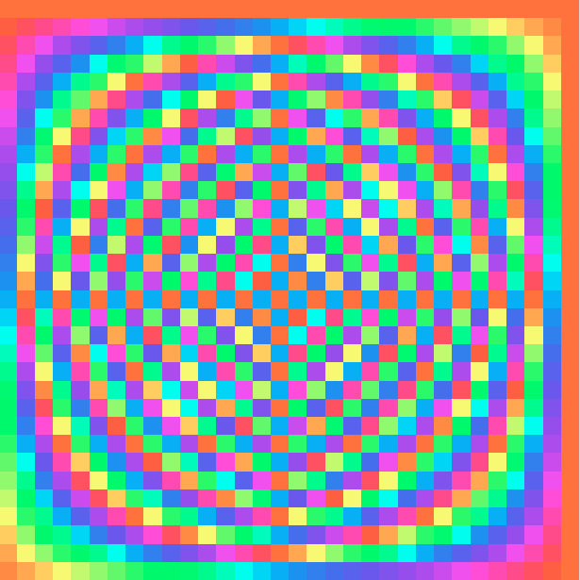
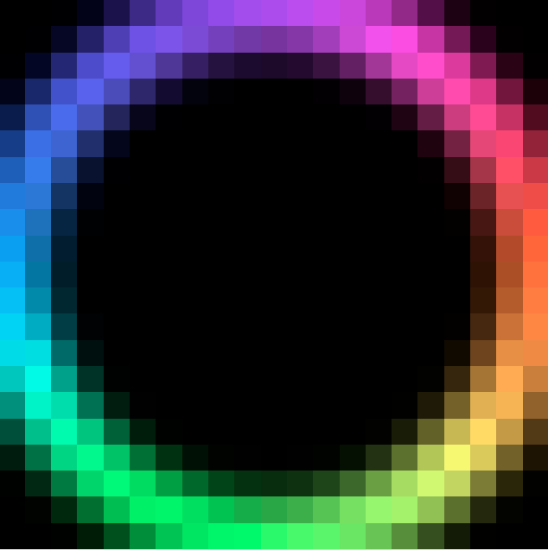
Fourier transform visualization
imaginary
j
real
1
color key
Fourier transform matrix
input signal

Slide 46

To get some sense of what basis elements look like, we plot a basis element --- or rather, its real part ---
as a function of x,y for some fixed u, v. We get a function that is constant when (ux+vy) is constant. The magnitude of the vector (u, v) gives a frequency, and its direction gives an orientation. The function is a sinusoid with this frequency along the direction, and constant perpendicular to the direction.
v
u

Slide 47

Here u and v are larger than in the previous slide.
v
u

Slide 48

And larger still...
v
u

Slide 49
Why is the Fourier domain particularly useful?
Linear, space invariant operations are just diagonal operations in the frequency domain.
Ie, linear convolution is multiplication in the frequency domain.

Slide 50
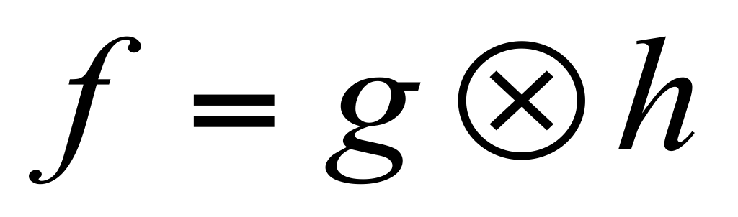
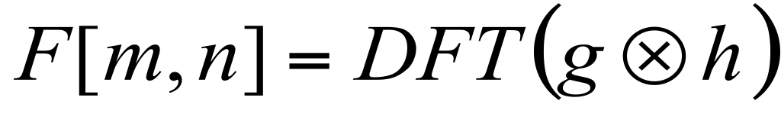
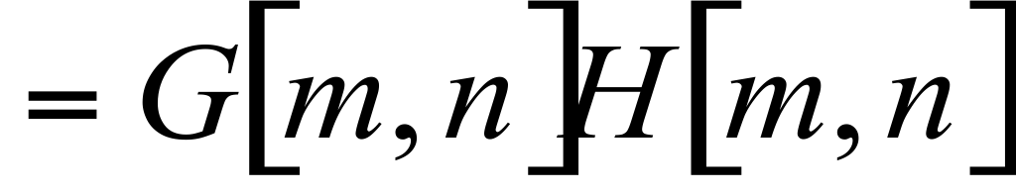
Fourier transform of convolution
Consider a (circular) convolution of g and h
In the transform domain, this just modulates the transform amplitudes

Slide 51
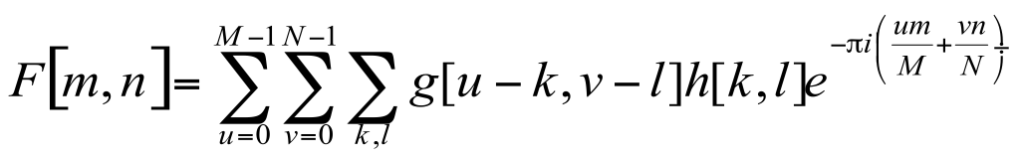
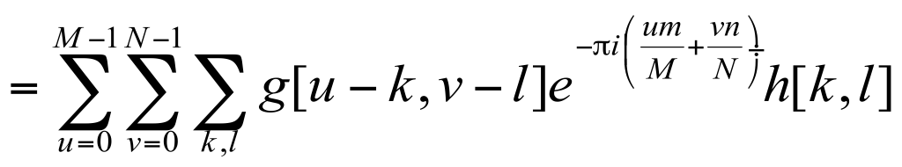
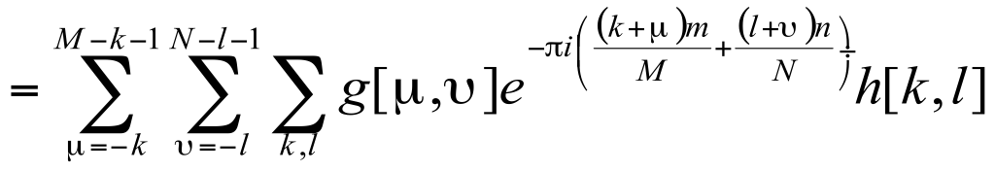
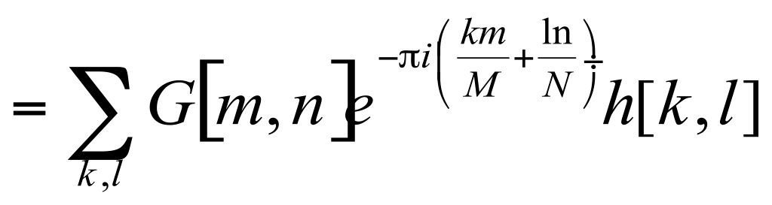
Fourier transform of convolution
Consider a (circular) convolution of g and h
Take DFT of both sides
Write the DFT and convolution explicitly
Move the exponent in
Change variables in the sum
Perform the DFT (circular boundary conditions)
Perform the other DFT (circular boundary conditions)

Slide 52
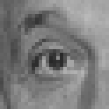

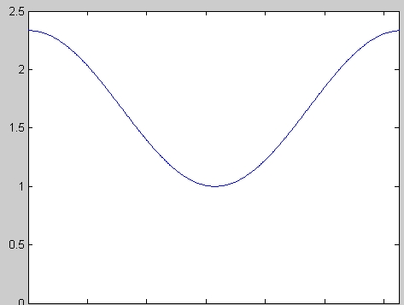
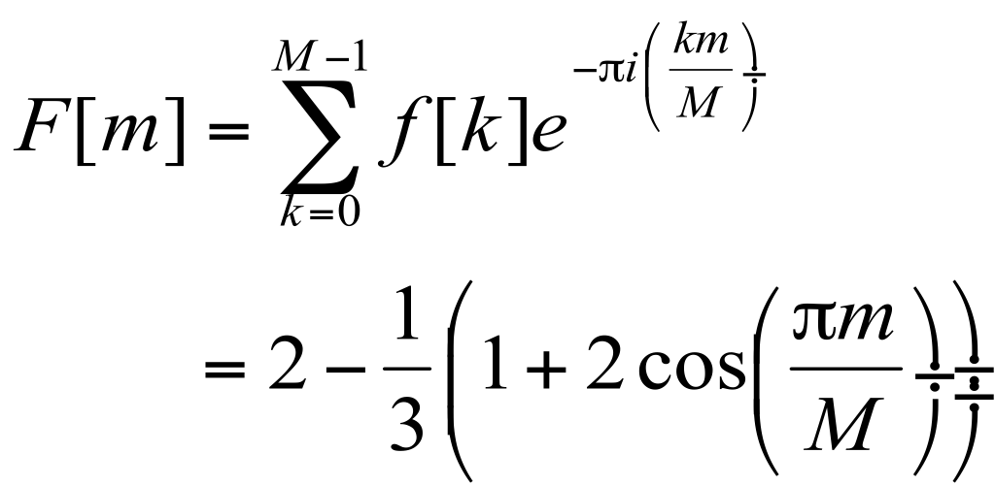

Analysis of a simple sharpening filter
2.0
0.33
0
0
original
sharpened
2.3
high-pass filter
1.0
0

Slide 53
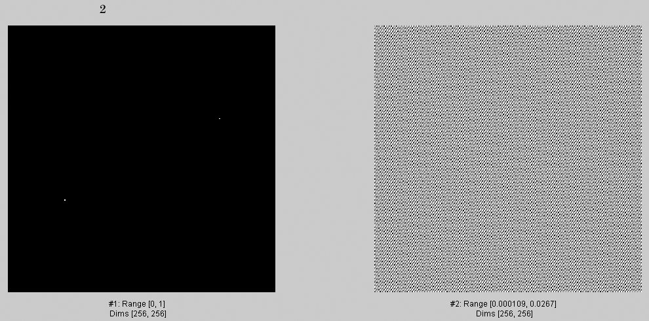
2

Slide 54
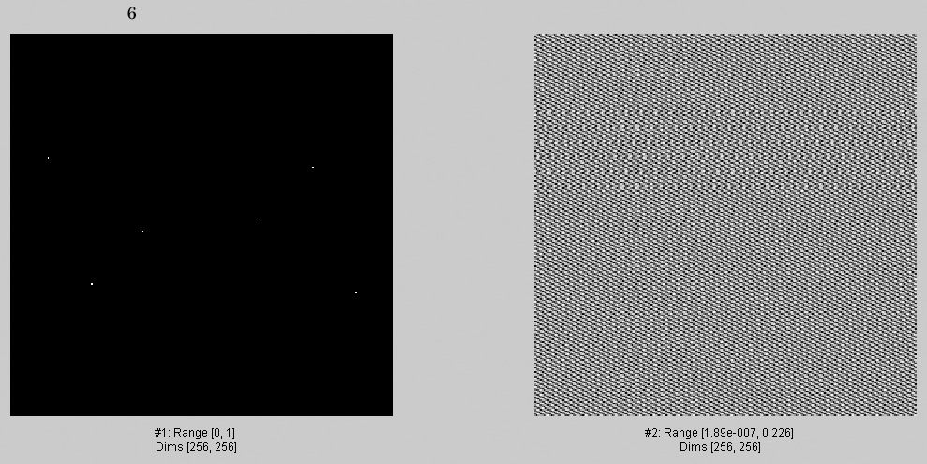
6

Slide 55

18

Slide 56

50

Slide 57

82

Slide 58

136

Slide 59

282

Slide 60

538

Slide 61

1088

Slide 62

2094

Slide 63

4052.
4052

Slide 64

8056.

Slide 65

15366

Slide 66

28743

Slide 67

49190.

Slide 68

65536.

Slide 69

3
Now, an analogous sequence of images, but selecting Fourier components in descending order of magnitude.

Slide 70

5

Slide 71

9

Slide 72

17

Slide 73

33

Slide 74

65

Slide 75

129

Slide 76

257

Slide 77

513

Slide 78

1025

Slide 79

2049

Slide 80

4097

Slide 81

8193

Slide 82

16385

Slide 83

32769

Slide 84

65536

Slide 85
Some important Fourier Transforms

Slide 86


Bracewell’s pictorial dictionary of Fourier transform pairs
Bracewell, The Fourier Transform and its Applications, McGraw Hill 1978

Slide 87

Szeliski, Computer Vision, 2010

Slide 88



Some important Fourier Transforms
Image
Magnitude FT

Slide 89


Some important Fourier Transforms
Image
Magnitude FT

Slide 90


The Fourier Transform of some important images
Image
Log(1+Magnitude FT)

Slide 91


How to interpret a Fourier Spectrum
Vertical orientation
Low spatial frequencies
45 deg.
0
Horizontal
orientation
0
fmax
High
spatial
frequencies
fx in cycles/image
Log power spectrum

Slide 92






Fourier Amplitude Spectrum
A
B
C
1
2
3
fx(cycles/image pixel size)
fx(cycles/image pixel size)
fx(cycles/image pixel size)

Slide 93


Fourier transform magnitude

Slide 94


Masking out the fundamental and harmonics from periodic pillars

Slide 95
Outline
Linear filtering
Fourier Transform
Human spatial frequency sensitivity
Phase
Sampling and Aliasing
Spatially localized analysis
95

Slide 96
Although this is a complex system, tools from linear
systems analysis can provide some useful insights…
From M. Lewicky
Notes:
Slides from lewicki

Slide 97



Slide 98


Contrast Sensitivity Function
From:
http://www.cns.nyu.edu/~david/courses/perception/lecturenotes/channels/channels.html

Slide 99

Contrast Sensitivity Function
A demo of human contrast sensitivity as a function of spatial frequency. Frequency rises from left to right at a constant rate. Contrast drops from bottom to top at a constant rate. The bars are visible further up for middle frequencies, showing these are more salient to the human visual system.
99

Slide 100
Contrast Sensitivity Function
Blackmore & Campbell (1969)
Maximum sensitivity
~ 6 cycles / degree of visual angle
Invisible
visible
Contrast sensitivity
0.1
1
10
100
Low
Spatial frequency (cycles/degree)
High

Slide 101

Laplacian
An illusion by Vasarely, left, and a bandpass filtered version, right.
http://web.mit.edu/persci/people/adelson/publications/gazzan.dir/vasarely.html

Slide 102


Neuromorphic circuits

Slide 103
Human Visual Perception
Low spatial frequency
Blur image
Sharp image
Medium spatial frequency
High spatial frequency
Spatial frequency channels
Notes:
The most important principle subtening the working of hybrid images is the mechanism of human perception: The observer is seeing the world through a collection of spatial frequency channels: studies in human vision have precisely established the way our brain decomposes an image. From a low spatial frequency image (blur image, out of focus) to a high spatial frequency image, represented by sharp contours, details, edges, looking like a drawing. This decomposition is hard wired: this is how our brain reads the world.

Slide 104

Hybrid Images
Oliva & Schyns
Notes:
We start by taking two pictures, we isolate the details and contours in one, here the woman, and we blur the second face. as you can see, the man seems to go out of focus and the details of the woman are superposed.

Slide 105
Hybrid Images

Slide 106
Hybrid Images

Slide 107


Slide 108
http://cvcl.mit.edu/hybrid_gallery/gallery.html

Slide 109
Outline
Linear filtering
Fourier Transform
Human spatial frequency sensitivity
Phase
Sampling and Aliasing
Spatially localized analysis
109

Slide 110
Phase and Magnitude
Curious fact
  all natural images have about the same magnitude transform
  hence, phase seems to matter, but magnitude largely doesn’t
Demonstration
  Take two pictures, swap the phase transforms, compute the inverse - what does the result look like?

Slide 111


Slide 112

This is the magnitude transform of the cheetah pic

Slide 113

This is the phase transform of the cheetah pic

Slide 114


Slide 115

This is the magnitude transform of the zebra pic

Slide 116

This is the phase transform of the zebra pic

Slide 117

Reconstruction with zebra phase, cheetah magnitude

Slide 118

Reconstruction with cheetah phase, zebra magnitude

Slide 119
Phase and Magnitude
Image with cheetah phase
(and zebra magnitude)
Image with zebra phase
(and cheetah magnitude)
Computer Vision - A Modern Approach - Set: Pyramids and Texture - Slides by D.A. Forsyth

Slide 120






Randomizing the phase

Slide 121
Outline
Linear filtering
Fourier Transform
Human spatial frequency sensitivity
Phase
Sampling and Aliasing
Spatially localized analysis
121

Slide 122

Sampling
Pixels
Continuous world

Slide 123

Sampling

Slide 124
Sampling

Slide 125
Sampling

Slide 126



What will be the best sampling pattern in 2D?
Retinal fovea
Retina periphery
Hexagonal
Random
Images from: http://www.cns.nyu.edu/~david/courses/perception/lecturenotes/retina/retina.html

Slide 127

The Fourier transform of a sampled signal
Bracewell, The Fourier Transform and its Applications, McGraw Hill 1978
Notes:
The crucial missing bit here is that the Fourier transform of a bed-of-nails function is another bed-of-nails
function. I mention this, but don’t prove it, as it takes some sophistication with limits and sums. It is usually a
good idea to point out to students that the linearity of the Fourier transform doesn’t mean you can take an infinite sum of shifted versions of the Fourier transform of a single delta function and expect the right answer.

Slide 128





Sampling
Mersereau, 1979

Slide 129


Slide 130

Notes:
This and the last slid constitute a “proof by drawing” of Nyquist’s theorem. It’s worth mentioning this, though
we don’t use it explicitly. The crucial point to mention here is that sampling doesn’t work if you have frequency
components that are too high.

Slide 131

Sampling
function
FT(Sampling
function)
Sampled image
Downsampling
FT(sampled image)

Slide 132

Sampling
function
FT(Sampling
function)
Sampled image
Downsampling
FT(sampled image)

Slide 133

Sampling
function
FT(Sampling
function)
Sampled image
Downsampling
FT(sampled image)

Slide 134

Antialiasing filter
Without
prefiltering
With
prefiltering

Slide 135

Sampling without smoothing. Top row shows the images,
sampled at every second pixel to get the next.

Slide 136

Sampling with smoothing. Top row shows the images. We
get the next image by smoothing the image with a Gaussian with sigma 1 pixel,
then sampling at every second pixel to get the next.

Slide 137

Sampling with smoothing. Top row shows the images. We
get the next image by smoothing the image with a Gaussian with sigma 1.4 pixels,
then sampling at every second pixel to get the next.

Slide 138
Outline
Linear filtering
Fourier Transform
Human spatial frequency sensitivity
Phase
Sampling and Aliasing
Spatially localized analysis
138

Slide 139
What is a good representation for image analysis?
Fourier transform domain tells you “what” (textural properties), but not “where”.
Pixel domain representation tells you “where” (pixel location), but not “what”.
Want an image representation that gives you a local description of image events—what is happening where.

