Slide 1
Fault-tolerant Consensus in Directed Networks Lewis Tseng Boston College Oct. 13, 2017 (joint work with Nitin H. Vaidya)

Slide 2
Fault-tolerant Consensus
Each node has an input
Agreement: good nodes must agree
Validity: some constraints on output
Termination
Exact vs. Approximate

Slide 3
Message-Passing Communication
undirected graph
A
B
C

Slide 4
Message-Passing Communication
directed graph
A
B
C
S
- Partially connected
- links may not be bi-directional
Notes:
Wireless link

Slide 5
Goal
Precise characterization of networks that can solve consensus
Known for undirected graphs
Unknown for directed graphs

Slide 6
Consensus
Fault Model | System/Output |  | Graph | Results
Crash | Synchronous | Exact
 |  | Approximate
 | Asynchronous
Byzantine | Synchronous | Exact
 |  | Approximate
 | Asynchronous
Notes:
Lili’s work ➔ Byzantine + synchronous + approximate + general

Slide 7
Consensus
Fault Model | System/Output |  | Graph | Results
Crash | Synchronous | Exact | Undirected | Well-known Results
 |  |  | Directed
 |  | Approximate | Undirected | Decentralized Control (e.g., [Tsitsiklis ‘84] [Jadbabaei ‘03])
 |  |  | Directed
 | Asynchronous |  | Undirected
 |  |  | Directed
Byzantine | Synchronous | Exact | Undirected | [PSL ‘80] [FLM ‘85]
 |  |  | Directed
 |  | Approximate | Undirected | [Dolev ‘83] [FLM ‘85]
 |  |  | Directed
 | Asynchronous |  | Undirected | [Dolev ‘83] [FLM ‘85]
 |  |  | Directed
Notes:
Lili’s work ➔ Byzantine + synchronous + approximate + general

Slide 8
Consensus
Fault Model | System/Output |  | Graph | Results
Crash | Synchronous | Exact | Undirected | Well-known Results
 |  |  | Directed | PODC ‘15
 |  | Approximate | Undirected | Decentralized Control (e.g., [Tsitsiklis ‘84] [Jadbabaei ‘03])
 |  |  | Directed
 | Asynchronous |  | Undirected
 |  |  | Directed | PODC ‘15
Byzantine | Synchronous | Exact | Undirected | [PSL ‘80] [FLM ‘85]
 |  |  | Directed | PODC ‘15
 |  | Approximate | Undirected | [Dolev ‘83] [FLM ‘85]
 |  |  | Directed | PODC ‘12
 | Asynchronous |  | Undirected | [Dolev ‘83] [FLM ‘85]
 |  |  | Directed | Open
Notes:
Lili’s work ➔ Byzantine + synchronous + approximate + general

Slide 9
Why Directed Networks?
Motivated by properties of wireless links
Better understanding of network requirements for consensus
Directed networks considered in several related contexts

Slide 10
Past Work on Directed Networks
Decentralized control
[Tsitsiklis ‘84],[Bertsekas, Tsitsiklis ‘97],[Jadbabaei et al. ‘03]
Malicious fault model
[Zhang et al. ‘12], [LeBlanc et al. ‘13]
Different problems
[Desmedt, Wang ‘02], [Bansal et al. ‘11], [Biely et al. ‘12],
[Pagourtzis et al. ‘14], [Maurer et al. ‘14], [Biely et al. ‘14]
Notes:
Reliable communication
Byzantine broadcast from fault-free source

Slide 11
Algorithms
General Algorithm
topology information
Iterative Algorithm
local computation
A
B
C
S

Slide 12
This Talk: Exact Consensus
General Algorithm:
Crash + Synchronous
Byzantine + Synchronous
[Tseng and Vaidya, PODC ‘15]

Slide 13
Intuition
- Remove some nodes
- For any node partition L, C, R,
either L or R has enough neighbors from outside
y
x
z
w
Notes:
Remove impact, how many nodes are enough?

Slide 14
Intuition
- Remove some nodes
- For any node partition L, C, R,
either L or R has enough neighbors from outside
L = {x}
C = {w}
R = {z}
y
No info. propagation
x
z
w
Notes:
Remove impact, how many nodes are enough?

Slide 15
Why L, C, R?
- Remove some nodes
- For any node partition L, C, R,
either L or R has enough neighbors from outside
One-way info. propagation
No info. propagation
L = {x, w}
R = {z}
L = {x}
C = {w}
R = {z}
y
y
x
z
x
z
w
w
Notes:
Remove impact, how many nodes are enough?

Slide 16
Crash Failures + Synchrony

Slide 17
Exact Consensus
Each node has a binary input
Agreement: Good nodes agree on an exact value
Validity: Agreed value is an input at some node
Termination

Slide 18
Crash in Undirected Graphs
Known result:
n > f and connectivity > f
necessary and sufficient
n nodes, up to f failures
Notes:
Node connectivity is not appropriate for directed graph

Slide 19
k-propagate
k
A B if at least k distinct nodes in set A
have links to nodes in set B
{x, y} {z}
2
y
x
z

Slide 20
k-propagate
k
A B if at least k distinct nodes in set A
have links to nodes in set B
{x, y} {z}
Whether set B has
enough neighbors from outside?
2
y
x
z

Slide 21
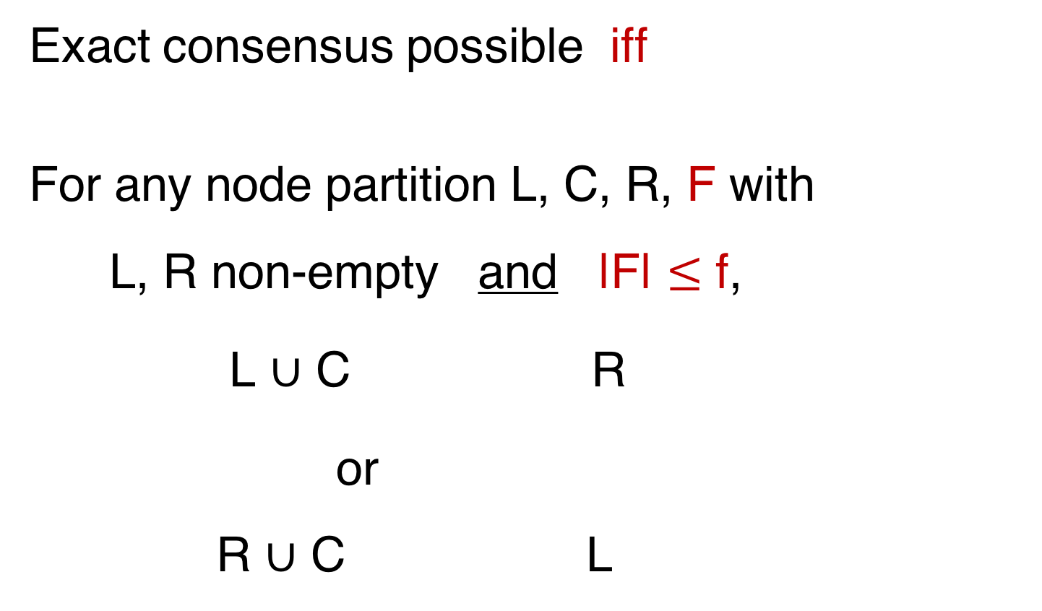
Crash Failures + Synchrony
Exact consensus possible iff
For any node partition L, C, R, F with
L, R non-empty and |F| $≤$ f,
L ∪ C R
or R ∪ C L
1
1
Notes:
After removing f, in any node partition L or R must have enough neighbors from outside

Slide 22
Example
y
x
z
w

Slide 23
Example
F = {y}
L ∪ C R
R ∪ C L
L = {x}
C = {w}
R = {z}
y
x
z
w
1
/
1
/

Slide 24
Example
F = {y}
L ∪ C R
R ∪ C L
L = {x}
C = {w}
R = {z}
y
x
z
w
1
/
Cannot tolerate
1 crash fault
1
/
Notes:
Also show why node connectivity not appropriate, and why we need the C

Slide 25
Necessity: Intuition
If condition is not true,
all removed nodes crash
two groups of nodes cannot communicate with each other
y
x
z
w
1
0
f=1

Slide 26
Necessity: Intuition
If condition is not true,
all removed nodes crash
two groups of nodes cannot communicate with each other
y
x
z
w
1
0
f=1

Slide 27
Equivalent Condition
Removing up to f nodes,
the remaining graph contains a
directed rooted spanning tree
Notes:
Only binary consensus, multi-valued in thesis

Slide 28
Example
F = {y}
L ∪ C R
L = {x}
C = { }
R = {z}
y
x
z
1

Slide 29
Example
F = {y}
L ∪ C R
L = {x}
C = { }
R = {z}
y
x
z
1
Can tolerate
1 crash fault

Slide 30
Sufficiency: Intuition
Source(s) can propagate its state
0
y
x
z
0
1
f=1

Slide 31
Sufficiency: Intuition
Source(s) can propagate its state
0
1
y
x
0
0
1
z
1
f=1

Slide 32
Sufficiency: Intuition
Source(s) can propagate its state
Which source is fault-free?
no failure: pick 1
0
1
y
x
0
0
1
z
1
f=1

Slide 33
Sufficiency: Intuition
Source(s) can propagate its state
Which source is fault-free?
no failure: pick 1
x fails:
0
y
1
x
0
0
1
z
1
f=1

Slide 34
Sufficiency: Intuition
Source(s) can propagate its state
Which source is fault-free?
no failure: pick 1
x fails: pick 0
0
y
1
x
0
0
1
z
1
f=1
Notes:
We don’t need to know which source,
as long as we run alg. long enough

Slide 35
Algorithm Min-Max
v_{i} = input
Phase p = 1 to 2f+2
Flood v_{i}
Receive set of values R_{i}
if p is even
v_{i} = min( R_{i} ) (Min Phase)
else
v_{i} = max( R_{i} ) (Max Phase)
Output v_{i} after 2f+2 phases
binary consensus

Slide 36
Algorithm Min-Max
v_{i} = input
Phase p = 1 to 2f+2
Flood v_{i}
Receive set of values R_{i}
if p is even
v_{i} = min( R_{i} ) (Min Phase)
else
v_{i} = max( R_{i} ) (Max Phase)
Output v_{i} after 2f+2 phases
binary consensus

Slide 37
Algorithm Min-Max
v_{i} = input
Phase p = 1 to 2f+2
Flood v_{i}
Receive set of values R_{i}
if p is even
v_{i} = min( R_{i} ) (Min Phase)
else
v_{i} = max( R_{i} ) (Max Phase)
Output v_{i} after 2f+2 phases

Slide 38
Algorithm Min-Max
v_{i} = input
Phase p = 1 to 2f+2
Flood v_{i}
Receive set of values R_{i}
if p is even
v_{i} = min( R_{i} ) (Min Phase)
else
v_{i} = max( R_{i} ) (Max Phase)
Output v_{i} after 2f+2 phases

Slide 39
Algorithm Min-Max
v_{i} = input
Phase p = 1 to 2f+2
Flood v_{i}
Receive set of values R_{i}
if p is even
v_{i} = min( R_{i} ) (Min Phase)
else
v_{i} = max( R_{i} ) (Max Phase)
Output v_{i} after 2f+2 phases

Slide 40
Algorithm Min-Max
v_{i} = input
Phase p = 1 to 2f+2
Flood v_{i}
Receive set of values R_{i}
if p is even
v_{i} = min( R_{i} ) (Min Phase)
else
v_{i} = max( R_{i} ) (Max Phase)
Output v_{i} after 2f+2 phases

Slide 41
Algorithm Min-Max
v_{i} = input
Phase p = 1 to 2f+2
Flood v_{i}
Receive set of values R_{i}
if p is even
v_{i} = min( R_{i} ) (Min Phase)
else
v_{i} = max( R_{i} ) (Max Phase)
Output v_{i} after 2f+2 phases
two consecutive
fault-free phases

Slide 42
Sufficiency: Correctness
Two consecutive fault-free phases p and p’
Suppose p = min phase and
p’ = max phase
If any source in phase p has 0, then done
Otherwise, the source(s) can propagate 1 in phase p’

Slide 43
Sufficiency: Correctness
Two consecutive fault-free phases p and p’
Suppose p = min phase and
p’ = max phase
If any source in phase p has 0, then done
Otherwise, the source(s) can propagate 1 in phase p’
Necessary condition:
there exists a directed rooted spanning tree

Slide 44
Byzantine Failures + Synchrony

Slide 45
Exact Byzantine Consensus
Each node has a binary input
Agreement: Good nodes agree on an exact value
Validity: Agreed value is an input at some good node
Termination

Slide 46
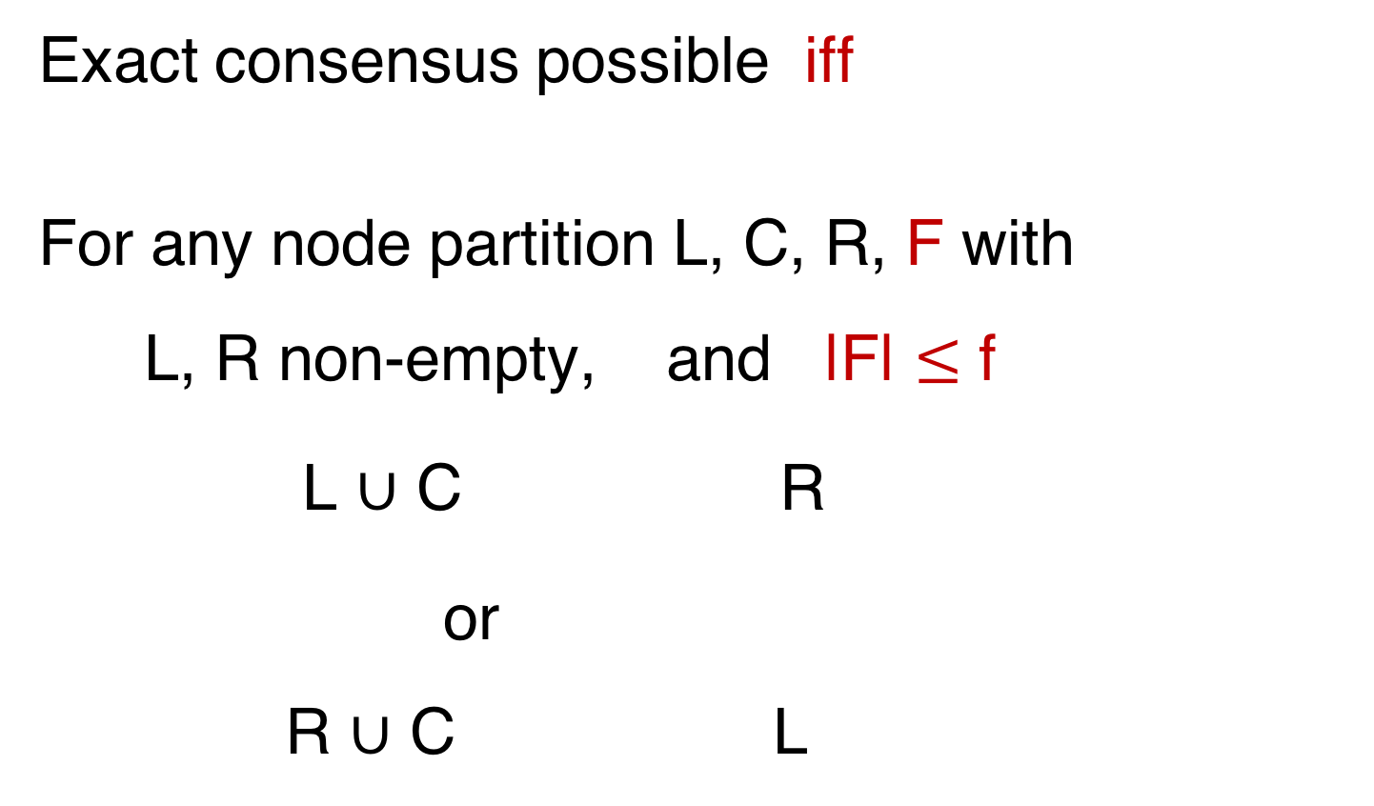
Byzantine Failures + Synchrony
Exact consensus possible iff
For any node partition L, C, R, F with
L, R non-empty, and |F| $≤$ f
L ∪ C R
or R ∪ C L
f+1
f+1
Notes:
Key difference, no F, f+1

Slide 47
Example
y
x
z
w
Tolerate 1 crash fault

Slide 48
Example
L = {x}
C = {w} F = {y}
R = {z}
L ∪ C R
R ∪ C L
y
x
z
w
2
/
2
/

Slide 49
Example
L = {x}
C = {w} F = {y}
R = {z}
L ∪ C R
R ∪ C L
y
x
z
w
2
/
Cannot tolerate
1 Byzantine fault
2
/

Slide 50

Necessity: Intuition
L = {x}
C = {w} F = {y}
R = {z}
L ∪ C R
R ∪ C L
y
x
z
w
2
/
Cannot tolerate
1 Byzantine fault
2
/

Slide 51
Necessity: Intuition
L = {x}
C = {w} F = {y}
R = {z}
L ∪ C R
R ∪ C L
1
y
0
x
z
w
1
1
- x cannot hear from z
- z cannot receive x’s msg reliably
2
/
Cannot tolerate
1 Byzantine fault
2
/

Slide 52
Equivalent Condition
1. Remove F (|F| ≤ f)
2. Remove outgoing links of F1 (|F1| ≤ f)
Then, the remaining graph contains a
directed rooted spanning tree

Slide 53
Key Properties
In the graph:
F
SC
Rest
~~~~~~~~
strongly connected (of size > f)
f+1 paths excluding F to the rest of the graph

Slide 54
Sufficiency: Algorithm BC
OUTER Loop: enumerating over all possible F
INNER Loop: enumerating over all partitions
SC propagates values

Slide 55
Propagation
F
SC: using f+1 paths excluding F to send values
Rest: if same received values,
state := value
SC
Rest
~~~~~

Slide 56
Propagation
F
SC: check if states are the same,
use f+1 paths excluding F to send state v
Rest: if same received values,
state := value
SC
Rest
~~~~~

Slide 57
Propagation
F
States stay valid
SC: check if states are the same,
use f+1 paths excluding F to send state v
Rest: if same received values,
state := value
Agreement is achieved:
F = actual fault set
nodes in SC have same state
SC
Rest
~~~~~

Slide 58
Algorithm BC
OUTER Loop: enumerating over all possible F
INNER Loop: enumerating over all partitions
SC propagates values

Slide 59
Algorithm BC
F
SC
Rest
~~~
OUTER Loop: enumerating over all possible F
INNER Loop: enumerating over all partitions
SC propagates values

Slide 60
Algorithm BC
F
SC
Rest
~~~
OUTER Loop: enumerating over all possible F
INNER Loop: enumerating over all partitions
SC propagates values
Propagation:
values stay valid

Slide 61
Algorithm BC
F
SC
Rest
~~~
OUTER Loop: enumerating over all possible F
INNER Loop: enumerating over all partitions
SC propagates values
F = actual fault set
Propagation:
values stay valid
Agreement is achieved
when nodes in SC have the same value

Slide 62
2-clique Network
K₁:
clique of 7 nodes
u₁
u₂
u₃
u₄
u₅
u₆
u₇
K₂:
clique of 7 nodes
w₁
w₂
w₃
w₄
w₅
w₆
w₇
4 directed links
in each direction
between the cliques
Can tolerate 2 Byzantine faults

Slide 63

2-clique Network
K₁ and K₂ cannot talk reliably with each other?
K₁:
clique of 7 nodes
u₁
u₂
u₃
u₄
u₅
u₆
u₇
K₂:
clique of 7 nodes
w₁
w₂
w₃
w₄
w₅
w₆
w₇
4 directed links
in each direction
between the cliques
Can tolerate 2 Byzantine faults

Slide 64
Consensus
Fault Model | System/Output |  | Graph | Results
Crash | Synchronous | Exact | Undirected | Well-known Results
 |  |  | Directed | PODC ‘15
 |  | Approximate | Undirected | Decentralized Control (e.g., [Tsitsiklis ‘84] [Jadbabaei ‘03])
 |  |  | Directed
 | Asynchronous |  | Undirected
 |  |  | Directed | PODC ‘15
Byzantine | Synchronous | Exact | Undirected | [PSL ‘80] [FLM ‘85]
 |  |  | Directed | PODC ‘15
 |  | Approximate | Undirected | [Dolev ‘83] [FLM ‘85]
 |  |  | Directed | PODC ‘12
 | Asynchronous |  | Undirected | [Dolev ‘83] [FLM ‘85]
 |  |  | Directed | Open
Notes:
Lili’s work ➔ Byzantine + synchronous + approximate + general

Slide 65
Our Other Work
Byzantine + Synchronous + Approximate + Iterative:
Fault Model | Results
up to f failures | [Vaidya, Tseng, Liang, PODC ‘12]
Generalized | [Tseng, Vaidya, ICDCN ‘13]
Link failures | [Tseng, Vaidya, NETYS ‘14]
Mobile faults | [Tseng, SSS ‘17]
Byzantine Broadcast:
- [Tseng, Vaidya, Bhandari, IPL ’16], [Tseng NCA ‘17]
Convex Hull Consensus:
- [Tseng, Vaidya, PODC ‘14]

Slide 66
Open Problems
Graph property for Asynchrony + Byzantine
More efficient algorithms
Lower bound on time complexity
Given G, find the maximum number of faults that can be tolerated

Slide 67
Open Problems
Other types of consensus
k-consensus
different fault models
different validity conditions
Other types of networks
time-varying network
Different network interpretation, e.g., network of trusts

Slide 68
Network of Trusts
From Ripple Consensus White Paper [2014]

Slide 69
Thanks!

