Slide 1

See Through Walls with Wi-Vi
6.888: Wireless Communication Systems
October 24, 2013

Slide 2
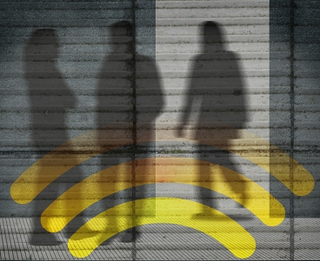
Can your cellphone give you X-ray vision?

Slide 3
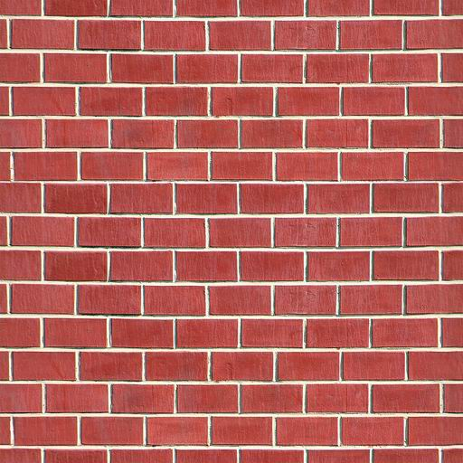
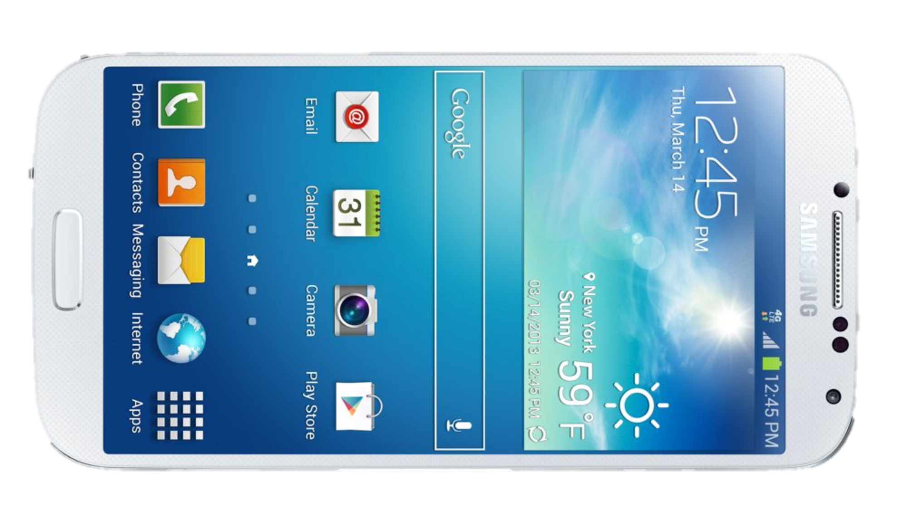
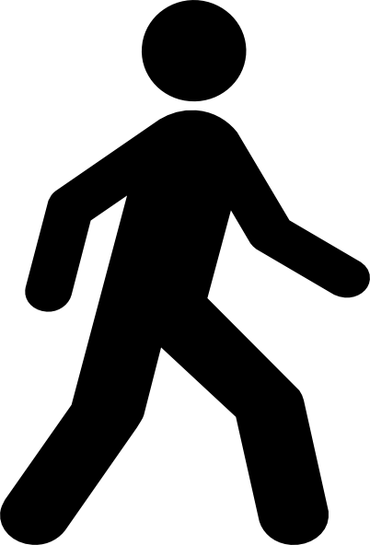

Key Idea

Slide 4
Challenges
Wall refection is 10,000x stronger than reflections coming from behind the wall
Tracking people from their reflections
Notes:
The technical problem with the wall’s reflection is due to the limited dynamic range of the ADC (analog to digital converter). The dynamic range is the ratio of the strongest to the weakest signals that can be registered simultaneously
For an ADC with 10 effective number of bits, the ratio is about 4K < 10K.
Therefore, the wall’s reflection will saturate the ADC and prevent it from registering any signal coming from behind the wall.

Slide 5
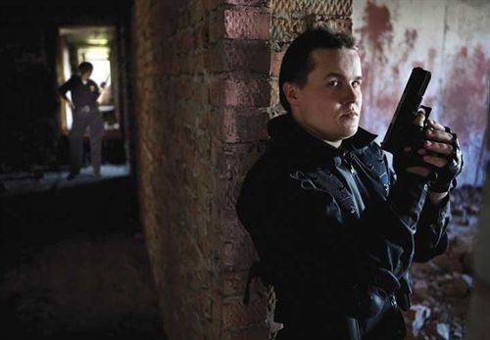
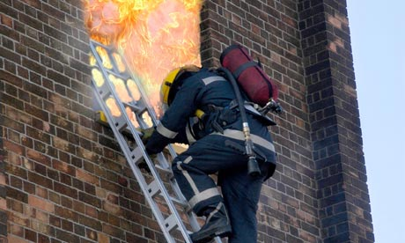

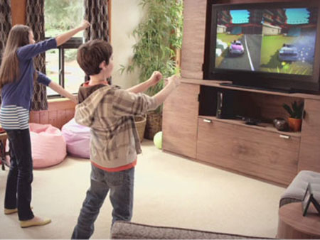
Applications
Police avoids ambush
Firefighters check for humans
Personal security
Gesture interface from behind a wall

Slide 6
Wi-Vi: Small, Low-Power, Wi-Fi
Eliminate the wall’s reflection
Track people from reflections
Gesture-based interface
Implemented on software radios

Slide 7
How Can We Eliminate the Wall’s Reflection?

Slide 8
Idea: transmit two waves that cancel each other when they reflect off static objects but not moving objects
Wall is static
disappears
People tend
to move
detectable

Slide 9
Eliminating the Wall’s Reflection
Receive Antenna:
x
Transmit Antennas
αx

Slide 10
Eliminating the Wall’s Reflection
0
Receive Antenna:
y = h₁ x + h₂αx
h₁
x
α = -h₁ / h₂
αx
h₂
Notes:
We estimate h1 and h2 using standard channel estimation techniques:
We transmit a signal x from first antenna alone, gets multiplied by h1 over the air, we get at the receive antenna y1=h1*x. We know x and we receive y1. so we can compute h1=y1/x
We stop transmitting from first antenna and transmit x from second antenna. It gets multiplied by h2 over the air. We can compute h2=y2/x
This is of 1 reflectors. What if have multiple reflectors? Wireless signals linearly combine. But, key thing to note is that our estimation of h1 did not assume 1 reflector. So, the technique really cancels out all static reflections.

Slide 11
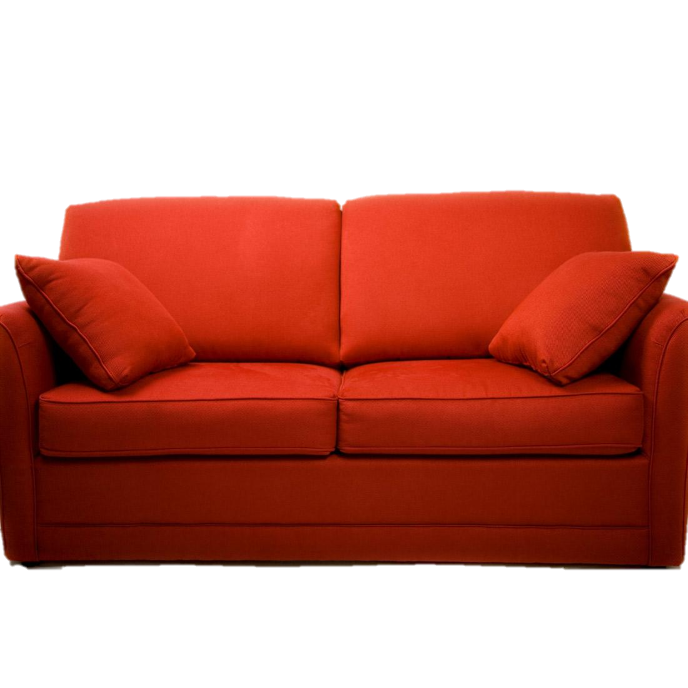

Eliminating All Static Reflections

Slide 12
Eliminating All Static Reflections
x
h₁
y = h₁ x + h₂αx
αx
h₂
Static objects (wall, furniture, etc.) have constant channels
People move, therefore their channels change
0
y = h₁ x + h₂(- h₁/ h₂)x
y = h₁’ x + h₂’(- h₁/ h₂)x
Not Zero

Slide 13
How Can We Track Using Reflections?

Slide 14
Tracking Motion
RF source
θ
Direction of reflection
Antenna Array

Slide 15
Tracking Motion
Direction of motion
θ
At any point in time, we have a single measurement
Antenna Array

Slide 16
Tracking Motion
Direction of motion
θ
θ
Direction
of motion
Antenna Array

Slide 17
Tracking Motion
Direction of motion
θ
θ
Direction
of motion
Human motion emulates antenna array
Antenna Array
Notes:
We talked in class about the relationship between doppler shift, ISAR, SAR, and antenna arrays.
Doppler shift is change in carrier frequency due to motion. Recall siren example given in class.
f(doppler) = f(transmitted)*v/speed_of_wave. You can derive it by looking at what happens to the wavelengths
The summary of what we said:
For antenna arrays: MP(theta) = sum(A[k]*e^(-j2*pi*d/lambda*k*cos(theta))
We don’t know d for our case, because person is moving, we assume some velocity v => d=vT where T is sampling rate
Instead of taking A[k] from the different antenna array elements, we take h[k] which is the channel across time and treat it as an antenna array
This gives us: MP(theta) = sum(h[k]*e^(-j2*pi*vT/lambda*k*cos(theta))
For doppler shift, it’s a frequency shift. To get frequency shift, typically do an FFT or any fourier transform
The DFT of the channel is: H(f_doppler) = sum(h[k]*e^(j2*pi*T*f_doppler*k))
Recall f_doppler = f(transmitted)*v/speed_of_wave = f*v/c (where c is speed of light because electromagnetic wave)
Because lambda = c/f, we get: f_doppler = v/lambda
This gives us: H(f_doppler) = sum(h[k]*e^(j2*pi*T*v/lambda*k)
This means that the only difference between Doppler and ISAR is the cosine theta. Because people tend to move at fairly constant speed indoors, this theta gives us an intuitive way to look at interpret motion, and we can start getting some understanding of whether someone is moving in a circle or straight line, etc.

Slide 18
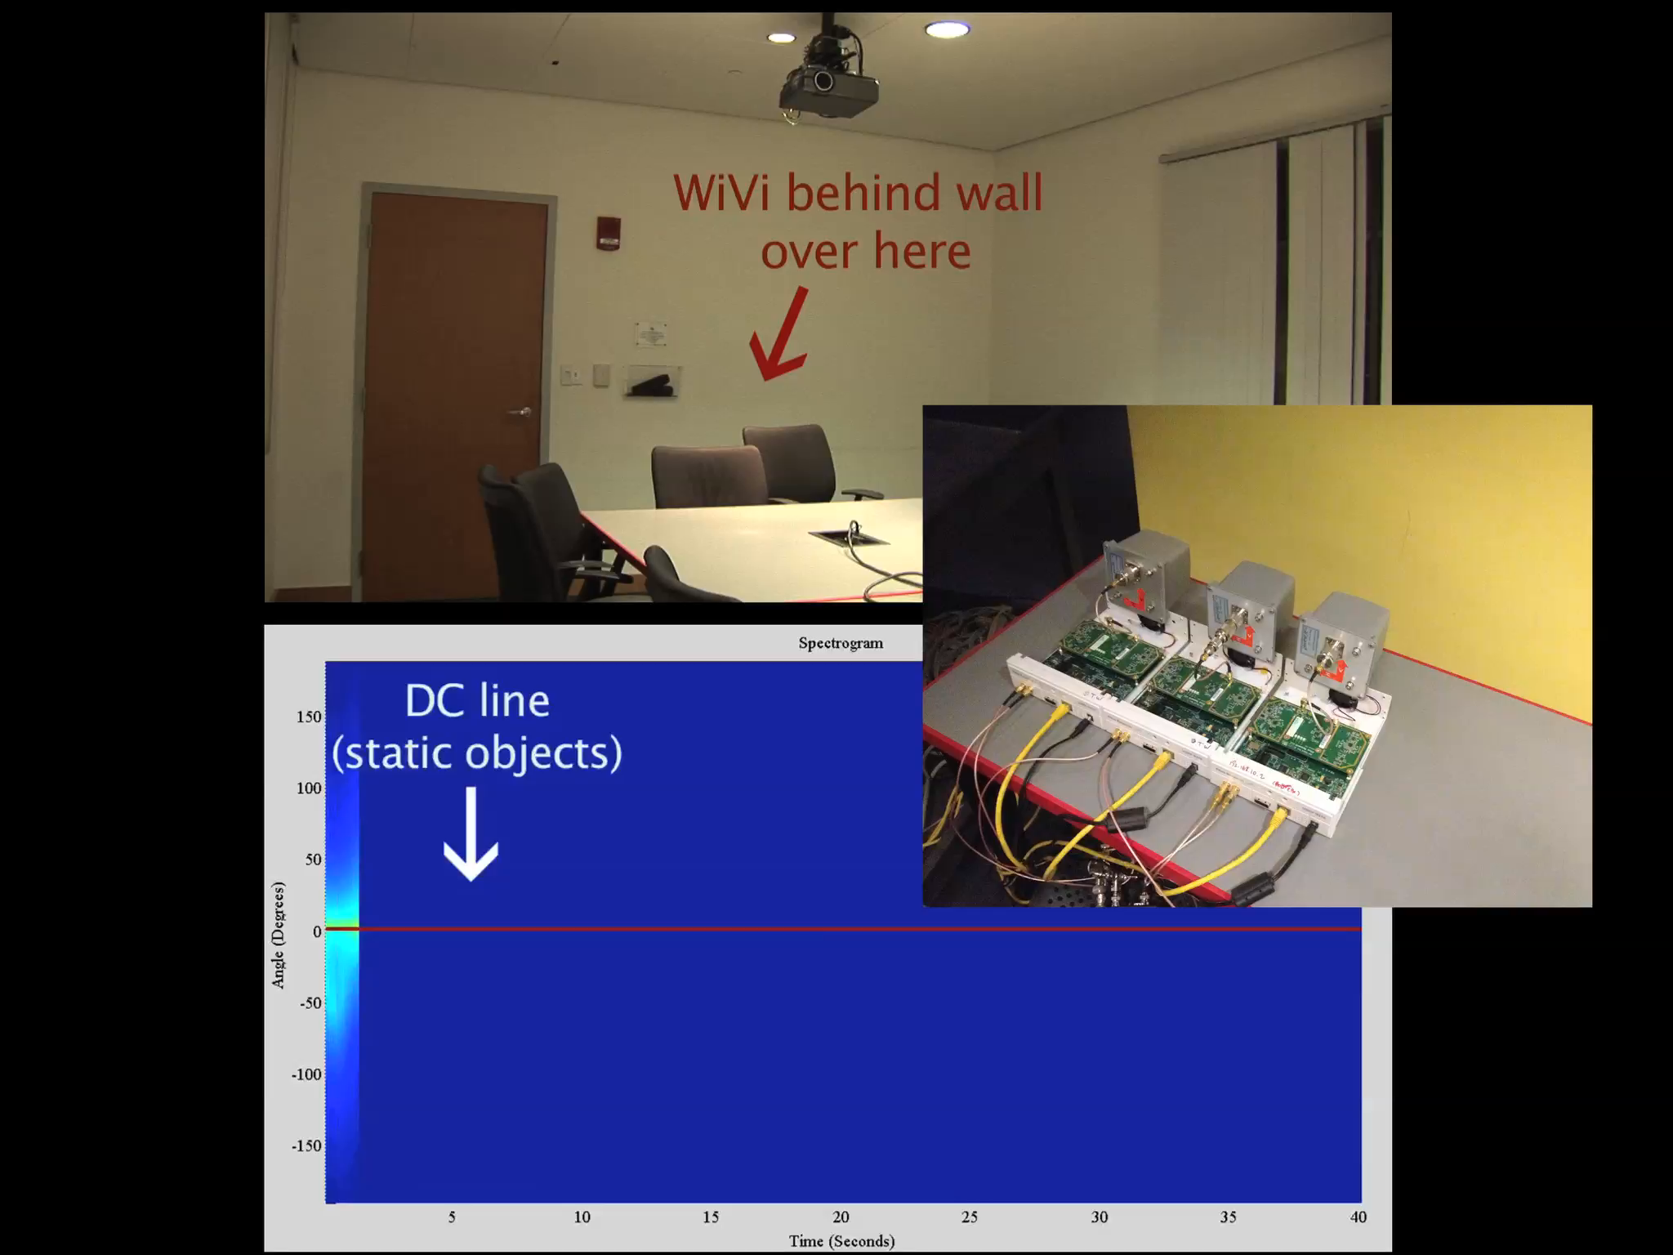

Slide 19
A Through-Wall Gesture Interface
Sending Commands with Gestures
Two simple gestures to represent bit ‘0’ and bit ‘1’
Can combine sequence of gestures to convey longer message

Slide 20
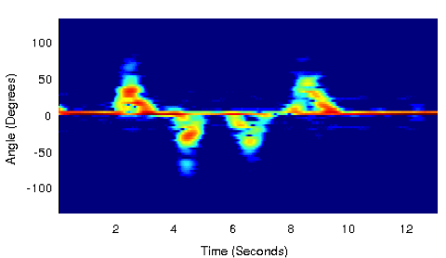
Gesture Encoding
Bit ‘0’: step forward followed by step backward
Bit ‘1’: step backward followed by step forward
Step Forward
Step Backward

Slide 21
Gesture Decoding
Matched Filter
Peak Detector
Bit ‘0’
Bit ‘1’
Gesture interface that works through walls and none-line-of-sight

Slide 22
Implementation and Evaluation
USRP software radios:
  Wi-Fi signals: 2.4GHz, OFDM
  5MHz to enable real-time channel estimation
  10mW transmit power
Old and new buildings on MIT campus
Eight human subjects
  200 experiments

Slide 23
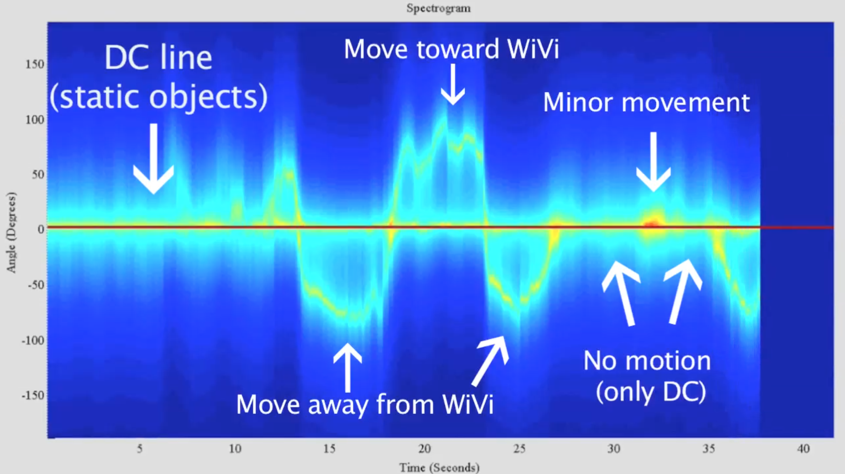
Tracking Multiple Humans
One moving person is indicated by a single curvy line
Notes:
In our experiments, remember that a single human appears as one bright curvy line.

Slide 24
Tracking Multiple Humans
Number of distinct curves at the same time corresponds to the number of humans
Two Humans
Three Humans
Notes:
The important thing to note is that when the different antenna arrays are super-imposed, the signal becomes much noisier.
We need a way to disentangle the signals from different reflectors (people).
One option: MUSIC algorithm allows disentangling independent sources
Problem with it: the reflections are all correlated because come from same source!
To deal with this, use smoothed music algorithm. It uses the fact that signals arriving from different directions are get shifted by different amounts in an antenna array

Slide 25
Automatic Estimation: Number of People
Classification algorithm in the paper
Detected Actual | 0 | 1 | 2 | 3
0 | 100% | 0% | 0% | 0%
1 | 0% | 100% | 0% | 0%
2 | 0% | 0% | 85% | 15%
3 | 0% | 0% | 10% | 90%
Notes:
Look at curve of 1 person, energy is concentrated in 1 place => variance is small.
More people, energy is spread out => variance increases
Use simple machine learning algorithm, train on set and test on another set.

Slide 26
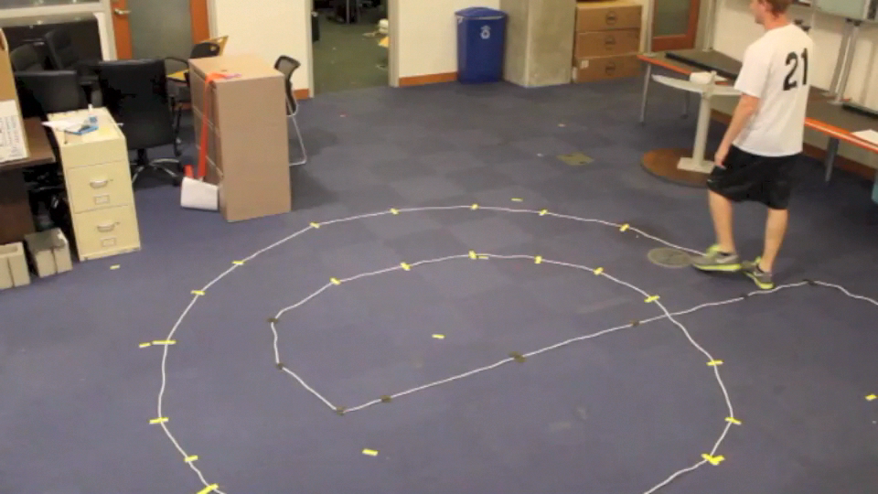
Current Status

