Slide 1



6.888: Wireless Communications Systems
Lecture 1: Introduction
Dina Katabi

Slide 2
General Information
Staff
  Lecturer: Dina Katabi, dk@mit.edu
  TA: Haitham Hassanieh, haithamh@mit.edu
Material (new class)
  Mainly research papers
  Your notes (each student will be a scribe for one lecture)
Prerequisites
  6.02 and 6.033
  Basic math: probability, Fourier, Dijkstra’s shortest path alg., …
  Matlab and C programming
Grading
  Research Project 50%
    Proposal, status report, presentation, final report
  Weakly Labs + Mini Assignments + Scribe notes – 50%

Slide 3
Fundamental Architectural Change
Traditional Approach
New Approach
Optimize within isolated layers
Optimize across the layers
Network & Apps
Cross-Layer Designs
Network and Apps
Comms. and Coding
Comms. and Coding
HW and Radios
HW and Radios
Disruptive gains are unlikely
Major opportunities!

Slide 4

10x Higher Data Rates

Slide 5
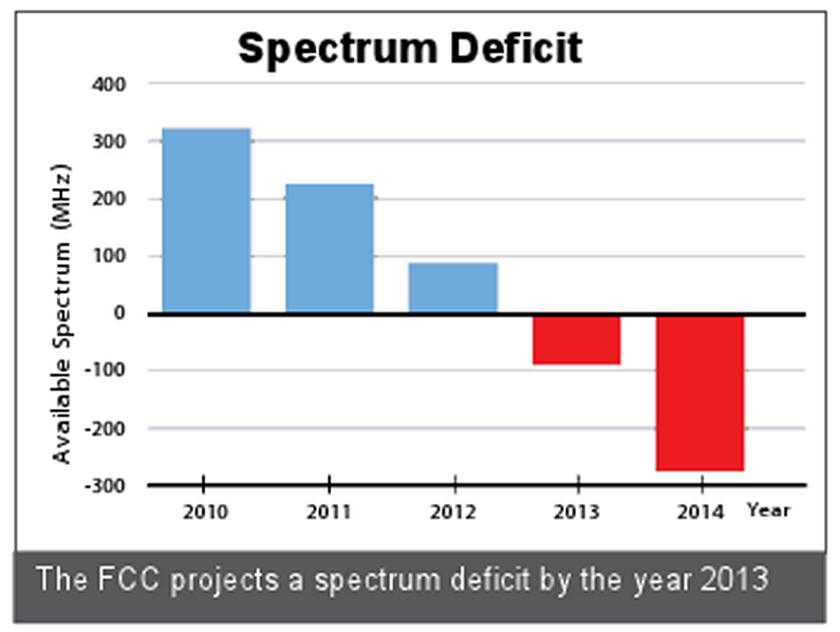
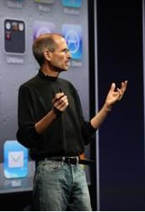
Looming Wireless Capacity Crunch
The FCC projects that the US will face a spectrum shortfall in 2013.
The iPhone 4 demo failed due to wireless congestion.
Jobs’s reaction: “If you want to see the demos, shut off your laptops, turn off all these MiFi base stations, and put them on the floor, please.”

Slide 6
MegaMIMO
Alleviates the capacity crunch by transmitting more bits per unit of spectrum

Slide 7



Today’s Wireless Networks
Ethernet
Access Point 1
Access Point 2
Access Point 3
User 1
User 3
User 2
Today, Access Points Can’t Transmit Together in the Same Channel

Slide 8
Today’s Wireless Networks
Ethernet
Access Point 1
Access Point 2
Access Point 3
Interference!
User 1
User 3
User 2
Today, Access Points Can’t Transmit Together in the Same Channel

Slide 9

MegaMIMO
Ethernet
Access Point 1
Access Point 2
Access Point 3
User 1
User 3
User 2
Interference:
d₂+d₃≈0
Data: d₁ survives
Interference: d₁+d₃≈0
Data: d₂ survives
Interference: d₁+d₂≈0
Data: d₃ survives
Access Points Can Transmit Simultaneously in the Same Channel

Slide 10
MegaMIMO = Distributed MIMO
Access Points act as a huge distributed MIMO transmitter with sum of antennas
Ethernet
AP1
AP2
AP3
                …
AP10
                …
User 1
User 2
User 3
User 10
10 Access Points → 10x Higher Throughput

Slide 11
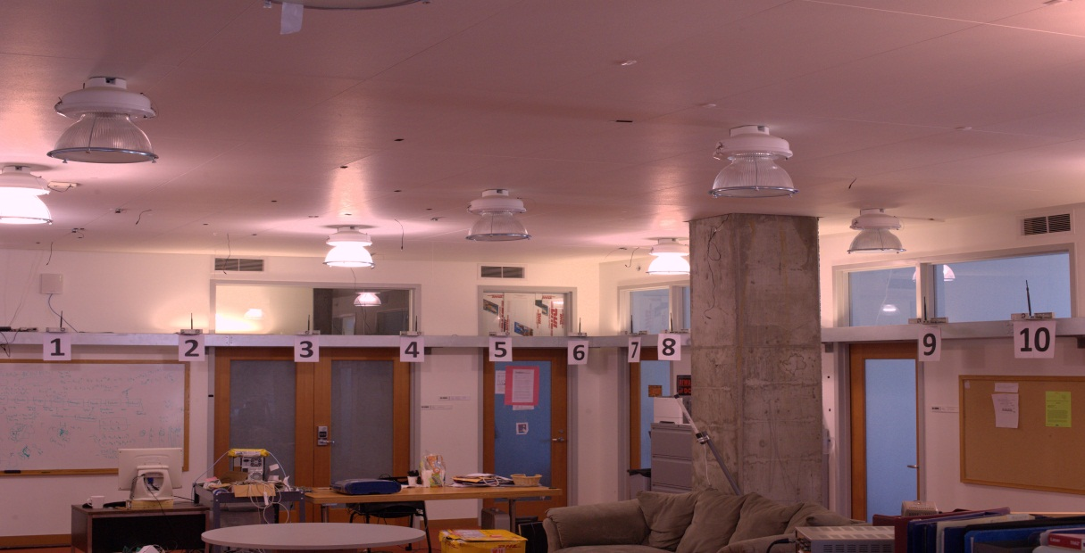
Testbed of Software Radios
Dense Conference Room Like Deployment

Slide 12
Results from Prototype
MegaMIMO
Total Throughput [Mb/s]
10x
802.11
Number of Access Points on Same Channel
10x throughput gain over existing Wi-Fi

Slide 13
OpenRF (uses existing 802.11 cards)
Manages wireless interference
  Interference nulling, interference alignment, and beamforming
Self-configures MIMO techniques to benefit any network scenario
  Admins do not need to understand MIMO processing

Slide 14
OpenRF’s Goals
Ethernet
Controls Access Points to apply PHY techniques
OpenRF
OpenRF
AP-1
AP-2
Alice
Bob
Notes:
Let’s first understand what OpenRF aims to achieve in a wireless network.
We consider a simple example where we have two access points : AP-1 and AP-2 connected by a wired backbone.
Let’s say that the APs serve two clients Alice and Bob.
Essentially, OpenRF aims to control downlink traffic from APs to clients.
In other words, it provides a software layer that controls each Access Point in the network to apply PHY techniques.
The clients however are independent devices that we do not coordinate or control.

Slide 15


OpenRF’s Goals
Ethernet
OpenRF
OpenRF
AP-1
AP-2
Alice
Alice
Alice
Alice
6 Mbps
time
Alice
Bob
Notes:
Now let’s suppose Alice decides to start watching a High-Definition Youtube video.
Let’s say AP-1 sends packets to Alice at 6 Mbps, which is just about enough for good quality.
Now suppose Bob decides to watch a video as well!
Unfortunately, the wireless medium is shared …

Slide 16

OpenRF’s Goals
Ethernet
OpenRF
OpenRF
AP-1
AP-2
Alice
Alice
3 Mbps
3 Mbps
Bob
Bob
time
Alice
Bob
Buffering…
Buffering…
Notes:
… So, Alice and Bob are forced to take turns on the medium,
Thus, they only get half their earlier share, that is 3 Mbps each.
And this deteriorates the quality of service for both users.

Slide 17
OpenRF’s Goals
“Interference Nulling”
Ethernet
OpenRF
OpenRF
AP-1
AP-2
3 Mbps
3 Mbps
null
null
Alice
Bob
Buffering…
Buffering…
Notes:
To tackle this problem, OpenRF leverages a technique called interference nulling.
Essentially, AP-2 can leverage its multiple antennas to cancel any interference at Alice.
Similarly AP-1 cancels interference at Bob.

Slide 18
OpenRF’s Goals
“Interference Nulling”
Ethernet
OpenRF
OpenRF
AP-1
AP-2
3 Mbps
3 Mbps
null
null
Alice
Bob
Buffering…
Buffering…
Notes:
In effect, this technique uses the multiple antennas on the AP to re-direct the interfering beams away from the clients.

Slide 19
OpenRF’s Goals
“Interference Nulling”
Ethernet
OpenRF
OpenRF
AP-1
AP-2
Alice
Alice
Alice
Alice
6 Mbps
6 Mbps
Bob
Bob
Bob
Bob
null
null
time
Alice
Bob
HD Quality!
HD Quality!
Notes:
This enables AP-1 and AP-2 to transmit simultaneously and hence go back to 6 Mbps each.
Thus they can both enjoy HD quality videos.

Slide 20
OpenRF’s Goals
“Beamforming”
Ethernet
OpenRF
OpenRF
AP-1
AP-2
6 Mbps
3 Mbps
beamform
null
null
Alice
Bob
Notes:
But now let’s say Bob walks farther away from AP-2,
… so his throughput drops to 3 Mbps.
In this case, OpenRF can apply another technique “coherent beamforming” to maximize received signal power to Bob.

Slide 21
OpenRF’s Goals
Ethernet
OpenRF
OpenRF
AP-1
AP-2
6 Mbps
6 Mbps
beamform
null
null
Alice
OpenRF must self-configure to network dynamism
Bob
Notes:
Essentially this leverages the AP’s antennas to focus the beam and maximize received power at Bob.
In effect, this can push Bob’s rate back to its original 6 Mbps.
Hence, OpenRF must be able to apply the right set of MIMO techniques to self-configure to such dynamism in the network.

Slide 22
OpenRF’s Architecture
Control Plane
OpenRF Interface
Ethernet
Flow-id
Action
OpenRF
OpenRF
AP-1
AP-2
Data Plane
PHY
techniques
null
null
Alice
Bob
Notes:
So let’s see how OpenRF’s architecture achieves this goal.
At the heart of OpenRF is an interface that separates the data and control plane.
The interface operates over a (flowid, action) table much like OpenFlow. In an OpenFlow switch, the action refers to an output port along which a flow must be forwarded.
In contrast, an OpenRF action refers to the PHY techniques that an AP applies to a flow.

Slide 23
OpenRF’s Architecture
Control Plane
OpenRF Interface
Ethernet
Flow-id
Action
OpenRF
To:Bob
beamform @Bob
null @Alice
OpenRF
AP-1
AP-2
Data Plane
beamform
null
null
Alice
Bob
Notes:
For example, the control plane may ask AP-2 to beamform any packet to Bob, while nulling it at Alice.
The interface then feeds this information to the data plane….

Slide 24
OpenRF’s Architecture
Control Plane
OpenRF Interface
Ethernet
Flow-id
Action
OpenRF
To:Bob
beamform @Bob
null @Alice
OpenRF
AP-1
AP-2
Data Plane
beamform
null
null
Alice
Bob
Notes:
… which redirects the signal beam to apply these techniques.
In other words, an action in OpenRF refers to the spatial direction along which a signal must be forwarded.

Slide 25
OpenRF’s Architecture
Control Plane
OpenRF Interface
Ethernet
Flow-id
Action
OpenRF
To:Bob
beamform @Bob
null @Alice
OpenRF
AP-1
AP-2
Data Plane
beamform
null
null
Alice
In OpenRF, action = spatial direction to forward signal
Bob
Notes:
… which redirects the signal beam to apply these techniques.
In other words, an action in OpenRF refers to the spatial direction along which a signal must be forwarded.

Slide 26
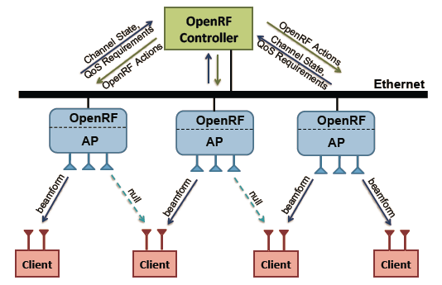
Software Defined MIMO Networks
Prototype is compatible with the 802.11n/ac standards
APs collect channel states and send them to controller
Controller automatically figures out where to apply interference nulling, alignment , MU-MIMO and inform the APs

Slide 27


Video Application
Two clients watch video over VLC
802.11
Blue
Red
Frame Delay (ms)
OpenRF
Blue
Red
Frame Delay (ms)
Notes:
Finally, we measure the impact of OpenRF for real applications.
We consider two clients streaming a HD video over VLC.
We compare the delays in the video for 802.11 and OpenRF.
Here are the results.
For 802.11, the delays remain low when the blue client is the only client in the network, but clearly begin to spike once the red client joins the network.
In contrast, the delays remain low for OpenRF even when both clients are streaming video at the same time.
Let’s look at how this translates to Bob’s actual video experience. We start with 802.11
(Play)
As you can see the video suffers from major glitches and stalls. Next let’s look at OpenRF.
(Play)
Clearly the video is of much better quality!

Slide 28
Centimeter-Scale Localization
Today, RF-based localization has about one meter accuracy
Challenge: Multipath effects confuse the localization system
Solution: Use the multipath reflection pattern as a signature of the location

Slide 29
Use Multipath Reflections
35º
Reader
Power of Reflection
35º
Spatial Angle (degree)

Slide 30
Use Multipath Reflections
140º
Reader
Power of Reflection
140º
Spatial Angle (degree)

Slide 31
Use Multipath Reflections
Can localize to within a few centimeters
Reader
Power of Reflection
Spatial Angle (degree)

Slide 32
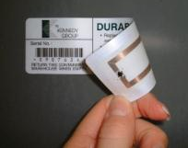
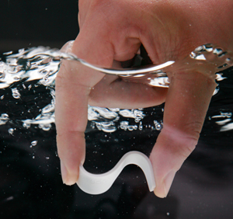
Works even with RFIDs
Battery-free stickers to tag any and every object

Slide 33

No more customer checkout lines
RFIDs on goods

Slide 34
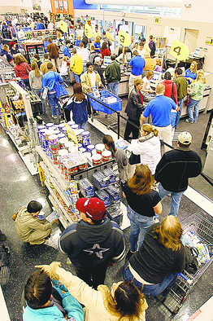
No more customer checkout lines
RFIDs on Basket

Slide 35
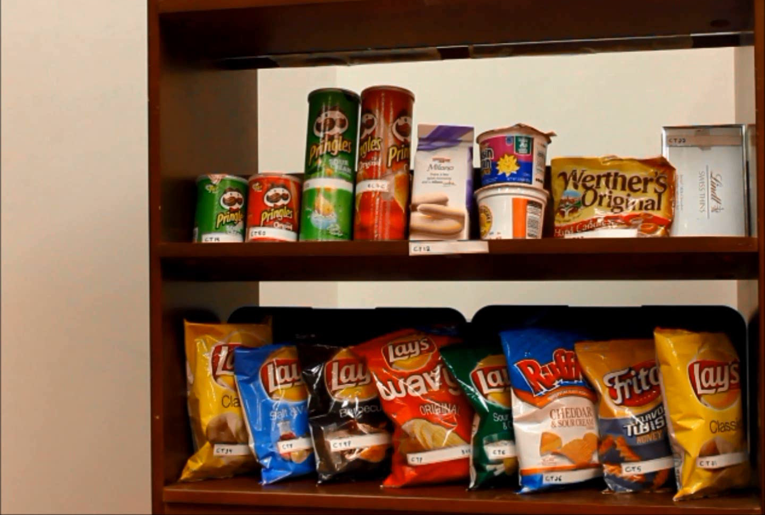
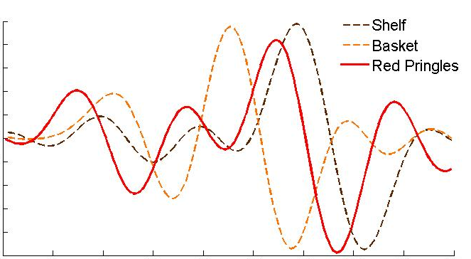
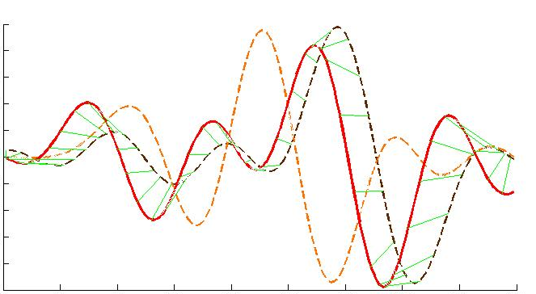
Red Pringles RFID
Shelf RFID
Basket RFID
Pringles
Shelf
Basket

Slide 36
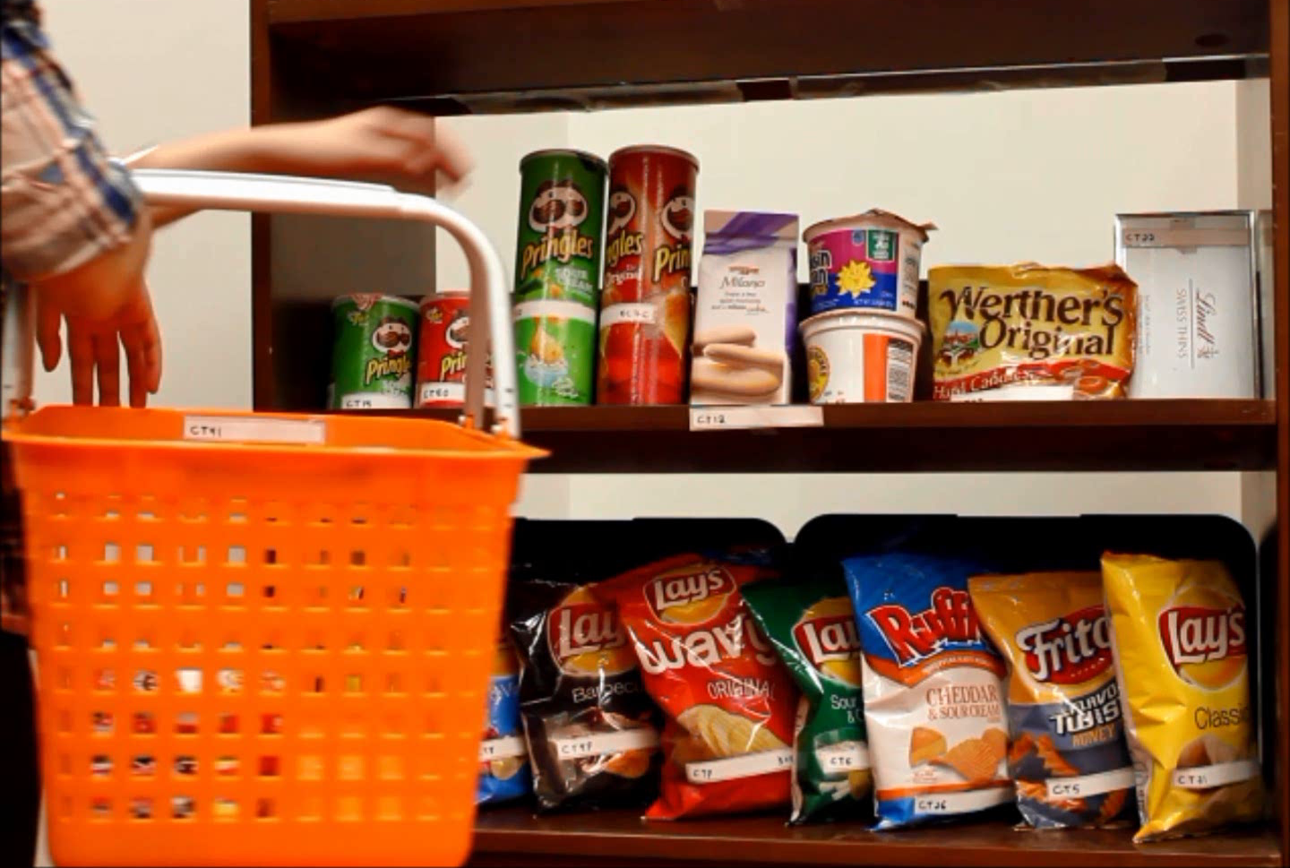
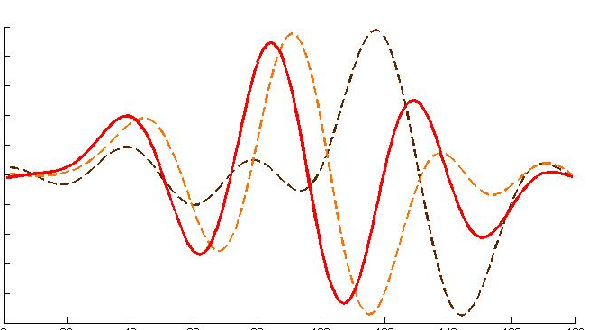
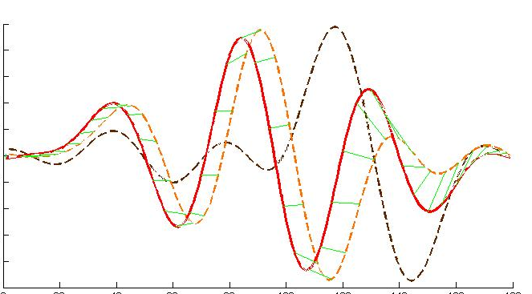
Shelf RFID
Basket RFID
Basket
Shelf
Pringles
Red Pringles RFID

Slide 37
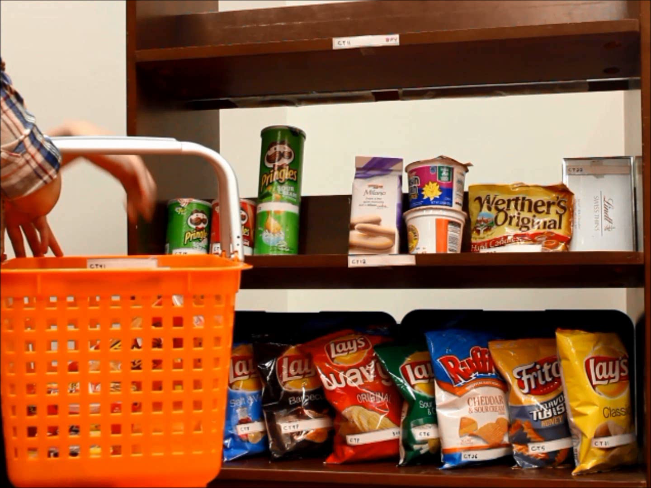

Slide 38
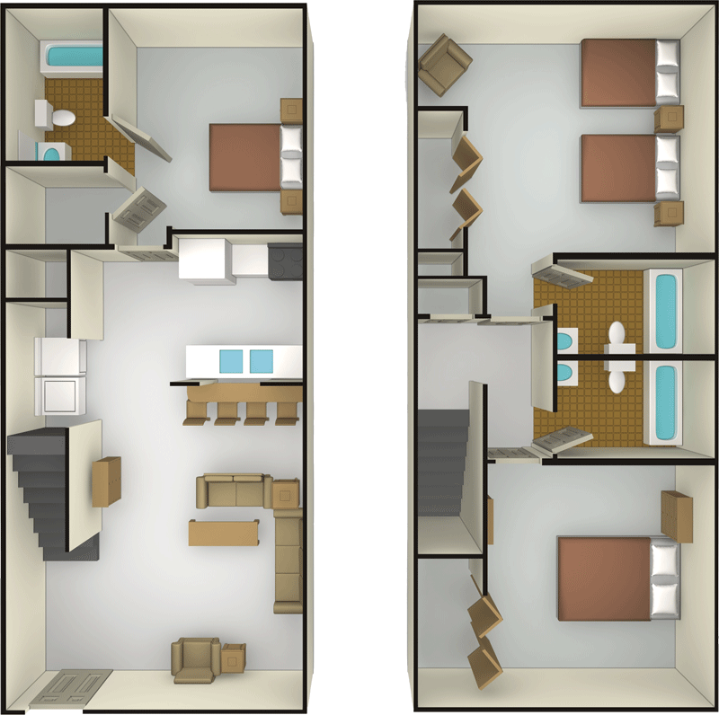



Smart Homes
RFID-tagged
Laptop Charger
RFID-tagged Laptop
RFID-tagged
Handbag

Slide 39
Smart Homes
Reference RFIDs

Slide 40
Smart Homes

Slide 41
Smart Homes
RFIDs on the Door Frame
Charger left behind!

Slide 42
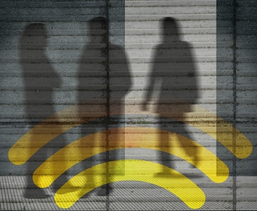
Can your cellphone give you X-ray vision?

Slide 43
WiVi: See through-walls with WiFi
WiFi signals traverse walls and reflect off objects
Challenge: reflections off the separating wall are 10,000x higher than off a human behind the wall
Solution: use two transmit antennas and one receive antenna; the two transmitted waves cancel each other for static objects but not animated objects
See video on YouTube
https://www.youtube.com/watch?v=uJkQzLjYBFI

Slide 44
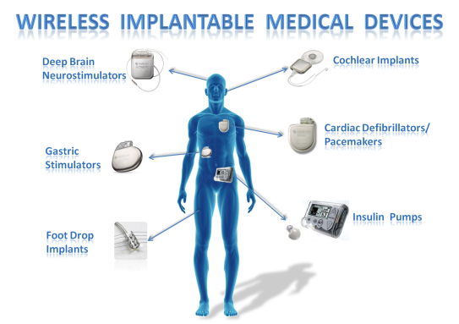
Securing Medical Devices
Medical implants and sensors are power limited
➔ Can’t have strong cryptography

Slide 45
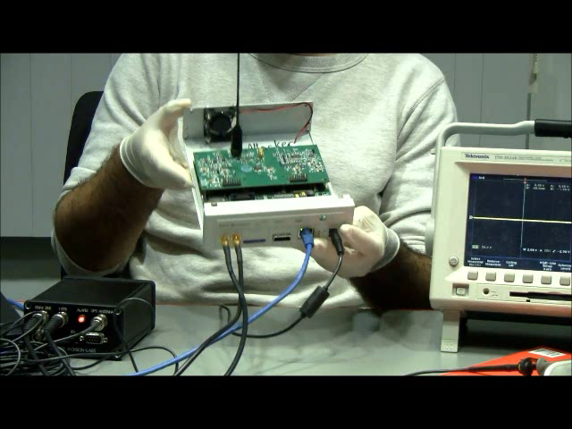
Notes:
So here we have a off the shelf software radio which as we can see is connected to a laptop.
Next we have an implanted cadiac defibrillator on which we demonstarte the shock. Behind it is an oscilloscope which we use to monitor the implant.
Now let us send a command on the laptop to deliver the shock. The software radio is sending the signals and the laptop now says that the shock has been delivered.
Now on the oscilloscope, we see voltage spike confirming that the shock as been delivered.
We are going to repeat this experiment multiple times and focus on what’s really happening at the implant.
As we can see, the resistor on the implant starts burning. Clearly, this is not desirable inside a human body.

Slide 46
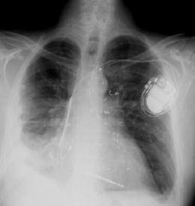




Encryption on the Air
Encrypt using a random signal
Implant’s signal
Random Sum
Doesn’t know jamming signal
→ can’t decode
Reader
jams
Can secure medical devices even if they have no encryption of weak encryption
Reader knows the jamming signal
subtract it
decode implant’s transmission
Deliver data to doctor
How does the reader decrypt?
Jamming signal acts as an analog one-time pad
Notes:
Our solution is called encryption on the air.
So say we have an eavesdropper who is trying to snoop on the implant’s data.
In order to encrypt the implant’s transmissions, the reader is going to use a random signal.
So say this is the implant’s signal. The reader pciks a random signal and jams the implant’s transmission.
Now since the eavedropper does not know the jamming signal, it cannot decode the implant’s signal.
Thus, effectively, the random jamming signal acts as a one-time pad.
But how does the reader decrypt this signal?
Remember that the reader knows the random jamming signal because it is the one who generated it.
So, in principle, it can subtract the jamming signal and decode the implant’s transmission.
The reader then forwards the decrypted data to the health care professional.
So we want a wireless device that can transmit and receive simultaneously, which is a hard problem.

Slide 47
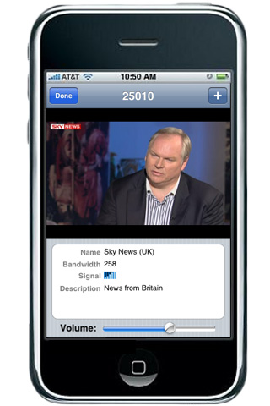
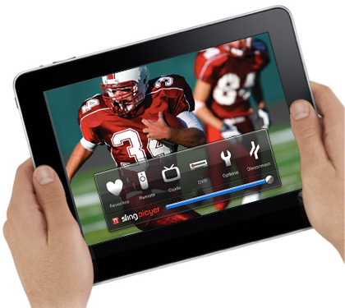
Mobile Video Is the Killer App.
All TV programs to your handheld device
Live broadcast of concerts and sports anywhere anytime
But today’s mobile video suffers glitches and stalls
Notes:
According to all predictions, Mobile video is the next killer application
[animate] We all want to watch TV programs on our handheld devices
[animate] watch live broadcast of concerts and sporting events, anywhere, anytime
[animate] The problem however is that today’s mobile video glitches and stalls.
Without a solution, it is unlikely mobile video will achieve its potnetial.

Slide 48
Why Does Video Suffer Glitches and Stalls?
Today’s video has two isolated components
Video Compression
Wireless Physical Layer
Video codecs, originally designed for DVD and CD
Wireless has high bit errors and packet drops
Assume no errors or drops
Video Glitches and Stalls
Notes:
But why does today’s mobile video glitch and stall?
[animate] Today’s video has two components that are designed in isolation from each other.
[animate] Specifically, it has a video codec which compresses the video.
It also has a wireless physical layer that encodes the bits to produce the transmitted signal
[animate] The problem however is that the video codec (i.e., MPEG4/H264 and its variants) was originally designed to store video on DVD and CDs. It does a great job on compression. BUT IT ASSUMES NO BIT ERRORS or packet drops.
It becomes very fragile in the presence of errors or drops.
[animate] the Wireless physical layer on the other hand suffers from bit errors and packet drops.
So, you take a video that assumes no error or packet drops and you put it on top of a channel that has drops and errors ➔
[animate] You get video glitches and stalls
[animate] That is you get a system that works perfectly when there are no residual errors after decoding. But even if there is only one bit error after decoding, it can result in an arbitrary amount of errors in the video.
[animate]

Slide 49
Our Solution: SoftCast
Optimizes video compression and channel coding together
Joint code to compress and protect from channel errors
Digital Signal
Video Compression
Wireless Physical Layer
Pixel Values
Code Is Linear
Small perturbation in pixel values
Small perturbation on channel
Smooth degradation; No glitches or stalls
Notes:
Softcast solves this problem
At a high level it works as follows:
[animate] instead of having two components one for compression and one for encoding the signal to transmit it on the channel,
[animate] Softcast has a single code that both compresses the video and protects it from errors as it is transmitted over the wireless channel.
[animate] SoftCast code however is special in that it makes the whole network stack with all of its layer act like a linear transform
Thus the least significant bits in pixels’ luminance get mapped into the least significant bits in the transmitted signal samples,
And the most significant bits in pixels’ luminance get mapped into the Most significant bits in the transmitted signal samples,
Hence, video shows a smooth performance and no glitches or stalls.
[animate] Moreover the code can maintain this smooth degradation while compressive the video.
[Animate] thus, when channel variations cause small perturbations in the signal samples, this translates into similarly small perturbations in the pixel luminance
[animate] and no cliff effect.
[animate] alone this is not sufficient

Slide 50
The Sparse Fourier Transform

Slide 51

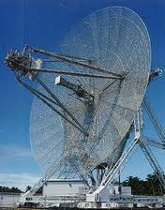

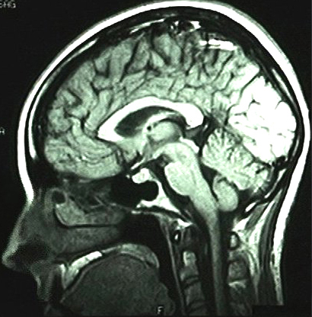



The Fourier Transform Is Everywhere
Audio
Video
Radar
Medical Imaging
Sequencing
GPS
Oil exploration
Notes:
FFT is widely used
Making improvement to the way we do FFT → improvement to large number of applications and domains.

Slide 52
Computing the Discrete Fourier Transform
Naïve Algorithm O(n²)
In 1965, Cooley and Tukey introduced the FFT which computes the frequencies in O(n log n)
But … FFT is too slow for BIG Data problems
Can we design a sublinear Fourier algorithm?

Slide 53
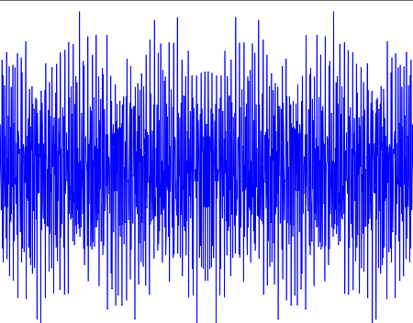
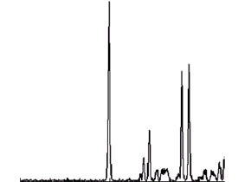
Idea: Leverage Sparsity
Often the Fourier Transform is dominated by a few peaks
Time Signal
Approximately Sparse Freqs.
Sparse FFT runs in sub-linear time on sparse data
Fastest Algorithm today
Top 10 Emerging Technologies -- Technology Review

Slide 54


How Does the Sparse FFT Work?
1- Bucketize
$Spectrum \hat{x}$_{f}
Divide spectrum into a few buckets
→ Can ignore empty bucket
2- Estimate
Estimate the large coefficient in each non-empty bucket
$$value of bucket=∑\hat{x_{i}}$$

Slide 55
Simulation Results
FFTW
Sparse FFT

Slide 56

3D Photography Using Sparse FFT
Generate depth and perspective using a camera array
Images are correlated →4D frequencies are sparse
Goal: reduce the number of camera elements to enable implementation in a hand-held device
Solution: Camera images are correlated →Use sparse FFT

Slide 57
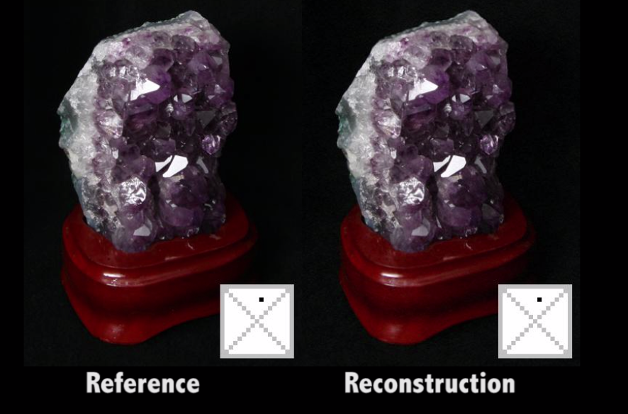
Results show that we can accurately reconstruct unsampled camera outputs

Slide 58
Conclusion
Exciting opportunities in the wireless and mobile domains
  MegaMIMO brings 10x increase in data rates
  Centimeter-scale indoor localization
  The sparse FFT enables 3D imaging
  WiVi enables portable devices like cell-phones to track people through walls and closed rooms
http://groups.csail.mit.edu/netmit/wordpress/

