Slide 1
A Hierarchical Volumetric Shadow Algorithm for Single Scattering
Ilya Baran, Jiawen Chen, Jonathan Ragan-Kelley, Frédo Durand, Jaakko Lehtinen
Computer Science and Artificial Intelligence Laboratory
Massachusetts Institute of Technology
Notes:
Hello, my name is Jiawen Chen
and today I’ll be talking about a new hierarchical algorithm
for rendering volumetric shadows

Slide 2
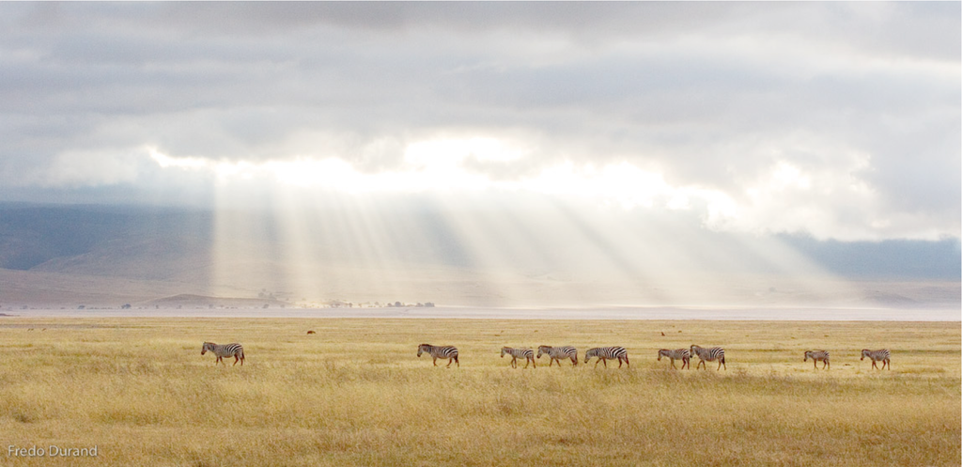
Volumetric scattering with shadows
Photo by Frédo Durand
Notes:
Volumetric scattering is an important component of the natural world that
Can dramatically increase the realism of computer generated images.
Volumetric shadows, where complex occluders block parts of the scattered light,
is what produces these beams of light in the sky
This photo wouldn’t be nearly as interesting if there were no clouds
it would just look like a hazy day

Slide 3
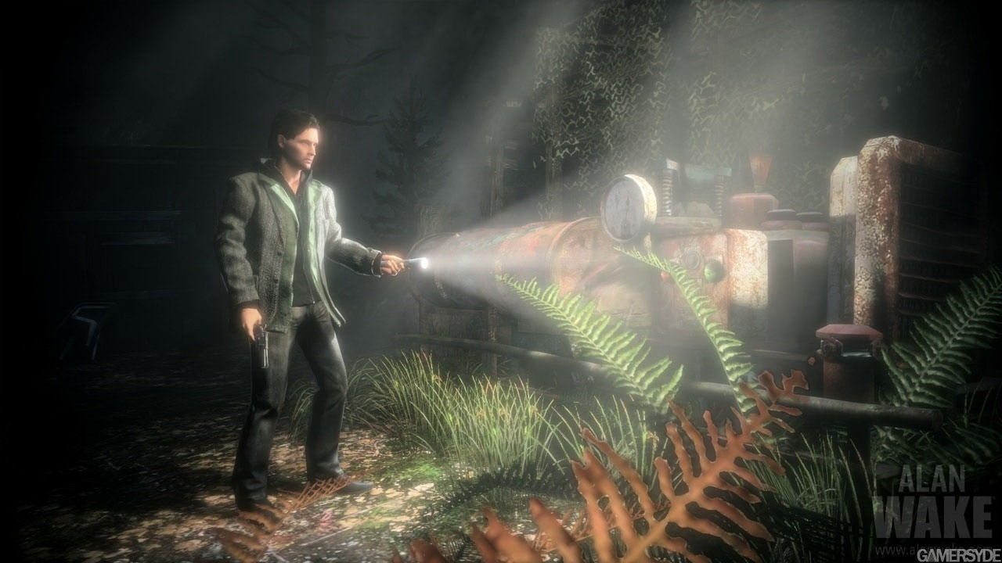
Alan Wake by Remedy Entertainment
Notes:
More recently, volumetric shadows have been incorporated as part of the gameplay
in titles such as Remedy’s Alan Wake.
- Let’s start by taking a quick look at how this phenomenon occurs

Slide 4
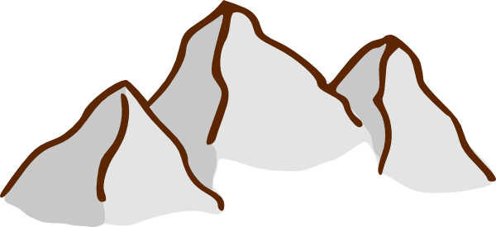
Notes:
Let’s say we have a camera on the left looking at a mountain in the distance
The sun is shining from above and the clouds block some of the light
Normally, when we render direct lighting,
We cast a ray toward the mountain <animate>
We do a lookup into a shadow map to determine if the light is visible from the surface point
And if it is, we shade it <animate>
Otherwise, it’s in shadow

Slide 5
Notes:
With a participating medium, such as fog particles in the air
In addition to the direct lighting,
We also get light scattered from the particles into the eye called the airlight.
The standard technique for simulating this in offline rendering is volume path tracing,
Which extends standard path tracing to explicitly model light rays interacting with the medium <animate>
Rays from the sun can undergo multiple scattering events before reaching the eye
It is computationally very expensive, even with accelerations such as volume photon mapping

Slide 6
Notes:
A common model used for real-time applications is the single-scattering approximation,
Which as its name suggests, assumes that the light is scattered only once by the medium <animate>
We also typically assume that the medium is homogeneous
And that light is partially absorbed and partially scattered by the medium
In single scattering, we don’t have to explicitly model the interactions between light rays and particles,
It has an analytical solution which is just an exponential decay along the length of the ray.

Slide 7
Notes:
The traditional algorithm for rendering single scattering is ray marching: <animate>
We walk along the ray from the camera and take a number of samples until we hit the first surface
For each sample, we perform a shadow map lookup, and if it’s visible,
We accumulate its contribution, attenuated by how far the sample is from the camera
Volumetric scattering has received some attention in recent years
let’s look at some related work before describing our technique

Slide 8
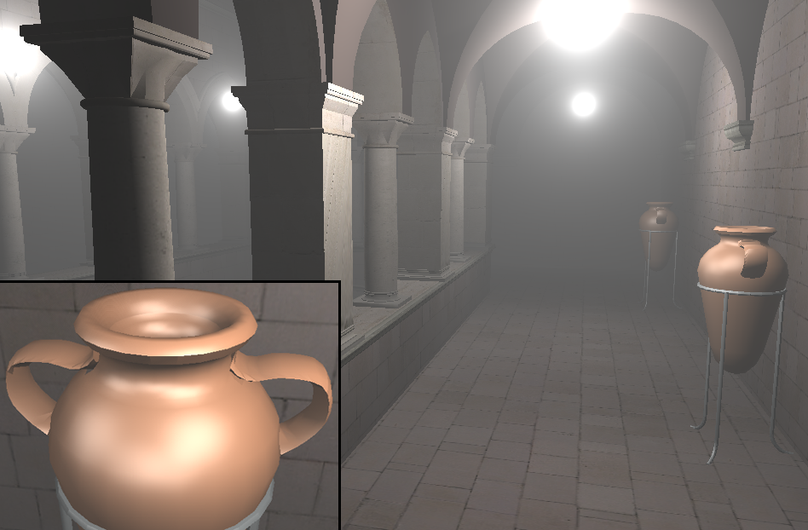
Related work
Ray marching (brute force)
Analytical scattering models
Sky lighting, bloom, etc.
Doesn’t account for visibility
Sun et al. [2005]
Notes:
In addition to ray marching, which is the brute force approach to the problem
There are a number of analytical scattering models for real-time rendering of participating media
these methods capture nice effects such as sky lighting,
and bloom near light sources.
however they don’t take into account visibility
therefore, analytic methods cannot produce the nice light beams i showed earlier

Slide 9
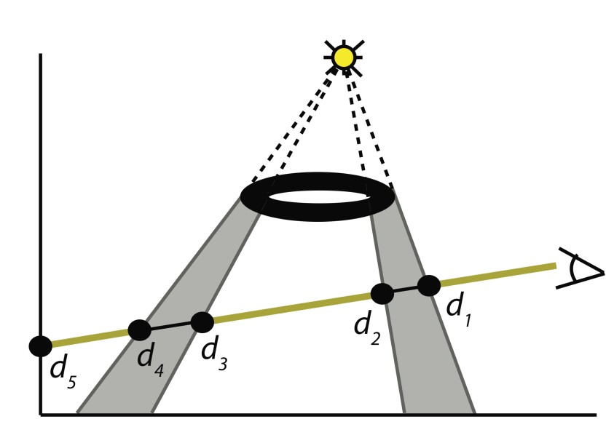
Shadow volume methods
Max [1986]
Analytical integration
Wyman and Ramsey [2008]
Ray marching along intervals
Notes:
A number of methods use shadow volumes to identify the lit intervals along each ray
they then either analytically integrate along these intervals
or ray march within the visible regions
Although these methods are accurate, their performance depends heavily on the complexity of the occluder geometry

Slide 10
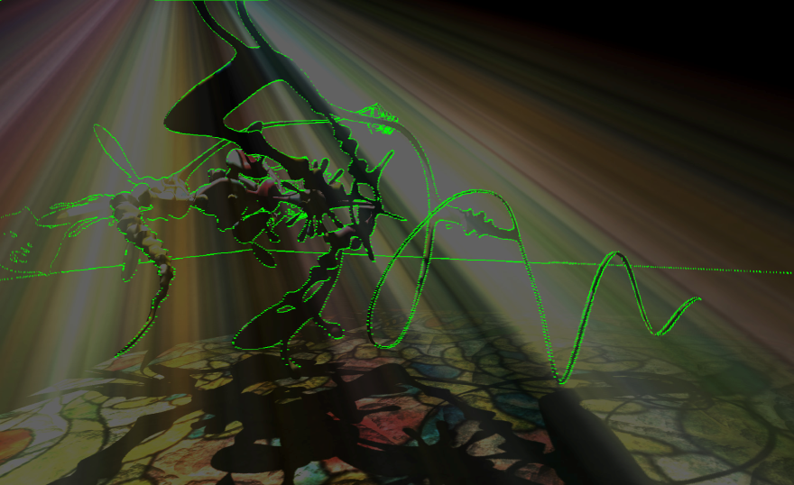
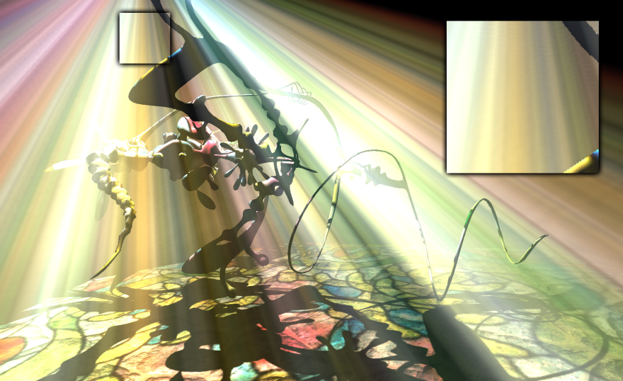
Related work
Engelhardt and Dachsbacher [2010]
Detect discontinuities, subsample and interpolate
Performance depends on occluder complexity
Epipolar geometry
Detected discontinuties
Engelhardt and Dachsbacher [2010]
Notes:
Recently, Engelhardt and Dachsbacher observed that the in-scattered radiance varies smoothly along light beams
except at depth discontinuities.
this observation lets them perform ray marching at a sparse set of pixels
and interpolate using a cross-bilateral filter
for all of these methods, except ray marching
performance is heavily dependent on occluder complexity
In contrast, our technique has a complexity guarantee independent of the scene.
finally, I want to mention that both of the techniques by Max, and Engelhardt and Dachsbacher,
make use of epipolar geometry, which is also important for our method.
I will cover it later in the talk.

Slide 11
Overview
Incremental integration
Approximating single scattering
Epipolar rectification
~
Notes:
our method has 3 key ideas
<animate>
we will first illustrate with a simple 2d case to demonstrate the structure of the problem
and show how to exploit this structure to compute the visibility part of the integral incrementally
<animate>
Then, we show how to extend the algorithm to incorporate the scattering effects that vary over space
such as attenuation along view rays and textured lights
<animate>
Finally, I will discuss epipolar rectification,
which reduces a general 3D camera-light configuration to our canonical configuration

Slide 12
Simplified scenario
Orthographic camera
Light direction perpendicular to view direction
Visibility only
Notes:
let’s consider this simplified scenario in 2D,
where we have an orthographic camera with parallel view rays
And we also have a directional light source, with parallel light rays perpendicular to the view direction
And finally, let’s consider visibility only,
And we’ll ignore things like attenuation and the scattering phase function

Slide 13
d
r
Notes:
The view rays are visualized in blue, and the light rays are in orange
We discretize the visibility integral over a grid in space.
The number of rows, r, is the image height
And the number of columns, d, is the shadow map width

Slide 14
Notes:
We have objects in the scene, which block both the view and light rays
<animate>
The bright nodes are lit, and the dark nodes are in shadow

Slide 15
Brute force complexity: O(rd)
7
1
5
Notes:
Our goal is, for each pixel (which corresponds to a row),
Count how many of the light rays are visible
For instance, the top row <animate>
is closer to the sun than any blockers.
Therefore, all the columns are lit and the answer is 7
For the second row, the view ray intersects an object <animate>
So we only integrate up to the first column and the answer is 1
But this row <animate>
Has 2 columns that are blocked, so the answer is only 5
Computing this integral using brute force ray marching
Costs order r times d
Because we have to iterate over potentially all d columns for each of the r rows

Slide 16
Brute force complexity: O(rd)
7
1
5
5
Notes:
But notice how this sum has a lot of structure: the answers only change between occluders.
For instance, these two rows have the same answer <animate>
and brute-force ray marching ends up re-computing the same thing.

Slide 17
Bit mask
1
1
1
1
1
1
1
Process top down incrementally
Notes:
We can exploit the structure of the problem by processing all the rows top down
Notice that once you turn a column off, it stays off
So, a smarter way to handle this problem would be to first,
sort all the occluders by distance from the light
Then, maintain a bit mask, which is initialized to all lit

Slide 18
Bit mask
1
1
1
1
1
1
1
7
Notes:
Then, we walk down the rows
For the first row, we query the mask at the depth of the camera ray, and it’s all lit and the answer is 7,
Like before

Slide 19
Bit mask
1
1
1
1
1
1
1
7
1
Notes:
The next row, it’s 1

Slide 20
Bit mask
1
1
1
1
1
1
1
7
1
Notes:
Here, the object occludes two columns,
so we turn off those two bits in the mask <next>

Slide 21
Bit mask
1
0
0
1
1
1
1
7
1
Notes:
<next>

Slide 22
Bit mask
1
0
0
1
1
1
1
7
1
5
Notes:
Then, we do another query, and we get 5.

Slide 23
Bit mask algorithm complexity: O(rd)
Bit mask
1
0
0
1
1
1
1
7
1
5
5
2
2
3
Notes:
We continue top down with these interleaved queries and updates until we’re done.
The bit mask algorithm takes advantage of the coherent structure of the problem,
But it’s not any faster than brute force.
It still takes linear time to get a prefix sum from a bit mask.
Fortunately, we can do better: we can reduce the order d query time
down to order log d by using a data structure called a partial sum tree

Slide 24
Partial sum trees
Binary tree
Each node stores sum of children
4
2
2
2
0
1
1
1
1
0
0
1
0
1
0
Notes:
A partial sum tree is a binary tree
where each node holds the sum of its two children
This data structure lets us both query for the sum along any interval,
and update the value at a leaf, in log(d) time
here's a quick overview of how the tree works
In this picture here, only some of the columns are lit, the rest are occluded
This column here just got occluded, so
we start at the leaf

Slide 25
Tree update
4
2
2
2
0
1
1
1
1
0
0
0
0
1
0
Notes:
Subtract 1 from it
And then,
subtract 1 from each node all the way to the root

Slide 26
Tree update
4
2
2
2
0
0
1
1
1
0
0
0
0
1
0

Slide 27
Tree update
4
2
1
2
0
0
1
1
1
0
0
0
0
1
0

Slide 28
Tree update
3
2
1
2
0
0
1
1
1
0
0
0
0
1
0
Notes:
it’s pretty clear that an update takes log(d) time

Slide 29
Tree query
3
2
1
2
0
0
1
1
1
0
0
0
0
1
0
∑ = 3
Notes:
Querying the tree is a sum over the nodes whose children make up the intervals we are interested in
And it gathers from at most one node from each level
Therefore, it also takes log(d) time

Slide 30
Complexity
2D
Brute force: O(rd)
Incremental with bit mask: O(rd)
Incremental with tree: O( (r+d) log d )
3D: s independent slices
Brute force: O(srd)
Incremental with tree: O( s (r+d) log d )
Notes:
With partial sum trees, we reduce the runtime of the
Incremental integration algorithm down to O( (r+d) log d)
because we have to do r queries and d updates.
And in 3D, where we have a cube with s independent slices
it will cost s times more
But we're not quite done yet.

Slide 31
Textured lights
Light texture
0.8
0.1
0.5
0.3
0.2
1
0.8
1
Light attenuation
0.9
0.8
0.6
0.5
0.4
0.3
Notes:
The algorithm I just showed you only computes visibility
In the full single scattering model, we have
<animate>
attenuation along camera rays and textured light sources,
which we multiply together into this row vector here
<animate>
And we have variation down the rows: the light rays get attenuated by the medium
The same algorithm actually still works in this case:
When we update the tree, we just have to insert floating point values instead of 1s.
And after doing a query, we just need to multiply by the coefficient for that row.
The kinds of spatial variations that our algorithm can integrate exactly
are ones that can be expressed as a function of only the light rays,
Times a function of only the view rays
But in general, we want to support arbitrary smooth variations throughout the slice
We will need this for doing correct light attenuation
when the camera and light are not in this nice orthogonal configuration

Slide 32
SVD approximation
+
+
~
=
+
A
U
SV^{T}
Notes:
So here’s a slice with some arbitrary smooth spatial variation visualized as the matrix A
We can approximate A as a sum of a few vector outer products
of the type that we just showed how to integrate exactly
The best such approximation for a fixed number of terms is given by a singular value decomposition
<animate>
In our experiments, we found that all but the first 4 singular values are negligible.
Therefore, this matrix product is equivalent to computing the sum of four integrals
<animate>
of the form I just showed you.
The fact that it’s rank 4 is nice since the operations fit nicely into SIMD hardware.
In practice, all we have to do is insert a 4-vector into the partial sum tree when we update
When we do a query, the tree returns a 4-vector
And we take its dot product with the corresponding row of U
Ok, now that I’ve described the core of our algorithm
Let’s look at how to convert a general camera-light configuration into the
canonical one we’ve been looking at

Slide 33
Epipolar rectification
Light direction
Eye
Epipolar slices
Notes:
The incremental integration algorithm we’ve been talking about only works in 2D
we decompose the full 3d problem into a collection of 2D sub-problems using epipolar geometry
Epipolar geometry describes the relative geometry between a camera and a light
Consider the case where we have a standard perspective camera
and a directional light source such as the sun where the light rays are parallel
Now consider all possible planes through the eye containing the light direction
every view ray <animate> and light ray is contained in exactly one of these planes
therefore, a view ray and a light ray in different planes can never intersect
we call these planes epipolar slices and
because they never intersect,
we can process them independently
we will use the variable alpha to index over these slices

Slide 34
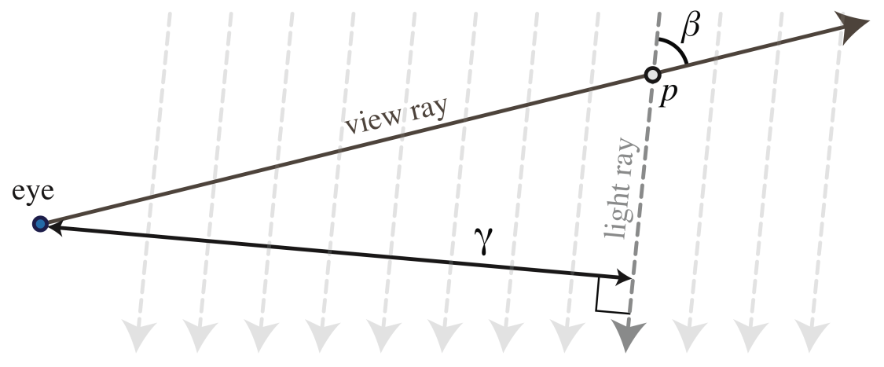
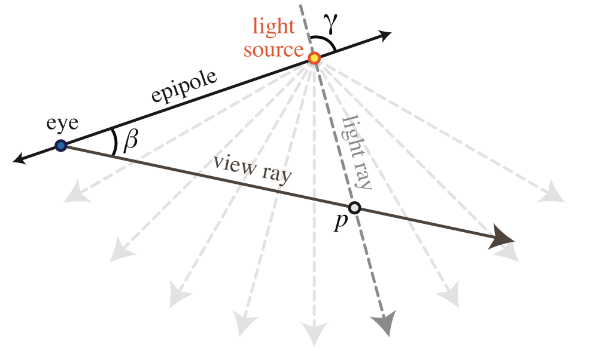
Epipolar coordinates
Directional light
Point light
Notes:
within an epipolar slice, our method relies on being able to index light rays and view rays independently
we call these epipolar coordinates beta and gamma, which uniquely specifies a point within the slice
<use mouse pointer>
for a directional light, beta indexes over the view rays: it is the angle between a view ray and the unique light direction
gamma indexes over the light rays and measures the distance between the point and the eye
<animate>
For point lights, both beta and gamma are angles

Slide 35
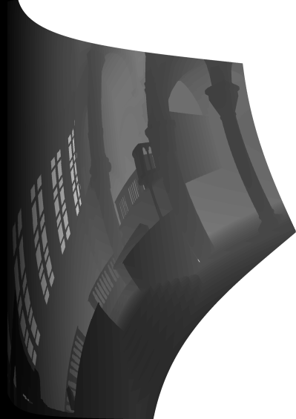
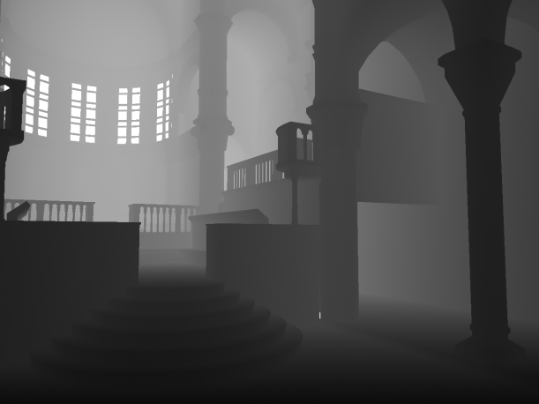
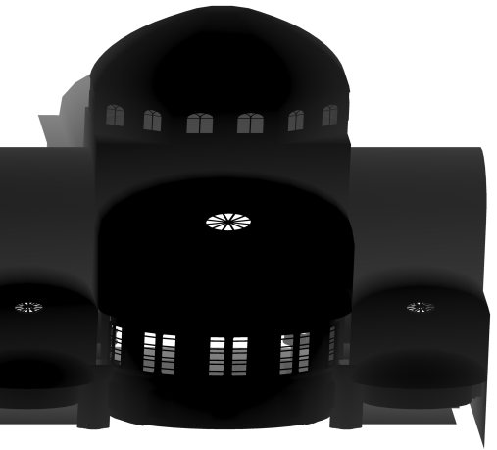
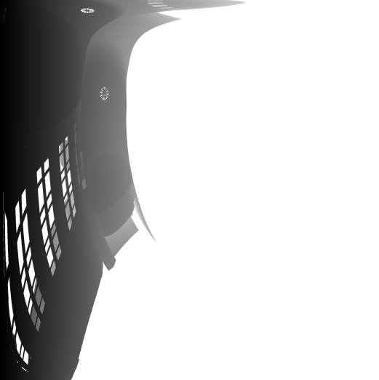
Depth map resampling
$$β$$
Camera depth map
Rectify
$$α$$
Corresponding epipolar slice
Light depth map
$$γ$$
Rectify
$$α$$
Notes:
In order for our incremental integration algorithm to process a slice,
We need to convert our input into epipolar coordinates
We call this process rectification
Notice that epipolar rectification is a nonlinear coordinate transformation
and cannot be directly rasterized.
instead, we render a standard depth map from both the camera and the light
and resample them into our epipolar coordinate system
We then obtain our integral in this rectified space
Since rectification is a change of variables,
it introduces a Jacobian to the integrand, which we bake into our SVD
and to get the final image, we do the inverse transformation
ok let’s take a look at some results

Slide 36
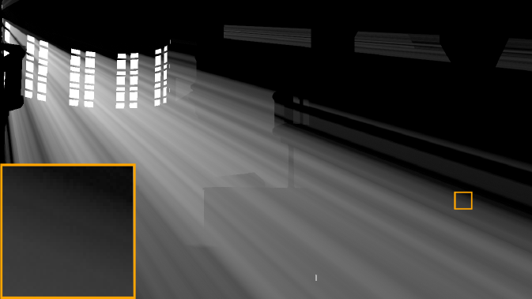
Equal quality comparison: Sibenik
Ray marching
Our method
169 sec
9.9 sec (17.1x)
Notes:
This is the Sibenik cathedral rendered on the CPU
For illustration, we’re only going to show the scattering component
So as to not distract you with direct lighting
compared to brute force ray marching, at equal quality,
our algorithm is about 17 times faster

Slide 37
Equal quality comparison: Terrain
Ray marching
Our method
54 sec
1.3 sec (41.5x)
Notes:
this is large scale outdoor terrain scene with 2 million triangles that our method renders in 1.3 seconds
at equal quality, we’re about 41 times faster than ray marching

Slide 38
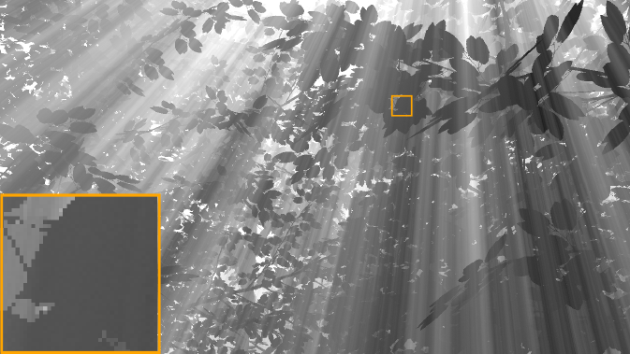
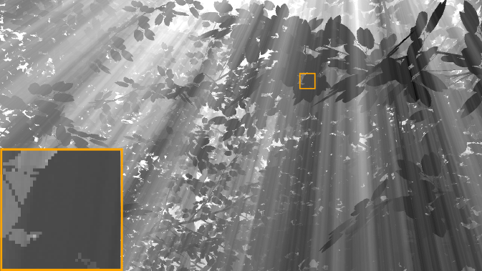
Equal quality comparisons: Trees
Ray marching
Our method
277 sec
2.3 sec (120.4x)
Notes:
and finally, we have a complex forest scene
where our method gets a very large speedup over ray marching
We also implemented our method using CUDA on the GPU
here’s a video of the Sibenik and Forest sequences

Slide 39
Notes:
This video shows the Sibenik scene in motion
Notice that our technique does not exhibit any temporal aliasing
when both the camera and light are in motion
And this is our forest scene
our technique does not require any precomputaion,
which allows us to handle dynamic geometry
- It also makes a nice screen saver

Slide 40
GPU Performance on Sibenik
Notes:
We compared our GPU implementation to ray marching and
the epipolar sampling technique of Engelhardt and Dachsbacher on Sibenik
At equal quality, and a resolution of 1280 x 960,
our method is about three and a half times faster than ray marching and
one and a quarter times faster than the state of the art

Slide 41
GPU Performance on Trees
Notes:
on the forest scene,
we achieve larger speedups because the scene geometry is significantly more complex

Slide 42
Limitations and future work
Non-homogeneous media
All points in volume must be visited
SVD will have high rank
GPU performance
Dynamic data structure: limited parallelism
Bandwidth intensive
Requires CUDA, not suitable for consoles
Notes:
I’d like to conclude with a discussion on the limitations of our technique and future work
<animate>
One feature that we cannot handle is a non-homogeneous participating medium
Our algorithm works because it exploits the coherent visibility structure in the problem
with a non-homogeneous medium, we’d have to visit all the points in the 3d volume.
furthermore, for a complex medium like smoke, our SVD approximation will no longer be low rank
<animate>
Another limitation of our approach is that it can’t use the GPU to its full capacity
because we need to maintain a dynamic data structure
we are limited in the amount of parallelism we can extract
Moreover, our data structure is also quite bandwidth intensive since the tree
does not fit into the shared memory of current hardware.
although we were able to implement our algorithm on GPUs using CUDA,
the process was, let’s say, not too much fun
and will not work on current consoles

Slide 43
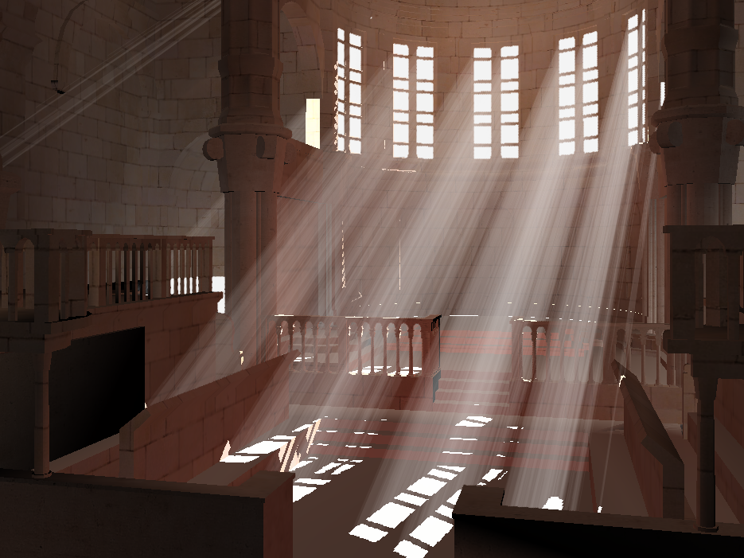
Summary
Hierarchical volumetric shadow algorithm with complexity guarantees
Significant speedups on CPUs
Moderately faster than state-of-the art on GPUs
Notes:
To summarize, we’ve presented a hierarchical volumetric shadow algorithm for single scattering
that’s asymptotically faster than ray marching
As a result, it features significant performance improvements on the CPU
and is moderately faster than the state of the art on the GPU

Slide 44
GPU Performance on Sibenik
Notes:
so this was the GPU performance plot on Sibenik that I showed earlier
Since our paper was submitted, Billeter and colleagues have developed a new
GPU technique using shadow volumes that outperforms our algorithm
<once more with feeling ☺>
However, since then, we’ve improved our method with a new data structure
that’s significantly faster and doesn’t require any GPGPU programming.
that paper will be presented in a few months at i3D.
That’s it. Thank you for your attention and I will take any questions.

