Slide 1
Laser Speckle Photography for Surface Tampering Detection
YiChang Shih Abe Davis Samuel W. Hasinoff, Frédo Durand William T. Freeman
Research Qualifying Exam presentation

Slide 2
Surface tampering detection
Before image

Slide 3
Surface tampering detection
Before image

Slide 4
Surface tampering detection
Before image
After image

Slide 5
Surface tampering detection
Before image
After image
Goal: detect the touched region

Slide 6
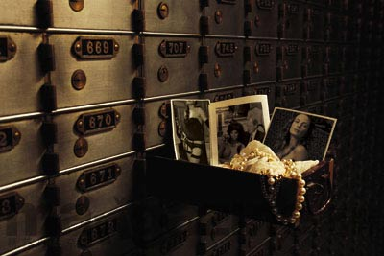
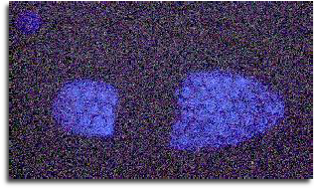
Security certification
Safe box
Footprint

Slide 7
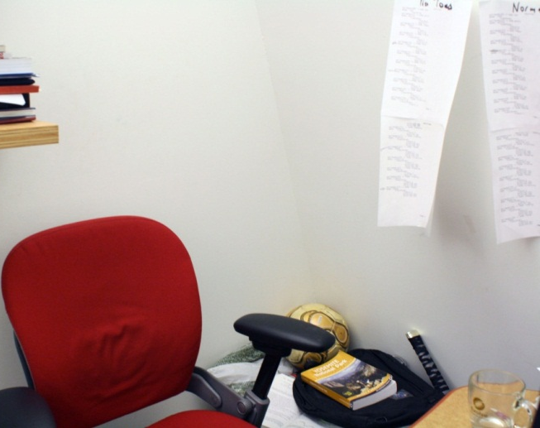
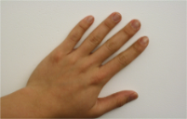
Challenging problem
The difference are minor and invisible
A lab wall (rock sheet)
Touched by hand
Difference between before and after images (scale to [0 1]), cannot see anything

Slide 8
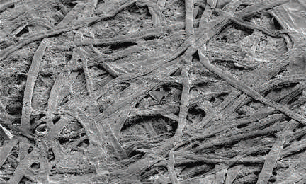
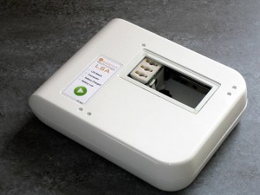
Related work: paper authentication
Certify whether the document is original [Pappu et al 2002][Buchanan et al 2005]
Use the micro-structure as signatures
Photographed by electronic microscope
Ingenia Techology
Notes:
Biggest limitation: only paper

Slide 9
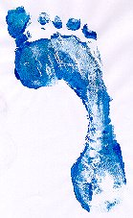
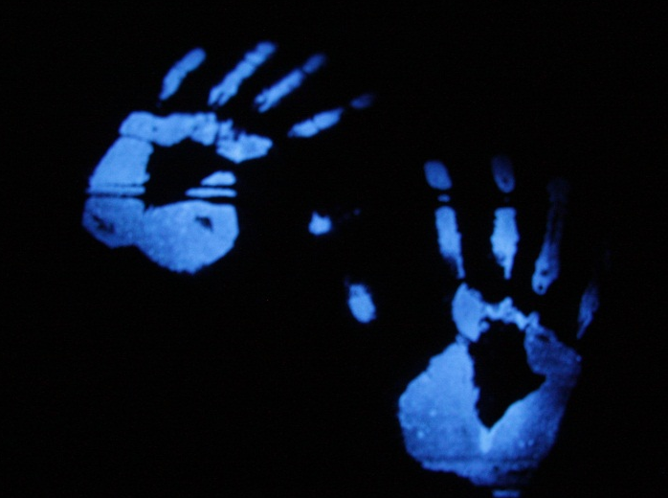
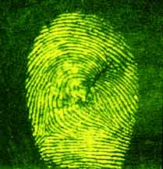
Related work: forensic technology
Rely on bio footprint, eg. blood, perspiration
Laborious works
Foot print
Luminol (blood)
Fingerprint powder

Slide 10
Problem statement
Input: before and after images
Output: the region that has been touched
Automatic, fast, work on various materials

Slide 11
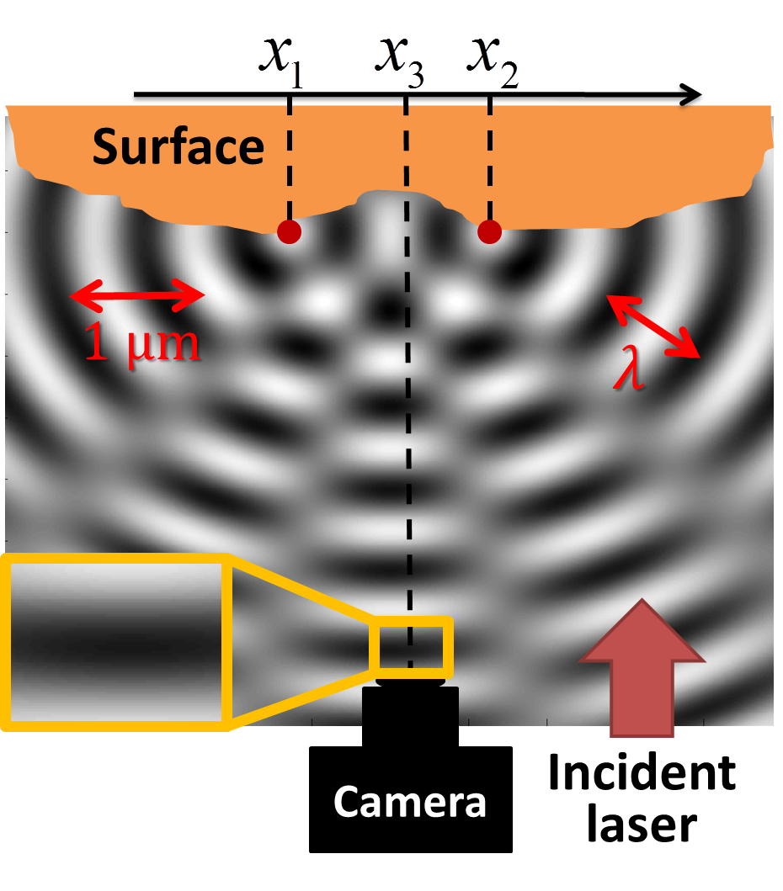
Key idea: laser speckle
Coherent light causes interference pattern

Slide 12
Laser speckle
The coherent light causes granular patterns
A lab wall
Without coherent light
With coherent light (laser speckle)
Notes:
Very different pattern

Slide 13
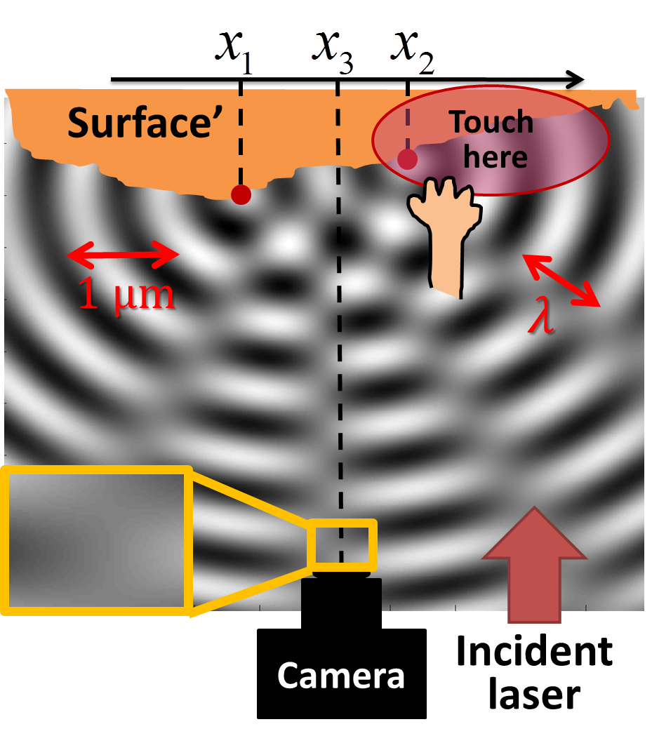
Tampering detection
Before touch the surface
After touch the surface, the interference patterns are changed

Slide 14
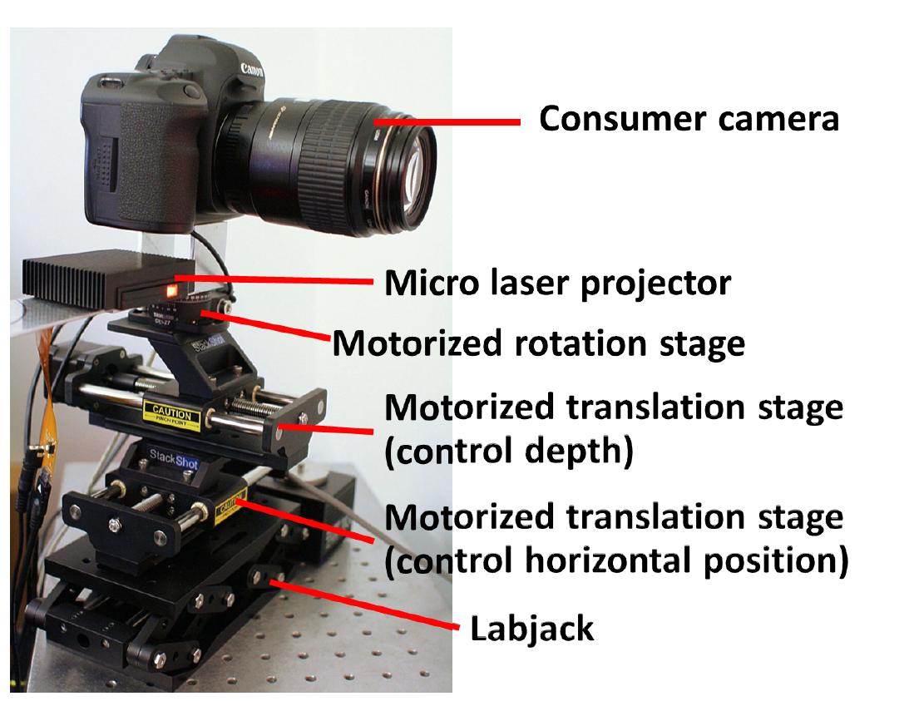
Hardware overview
Camera
Laser scanner
Controller
Notes:
- the relative position between camera and laser is fixed
- Can take out of the lab

Slide 15
Issues that need to be concerned
Compute the similarity map
Camera settings
Viewpoint alignment

Slide 16
Speckle formation
Two Fourier transform + low-pass filtering
Surface
Camera lens
CCD sensor

Slide 17
Speckle formation
Two Fourier transform + low-pass filtering
Fourier transform
Surface
Camera lens
CCD sensor

Slide 18
Speckle formation
Two Fourier transform + low-pass filtering
Low-pass filtering
Fourier transform
Surface
Camera lens
CCD sensor

Slide 19
Speckle formation
Two Fourier transform + low-pass filtering
Low-pass filtering
Fourier transform
Fourier transform
Surface
Camera lens
CCD sensor

Slide 20
Identifying the tampered regions
The speckle changes are local
We use normalized cross correlation (NCC)
Before (speckle image)
After
Similarity map by NCC

Slide 21
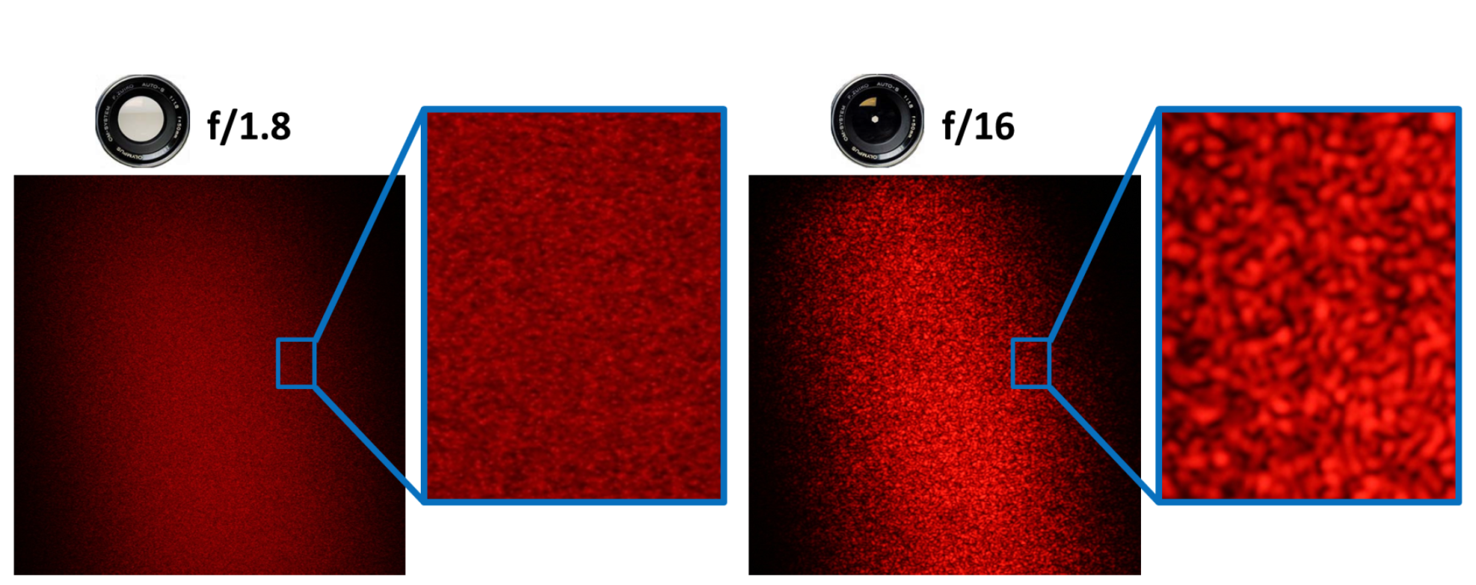
Camera settings
Aperture cannot be too large or too small
f/6.7 works best experimentally
Aperture too large: low contrast
Too small: no high-frequency, lost locality

Slide 22
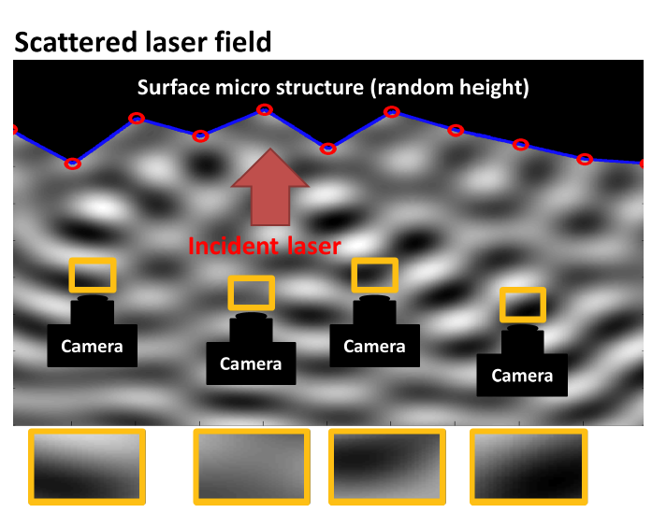
Viewpoint registration
Challenge: speckle is very sensitive to viewpoint change

Slide 23
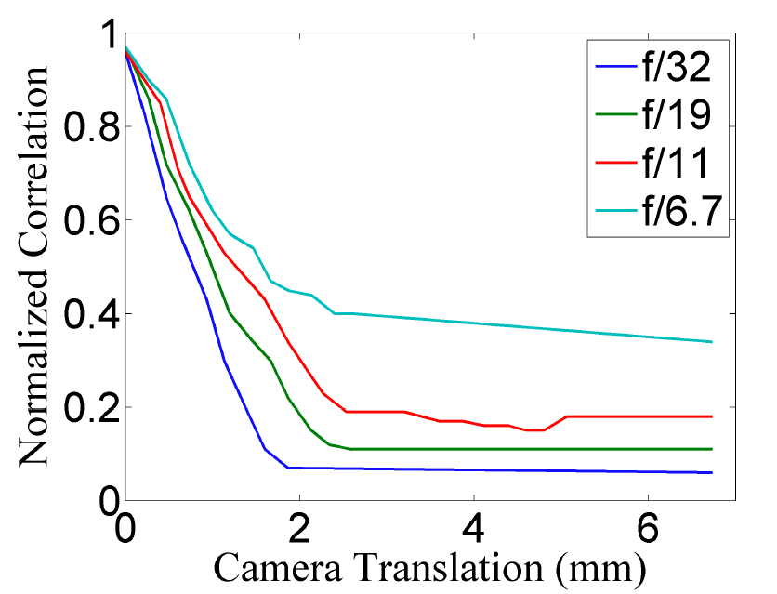
Very tight accuracy goal
Require the distance between the two viewpoints < 1mm
Notes:
No rephotography technique

Slide 24
Our approach: two-step alignment
Step 1: vision-based alignment - tolerance ~10 mm
Step 2: speckle-based alignment - tolerance < 1mm

Slide 25
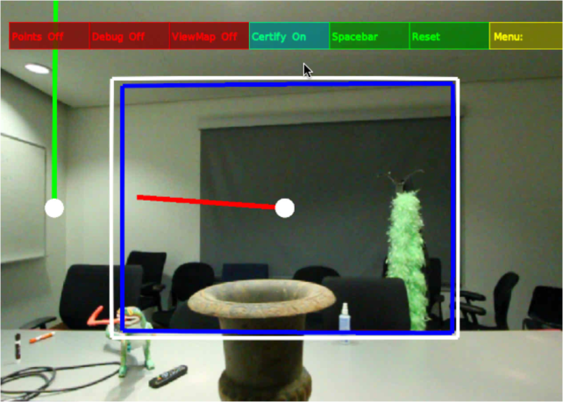
Coarse alignment by scene features
Based on parallel tracking and mapping (PTAM)
Feedbacks to guide user control
A few minutes to reach the viewpoint with 3mm accuracy
User interface
Notes:
Bundle adjustment and 3D mapping using patch feature

Slide 26
Fine alignment by speckles
Utilize the speckle sensitivity to viewpoint
Densely sample between [-5mm, 5mm]
Accurate to 0.5mm

Slide 27
Results
A lab wall
Touched by hand
Output: the touched region

Slide 28
Light-weight objects
A quarter on a card box (5.67g)
A card box
A quarter (5.67g)
Output: the detected tampered region

Slide 29
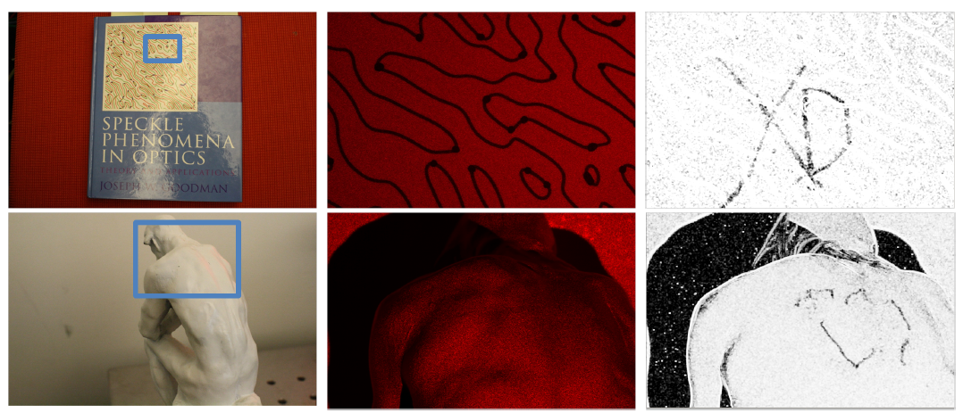
More materials
Book cover
A statue
Objects to detect
The speckle images
The detected tampering

Slide 30
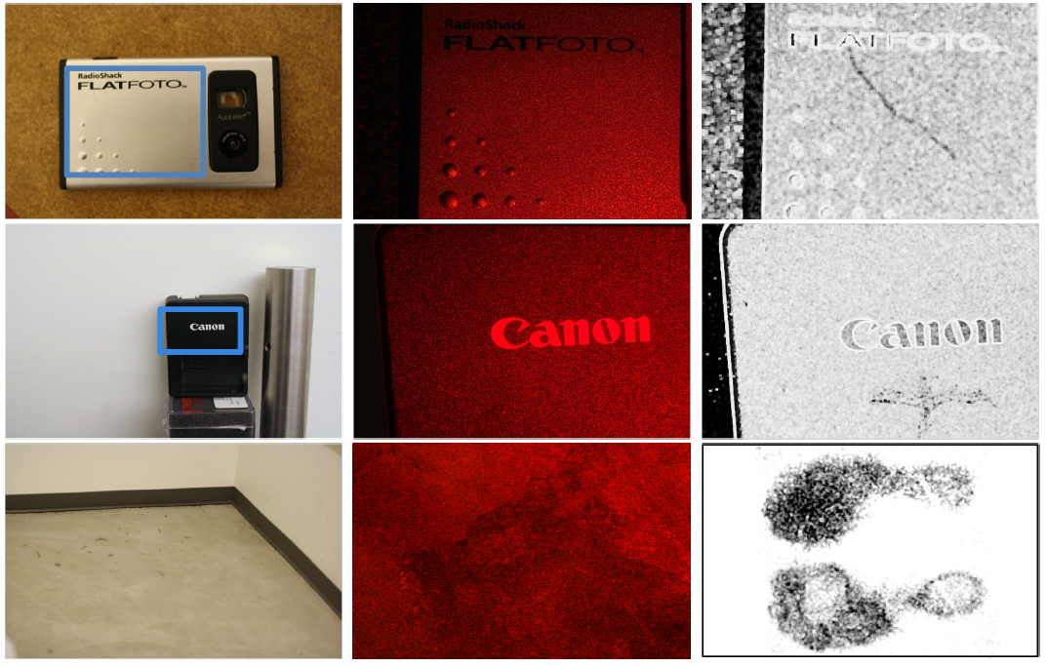
Metal case
Plastic case
Cement floor
Objects to detect
The speckle images
The detected tampering

Slide 31
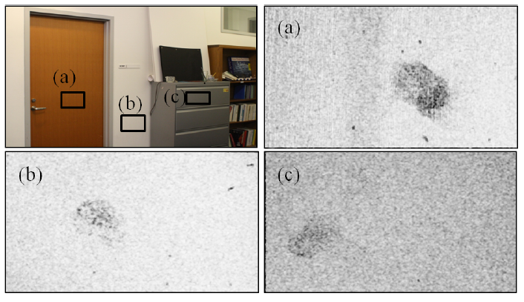
Indoor scene
Touched by a finger
Wood
Rock sheet
Metal

Slide 32
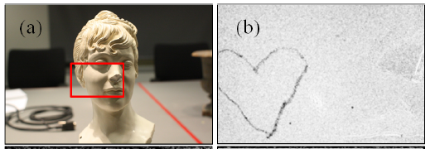
Curved surface
Objects to detect
The detected tampering

Slide 33
Textured surface
Objects to detect
The detected tampering

Slide 34
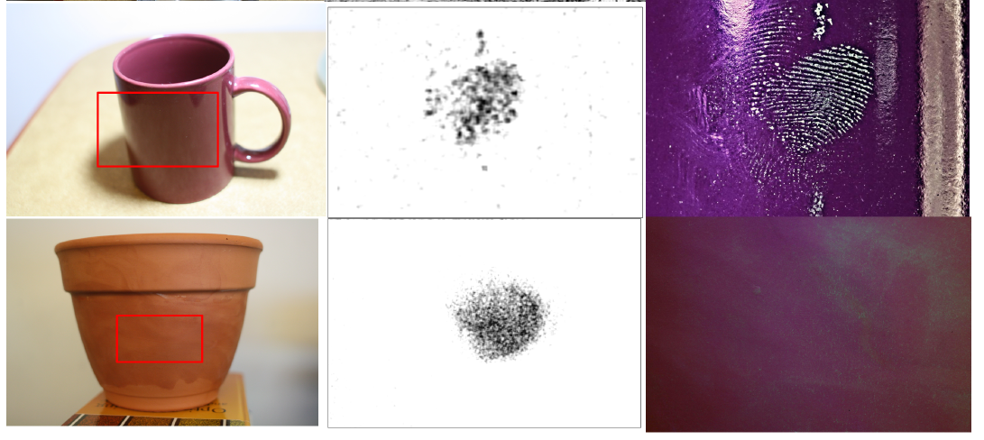
Comparisons to forensic techniques
Touched by a finger
Shiny surface
Rough surface
Objects to detect
Our speckle-based method
Fingerprint powder

Slide 35
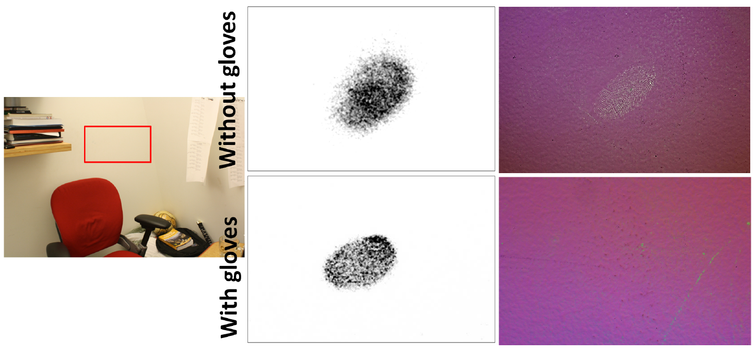
With gloves
Our speckle-based method
Fingerprint powder

Slide 36
Using the system
See the video!

Slide 37
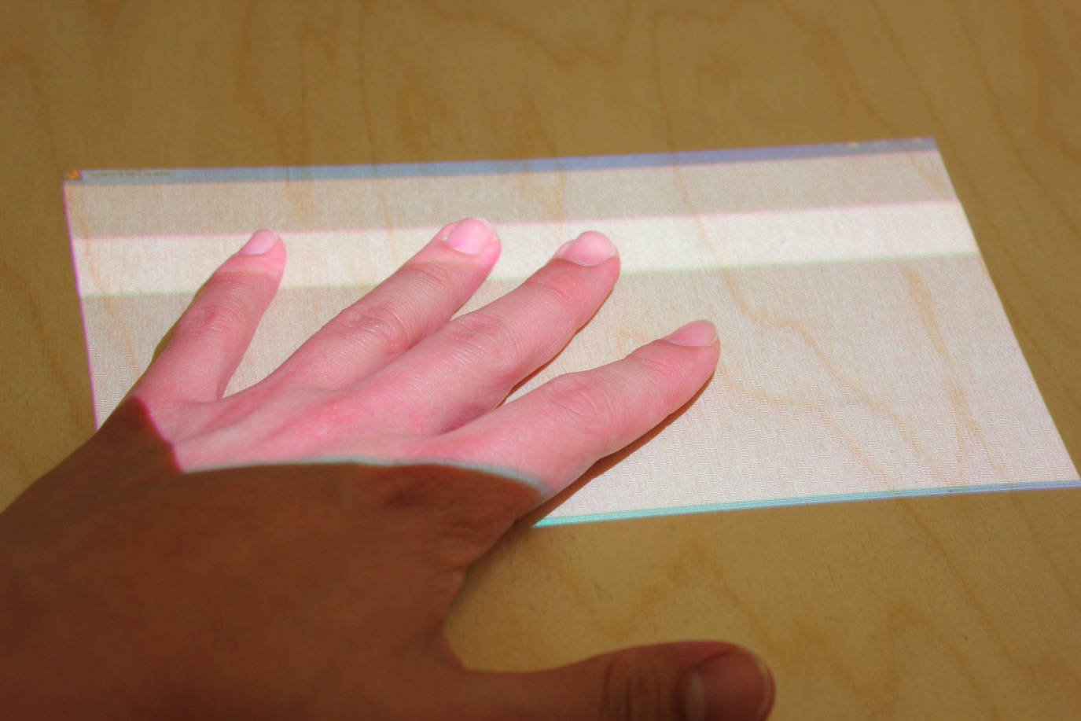
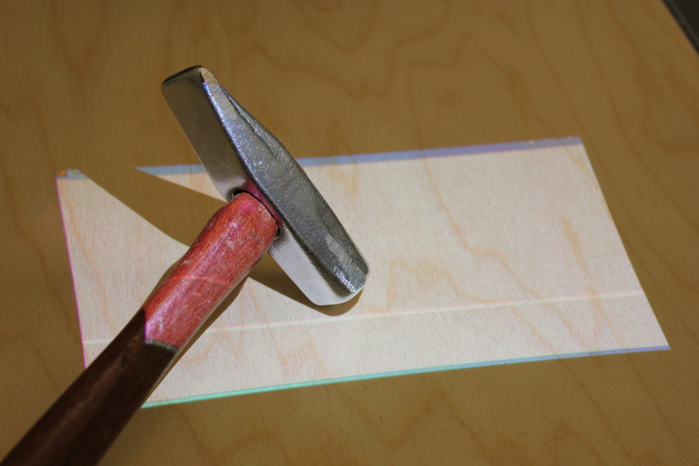
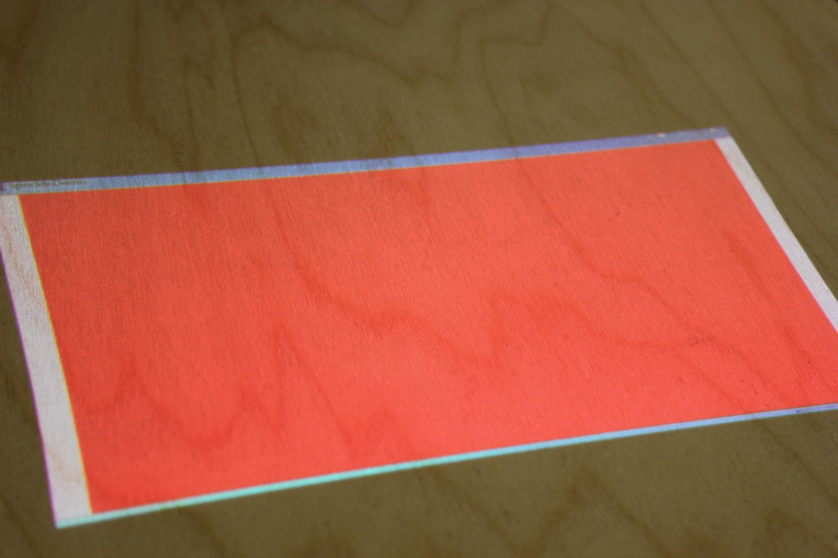
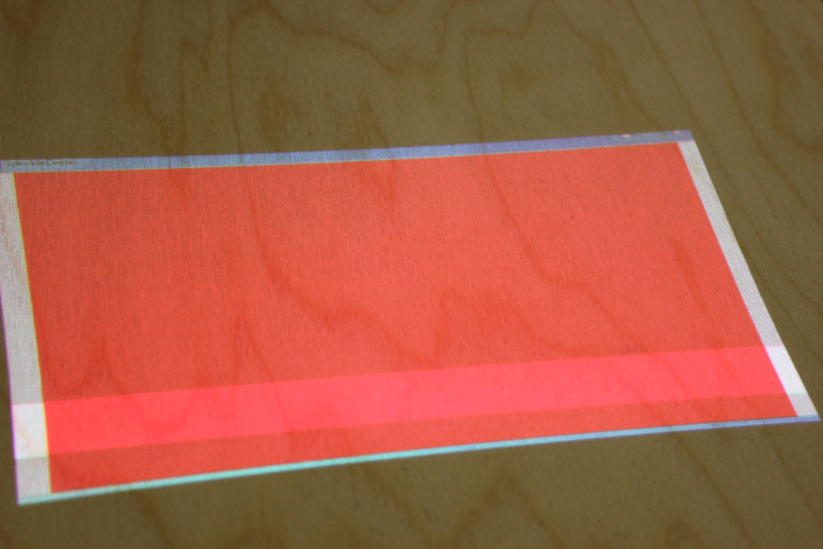
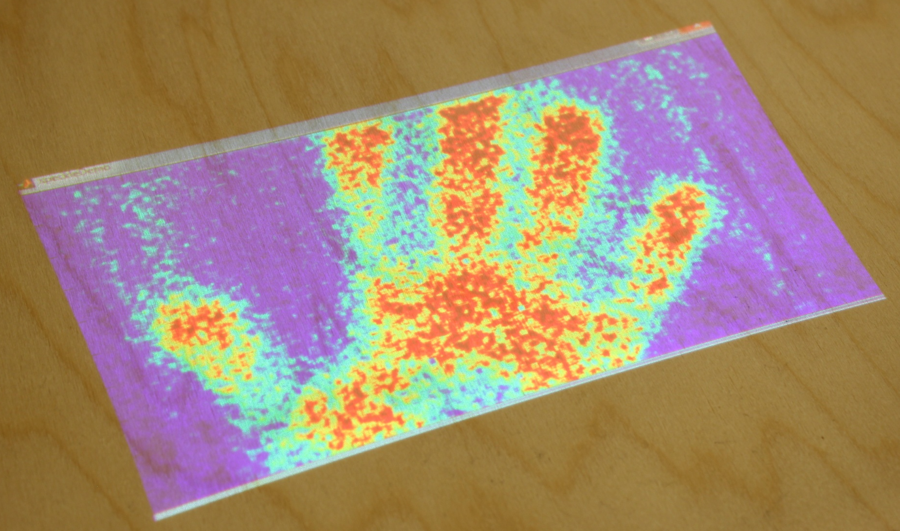
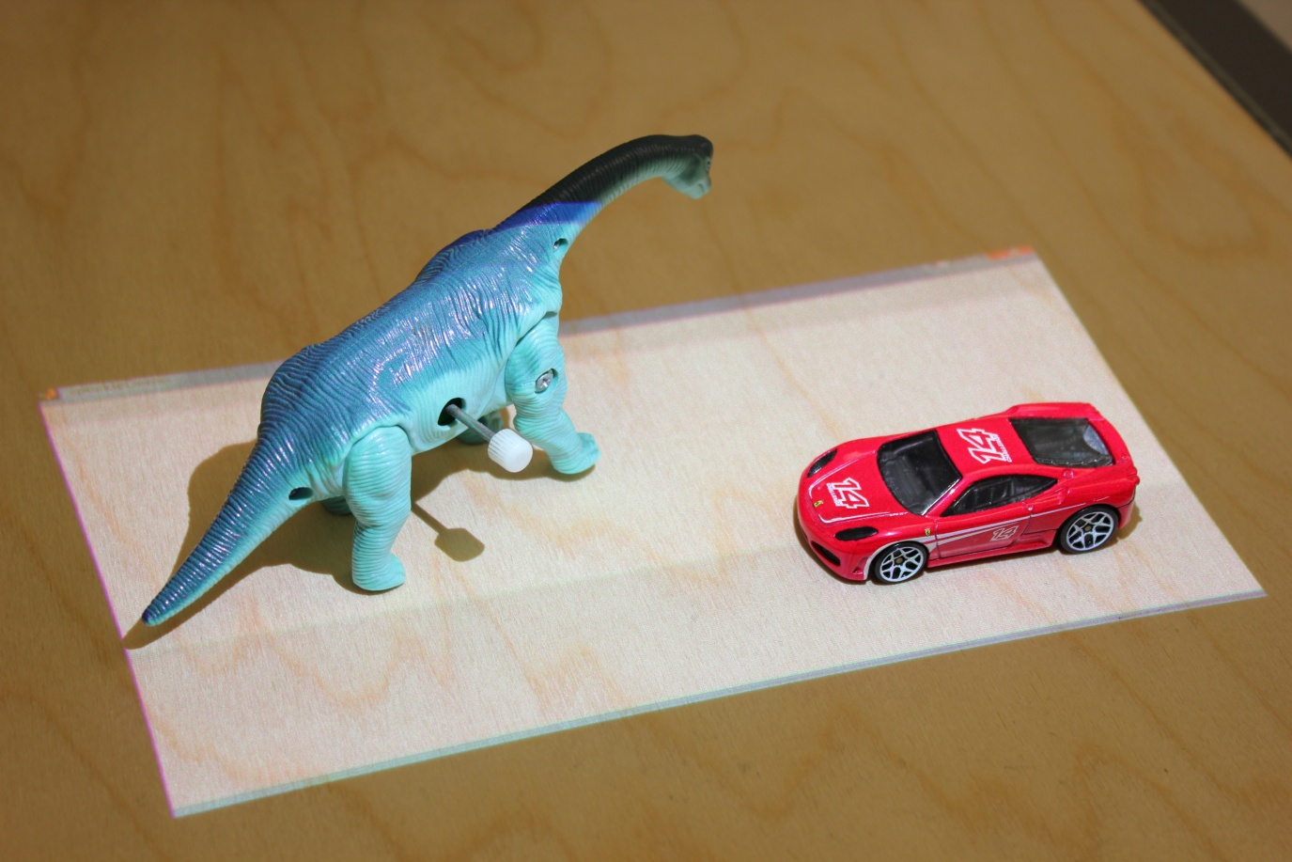
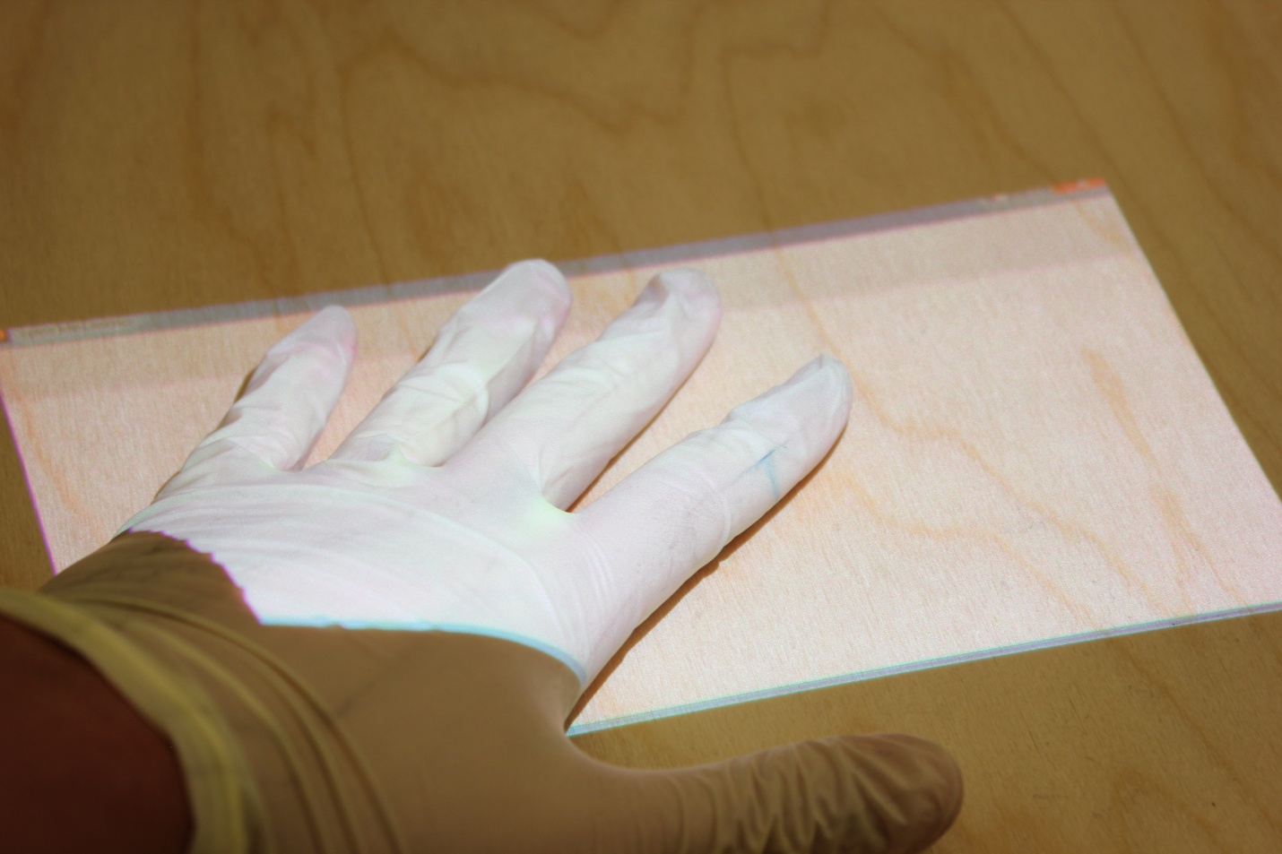
Demo at CVPR12
1
2
3
4
Take a reference
laser speckle image
Touch the surface
Take an “after” laser speckle image
Normalized correlation reveals the tampered area

Slide 38
Conclusion: seeing invisibles
Seeing the invincible difference between two images
Key idea: using laser speckle images
Viewpoint alignment with high accuracy
A lab wall
Touched by hand
Output: the touched region

Slide 39
Acknowledgements
We thank MicroVision for donation of equipment, and acknowledge gifts from Microsoft Research and Texas Instruments, and funding from NSF CGV No.1111415.

Slide 40
Conclusion: seeing invisibles
Seeing the invisible difference between two images
Key idea: using laser speckle images
Viewpoint alignment with high accuracy
A lab wall
Touched by hand
Output: the touched region

