Slide 1


Light Field Reconstruction Using Sparsity in the Continuous Fourier Domain
Lixin Shi
Haitham Hassanieh
Abe Davis
Dina Katabi
Fredo Durand
Notes:
Hi I’m Abe Davis and today we’re going to talk to you about
light fields and sparsity in the fourier domain
///
Hi I’m Abe Davis and today Haitham //HA-SA-NI-E
And today we’ll be telling you about light field reconstruction using sparsity in the continuous fourier domain
----- Meeting Notes (8/12/15 14:31) -----
put MIT/CSAIL somewhere

Slide 2
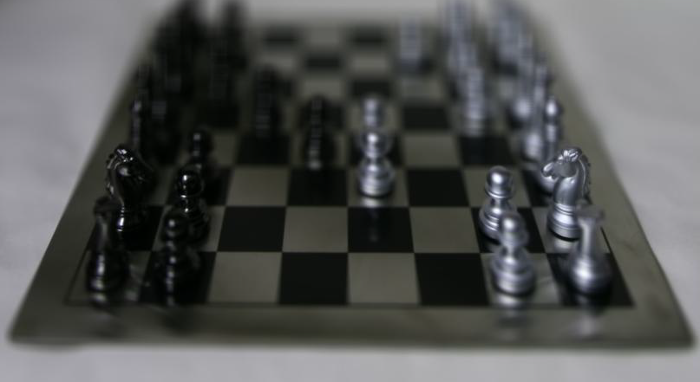
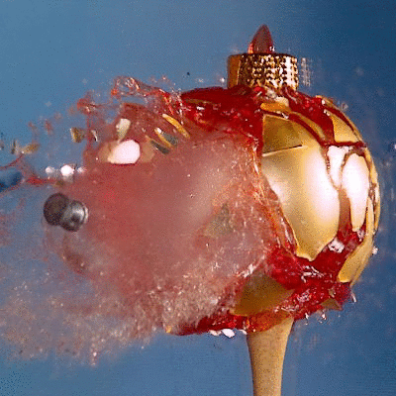
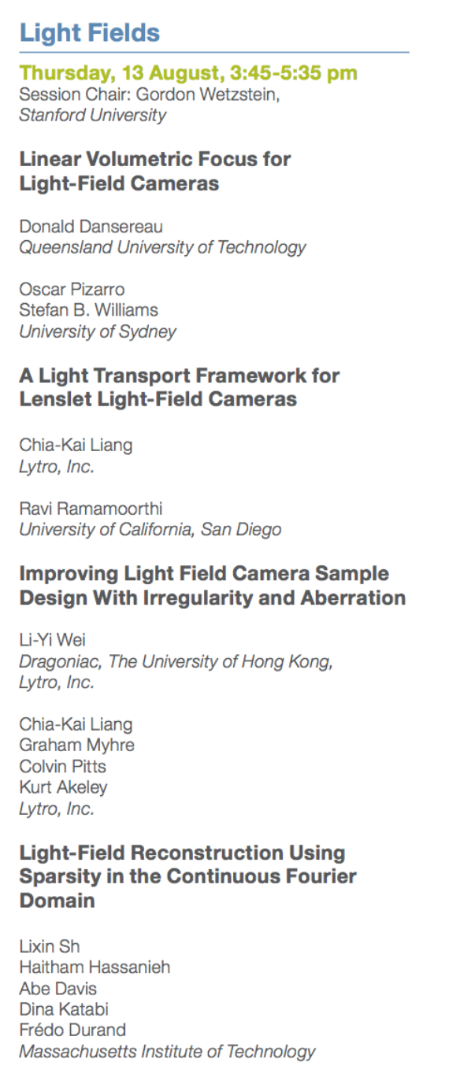

Light Fields Are Cool
4D!
Refocusing
Free viewpoint
Notes:
So light fields provide a very rich representation of a scene
That lets us do things like *refocusing and *viewpoint synthesis,
And this is especially relevant today as
*virtual reality is starting to get really compelling
But this is the
*fourth talk in a session that is CALLED “Light fields”
So I’ll assume that you’re all pretty much SOLD on their MERITS at this point

Slide 3
What we do
The Challenge
Dense Array of Cameras
Reduced Number of Cameras
Notes:
The PROBLEM with light fields is that they contain
*lots of data, which makes them very EXPENSIVE to capture
So the goal of this paper is to REDUCE that cost,
*by recovering high quality light fields from just a fraction of the image data we would normally have to capture
//
*And in our experiments we reduce the amount of image data that need to be captured from order N^2 to order N, like you see here
But, in general, the limits of this reduction are data-dependent so it may be possible to push this reduction much further

Slide 4


What we do
Captured View
Synthesized View
Non-Lambertian Scenes
Our Technique:
Stereo Techniques:
Synthesized View of
Non-Lambertian Crystal Ball
Notes:
And what’s REALLY exciting about our work is that it’s VERY good at reconstructing Non-Lambertian scenes like this crystal ball here
*So we’re really addressing something that stereo techniques can’t handle
And we do this by leveraging the fact that light fields are
sparse in the fourier domain

Slide 5
Sparsity in the Fourier Domain
Fourier Transform
Light Field
Sparse Spectrum
Notes:
And that means if we look at a light field as a SIGNAL, and we take the
*FOURIER TRANSFORM of that signal
*Then it’s spectrum has only a SMALL number of nonzero frequencies
//////////////
And this property is significant because there is a lot of established theory on efficiently recovering signals that are sparse in the fourier domain

Slide 6
Sparsity in the Fourier Domain
Leverage Established Sparse Fourier Theory
Sparse Continuous Representation in the Frequency Domain
Fourier Transform
Light Field
Sparse Spectrum
Notes:
And this property is significant for two reasons
*First, it lets us leverage a lot of established theory on sparse recovery, and
*Second, it means we can represent our light field in the CONTINUOUS fourier domain
By storing the coefficients of a sparse number of continuous frequencies
And later in the talk we’ll see how this is really great for interpolation and extrapolation
So sparsity in the fourier domain is really significant
And people HAVE used it in the past to motivate THEORETICAL arguments about light fields
But to our knowledge ours is the first work to use it directly for reconstruction,

Slide 7


Sparsity in the Fourier Domain
Not Very Sparse
Discrete Spectrum of Real Light Field Data
Notes:
And this is PROBABLY because if you take a real light field and compute it’s Fourier Transform
*you tend to get a spectrum that looks like this
*which isn’t really sparse by traditional standards
And this is surprising, because it disagrees with pretty established theoretical arguments that say light field spectra should be sparse

Slide 8


Sparsity in the Fourier Domain
*Continuous*
Not Very Sparse
Our
Algorithm
Discrete Spectrum of Real Light Field Data
Recovered Continuous Light Field Spectrum
Notes:
So part of this paper is about sorting out this discrepancy between theory and practice
And what we found was that the established theory IS correct,
*but only in the CONTINUOUS fourier domain,
While CAPTURING a light field puts it in the discrete domain, where much of this natural sparsity is lost
Fortunately, we show that it is possible to recover this lost sparsity
*by optimizing for frequencies in the continuous fourier domain

Slide 9
Contributions
Theoretical
  Continuous vs Discrete Sparsity
  Reconstruction algorithm
Applied
  Recover non-Lambertian scenes from fewer views
  Light field extrapolation
  Viewpoint denoising
Notes:
So our theoretical contributions are this observation about
*sparsity in the continuous vs discrete fourier domains, and a
*reconstruction algorithm that recovers a sparse continuous representation of light fields in the frequency domain
And the *application of this theory is
*A practical way to reconstruct non-lambertian scenes from fewer images
That also gives us a way to do
*light field extrapolation,
*And viewpoint denoising
Which Haitham will show later in the talk

Slide 10

Don’t Fear the Fourier
Fourier Transform
Notes:
Now, this work does have a little more fourier analysis than your average SIGGRAPH paper
But don’t be scared if you don’t come from a signal processing background
*If you just think of the fourier tranform as a black box, you should still be able to follow most of this talk

Slide 11
Don’t Fear the Fourier
Continuous Fourier Domain
Discrete Fourier Domain
Notes:
The important thing to understand is that
*the continuous fourier domain
*and the discrete fourier domain are different
And even if you don’t understand where these differences come from, you should hopefully be able to follow our explanations of why these differences are important

Slide 12
Overview
Prior Work
Continuous vs. Discrete Sparsity
Algorithm and Results
Notes:
So for the rest of this talk I’ll start by going over some
*prior work related to light fields and sparse recovery
*Then we’ll show what happens to the sparsity of light fields when we go from the continuous to discrete domain
*And at the end of the talk, Haitham will describe our algorithm, and show how it works on real data
*So let’s start by talking about light field priors for reconstruction

Slide 13


Prior work
Lambertian Prior
Notes:
The simplest and most common prior for reconstructing light fields is a Lambertian Prior.
*Which says that the world is made of
diffuse surfaces that
*appear the same from every angle
And this prior is part of pretty much anything that uses multiview stereo,
Because it’s an implicit assumption of photoconsistancy
///Of course, things are almost never entirely Lambertian,
///And things like specularity and transparency play an important role in our perception of a scene
So if we
So what
/////////
*Levin and Durand showed that a Lambertian prior corresponds to an assumption that
*the energy of a light field should be restricted to a particular subspace in the Fourier domain.
Now, people have used sparsity in the Fourier domain to motivate theoretical arguments about light fields for a long time
*But most work on light field reconstruction makes the stricter assumption of lambertian reflectance
And this assumption is really powerful, but it leads to a lot of errors in specular or transparent scenes
*Levin and durand 2010 describe how a lambertian prior can be formulated in the frequency domain to reconstruct scenes with unknown depth
Like them, we also operated in the frequency domain, but our prior on over that domain is more general, allowing for non-lambertian reflectance
*Finally, the work of Marwah et al 2013 also leverages a kind of sparsity for reconstruction, but tries to learn a basis for this sparsity from training data.
Here you can see the advantage of our approach being the use of an infinite continuous fourier basis, which allows for a kind of superresolution reconstruction in the frequency domain.

Slide 14
Prior work
Lambertian Prior
All energy must be in this Fourier subspace
Fourier Subspace
“Dimensionality gap”
[Levin and Durand 2010]
Frequency Domain
Notes:
Now, Levin and Durand showed that in the Fourier domain, this Lambertian prior corresponds to the assumption that
*the energy of a light field is restricted to a particular subspace

Slide 15
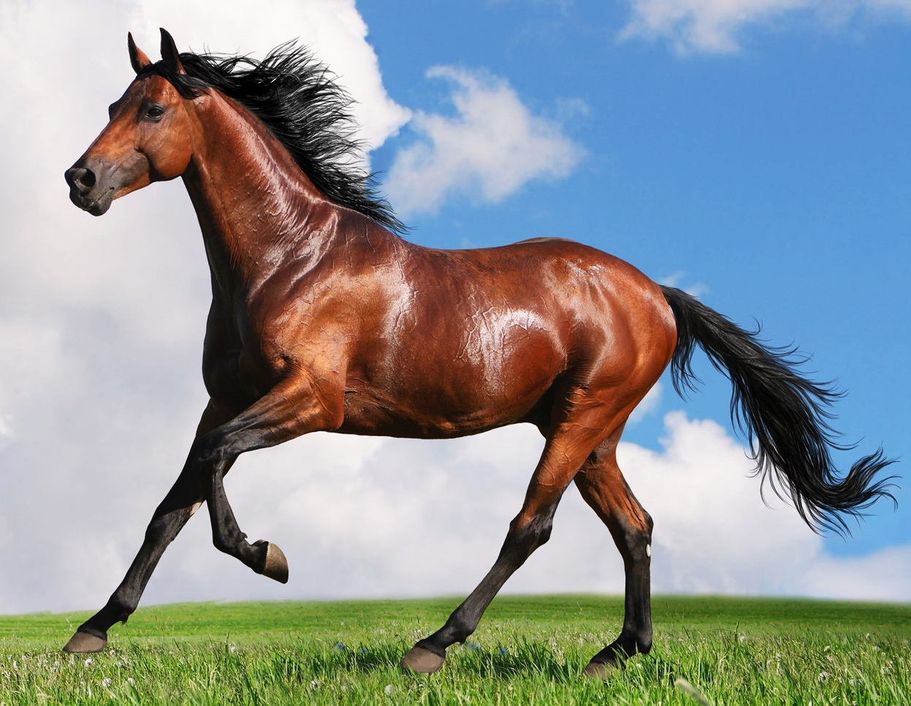

Prior work
The world is not entirely Lambertian
Fourier Subspace
Frequency Domain
Notes:
Of course, the real world is not entirely Lambertian,
*So real light fields tend to poke out of this lambertian subspace,
and things like *specularity and *transparency play a big role in our perception of a scene
So it’s important that we account for them in our reconstruction

Slide 16
Prior work
Sparsity
Energy can be anywhere…
…just not in too many places
Frequency Domain
Notes:
So WE do this by using a sparse prior
*Which says that energy can be anywhere in the frequency domain
*just not in too many places at once
So most of our spectrum is still empty in this case, which is why we can still recover it efficeintly,

Slide 17
Prior work
Sparsity
[Marwah et al. 2013]
(Learned Dictionary)
Notes:
Now the concept of sparsity WAS used for light field reconstruction by Marwah et al in 2013
But they leveraged a DIFFERENT kind of sparsity in a
*finite learned dictionary
So the advantage of our work is that the continuous fourier domain implicitly provides an infinite basis
which is really nice for interpolation, and especially extrapolation
as Haitham will show later in the talk

Slide 18
Prior work
Sparsity
Find locations of peaks
Notes:
So again, sparsity in the frequency domain is a very general and very powerful proir,
*but it does leave us with the aditional task of figuring out WHERE our energy is in the fourier domain

Slide 19
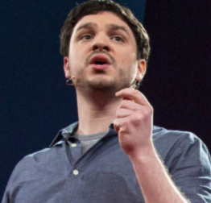
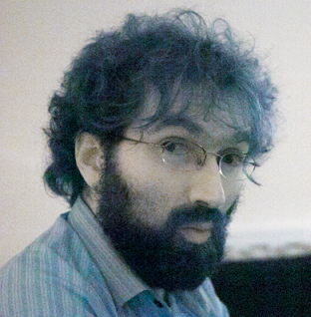
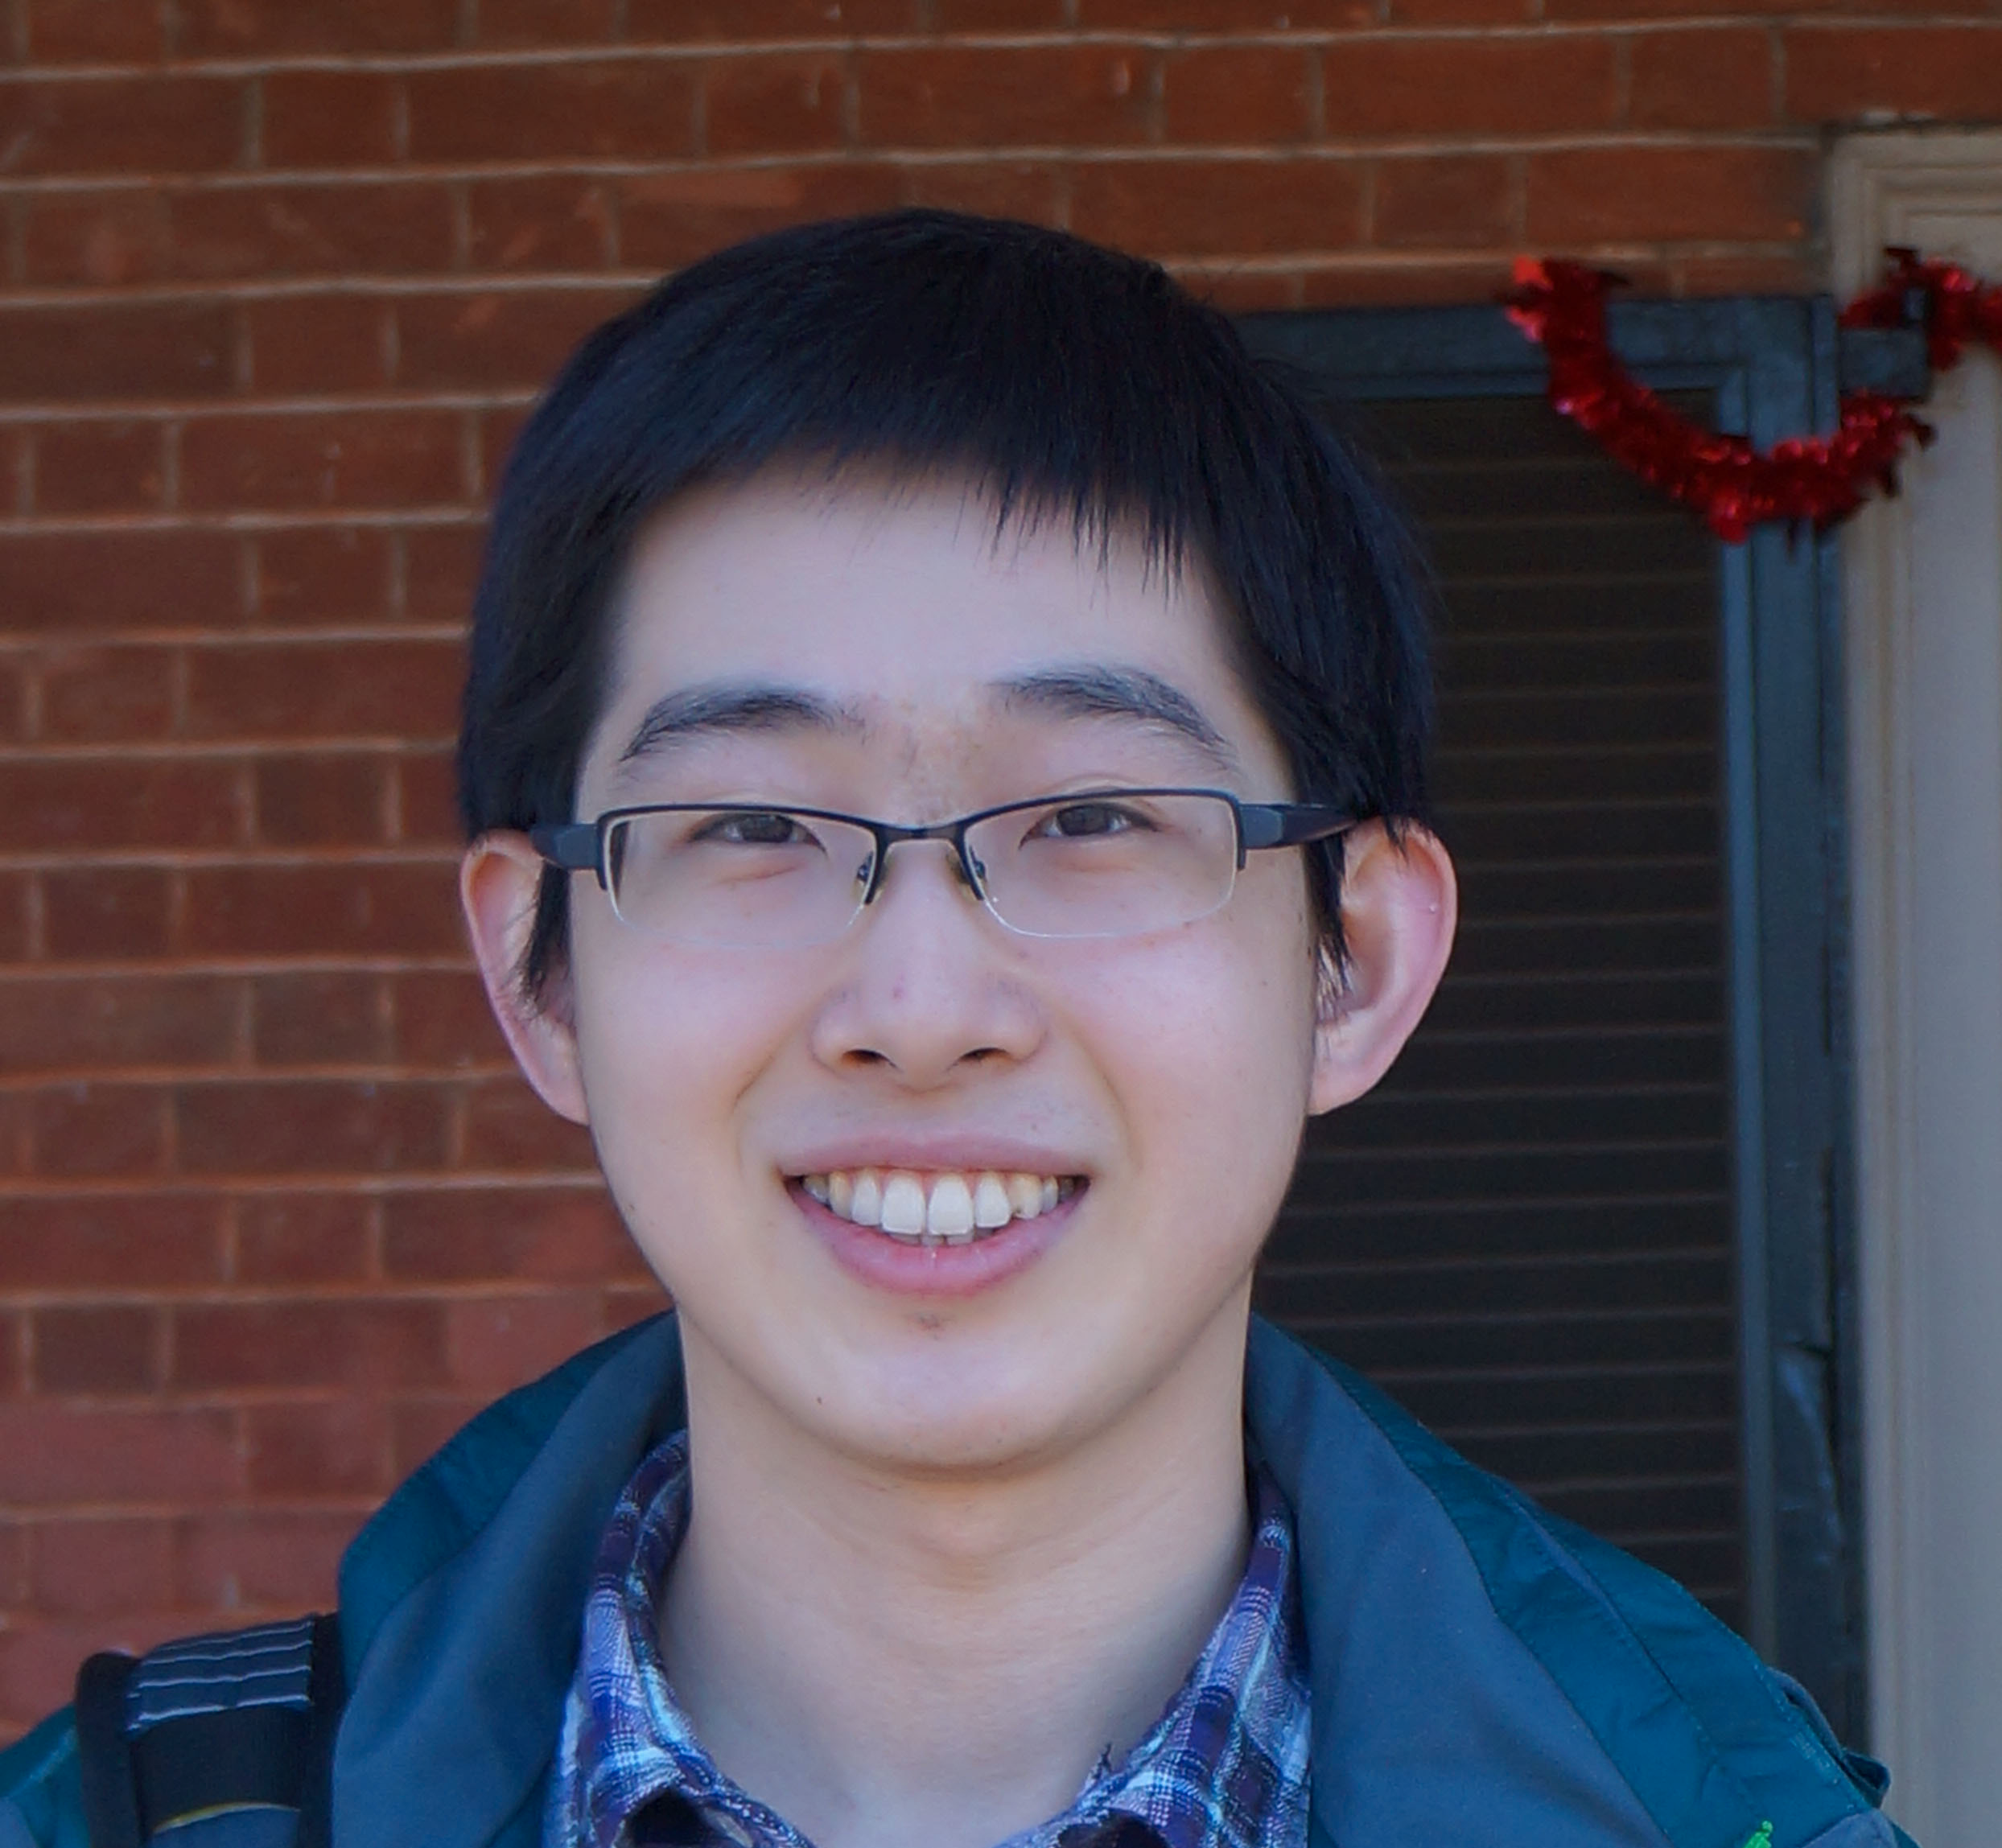
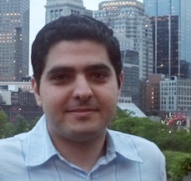
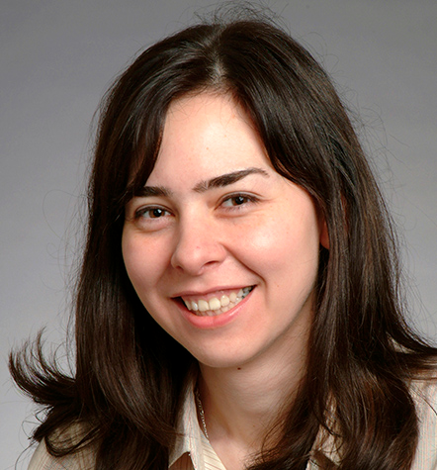
Prior Work
Sparse Recovery
  Compressive Sensing [Candès et al.’06, Donoho’06, …]
  Sparse Fourier Transform [Hassanieh et al.’12, Indyk et al.’14, …]
Fredo Durand
Haitham Hassanieh
Dina Katabi
Abe Davis
Lixin Shi
Notes:
Fortunately, there is some pretty established theory on sparse recovery
*Compressive sensing is probably the the most well-know example
But a more recent technique that’s even more relevant to our work is
*the Sparse Fourier Transform
Which is especially good at finding sparse frequencies in the fourier domain
And in fact this paper is a collaboration between
*two people in graphics
*And three experts on sparse recovery
So we started with high hopes that this would be a simple case of applying their theory to our application
///
Add me and fredo
Label, graphics sparse fourier

Slide 20
Overview
Prior Work
Continuous vs. Discrete Sparsity
Algorithm and Results
Notes:
but things ended up being a little more complicated than that
*And the reason is this difference between the sparsity of continuous and discrete light field spectra

Slide 21
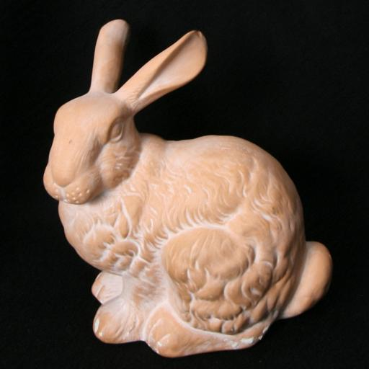
Traditional Sparse Recovery
Stanford Bunny Light Field
(example image)
Used Viewpoints
Captured Viewpoints
Notes:
Now we didn’t know this would be an issue at first,
so we started by seeing if we could approach light field reconstruction as a general sparse recovery problem
*we took this simple, Lambertian light field of the Stanford bunny,
*we threw out most of the images in the dataset
And we tried to recover the missing views using different established techniques
////
Takeaway point
And labels
///
We started with the assumption that we could take the standard theory on sparse recovery and apply it to light fields

Slide 22
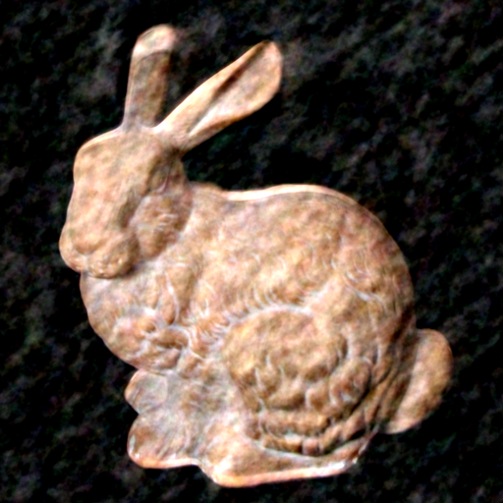
Traditional Sparse Recovery
Ugly Bunny
Let’s reconstruct this view
Sparse Recovery
Stanford Bunny Light Field
(Example Image)
Captured Viewpoints
Notes:
But when we started reconstructing missing views,
*we got a bunch of results that looked like this
Which still kind of looks like a bunny
*but not a very attractive one
So after getting a bunch of these results we decided to reexamine our assumptions
//
We picked the state of the art in this area, the sparse fourier transform
Which is particularly suited for signals that are sparse in the f domain/our signal

Slide 23
Light Field Spectrum
“Peaky”
But not sparse
u
ωu
ωv
DFT of full light field
v
Notes:
So we took the full captured light field of our bunny,
*and we computed it’s Fourier transform so that we could look at the supposedly sparse signal we were trying to recover
And if you look at the spectrum here, you find it’s not really all that sparse
*It’s peaky, but there are a lot of nonzero frequencies
And not only does this interfere with established algorithms for sparse recovery,
It also contradicts what we’ve been saying about light fields for decades
-which is that they’re sparse in the frequency domain

Slide 24
Continuous vs Discrete Fourier
Theory
Sparsity derived in continuous Fourier domain
Practice
Captured light field spectra are discrete
Notes:
So now we had this discrepancy between our
*theory, which said that the light field should be sparse, And
*real data, which wasn’t sparse
And the critical difference we found was that
*theoretical arguments for the sparsity of light fields are made in the continuous frequency domain
*But the process of capturing a light field implicitly puts it in the discrete domain

Slide 25
Continuous vs Discrete Fourier
Capture
(Discretization)
Our
Algorithm
Continuous Light Field Spectrum
Discrete Light Field Spectrum
Notes:
So now I’ll explain how the process of discretization affects sparsity
then I’ll hand things over to Haitham
*who will explain how our algorithm recovers the original sparsity of the continuous spectrum
///
And indeed it turns out that light fields are sparse in the continuous domain,
*but the discretization that happens when we capture a light field kills that sparsity
So now let’s take a look at why that is

Slide 26
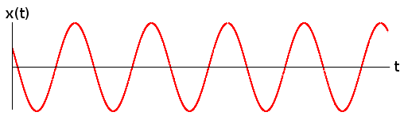
From Continuous to discrete
Sum of sinusoids
Notes:
Fourier analysis tells us that we can decompose our signal into a linear combination of sinusoids
So in a light field, these sinusoids are 4-dimensional
But the simplest way to understand what happens when we CAPTURE a light field
*is to look at what happens to a 1D slice of a single sinusoid

Slide 27
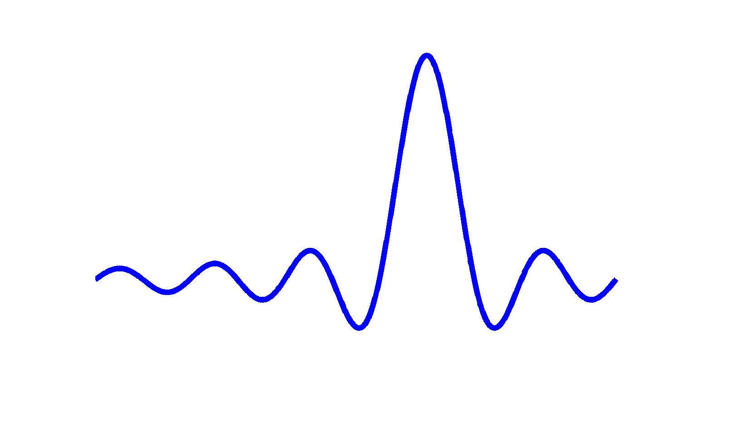
From Continuous to discrete
Window
Multiply by Box Window
Signal
Discrete Frequency
Convolve with Sinc Function
Continuous
Frequency
Notes:
So if we look at this one slice of our light field
*Then its continuous fourier transform is just a spike
*And there is an infinite space of possible views we could capture of this slice
But when we record a real light field,
*we sample over some finite window within this space
*And that essentially multiplies our light field by a box filter
*which convolves its FOURIER TRANSFORM by a sinc function
And this convolution
*blurs our spike over nearby frequencies,
And this already kills our sparsity in the continuous domain, but what makes matters even worse is that
*sampling puts us in the discrete domain, meaning not only have we lost our sparsity,
*but we’ve lost our ABILITY to represent the signal sparsely in this domain
///
Say light field is 4d, this is for illustration

Slide 28
Overview
Prior Work
Continuous vs. Discrete Sparsity
Algorithm and Results
Notes:
So we’ll get around this by optimizing for a sparsity in the continuous fourier domain, and I’ll turn things over to Haitham to explain how that works

Slide 29
Reconstruction
Algorithm
Algorithm
Sparse Continuous Frequencies in the 4D Spectrum
Invert
Back
Notes:
Ok So here is what we do,
--- Say this is the set of densely sampled viewpoints.
--- We are going to only use a few subsamples of this 2D array as input to our algorithm.
--- Now we chose these samples because they form a 1D trajectory but you can potentially use a different set of samples.
--- But we run our algorithm on these subsampled views and it will compute a sparse set of continuous frequencies in the 4D light field spectrum.
--- Now once we have the frequency representation of the 4D spectrum, we can invert it back to reconstruct all the missing viewpoints. And inverting back is actually pretty simple, you just sum the sinusoids of these continuous frequencies and evaluate them wherever you want to render a viewpoint image.
--But the hard part is the algorithm, how do we compute these sparse frequencies from a small set of input viewpoints.

Slide 30
Reconstruction
Continuous Frequency
Discrete Frequency
Optimization problem:
Minimize reconstruction error over a sparse set of continuous frequencies
Solve it using gradient descent
Notes:
And it is specially hard because we just established that frequency spectrum in the discrete domain is not that sparse.
Here I am showing you one dimension for simplicity but remember that all this is happening in 4 dimensions because light fields are 4D.
---Now if you think about it, all these values really come from a single frequency so if we can find that frequency in the continuous domain
---We can compute the sinc and recover all these values from just one frequency.
So let me explain to you at a very high level how the algorithm finds these continuous frequencies.
---we formulate the problem as an optimization problem where the goal is to minimize the reconstruction error as a function of a sparse set of continuous frequencies.
---And we solve this optimization problem using gradient descent. So the first question we need to answer is what is the objective function, how to compute this reconstruction error which we want to minimize subject to sparsity.

Slide 31
Reconstruction
2
Error
Gradient
Descent
Algorithm
Sparse Continuous Frequencies in the 4D Spectrum
Invert
Back
Notes:
Well I just told you here that once we find the continuous frequencies, we can invert back and recover the viewpoints.
--- Now out of these reconstructed viewpoints, we can take the ones that match our initial input. Then we can compute the
Reconstruction error as the difference between the input viewpoints and our reconstruction of these viewpoints.
And this is exactly the error that we want to minimize.
--- We run gradient descent and it will try to find the continuous frequencies that minimize this error.
The only remaining piece of the puzzle here is initialization, the gradient descent needs to start from some initial set of frequencies which it optimizes over. So how do we intialize?

Slide 32
Reconstruction
Sample
Fourier
Transform
Sparse Fourier
Discrete Frequency
Recovered Discrete Frequency
Notes:
---Well we know that the discrete Fourier transform of the densely sampled array is not that sparse
---So if we take our input samples and run a sparse Fourier transform on them, we will not get good results.
---However, it will still give us the large value which we can use as our initial input frequency to the gradient descent.
So we initialize the gradient descent with discrete frequencies and it will find their continuous positions.
Now it is good to note here that you can use any initialization you like and you can have a completely different sampling pattern as long as your initialization gives you good initial discrete positions of the continuous frequencies. The best case is that it rounds these continuous frequencies to the nearest grid point position.

Slide 33
Reconstruction
Algorithm
Sparse Continuous Frequencies in the 4D Spectrum
Invert
Back
Notes:
So to summarize, we take few input viewpoints, and we run our algorithm on them and it will generate these sparse continuous frequencies in the 4D. We then take these 4D sinusoids and sum them and evaluate them at the positions we want to reconstruct.
Of course there are much more details of the algorithm work and you can find all these in the paper. But for now let me show you what kind of results you get with this algorithm.

Slide 34
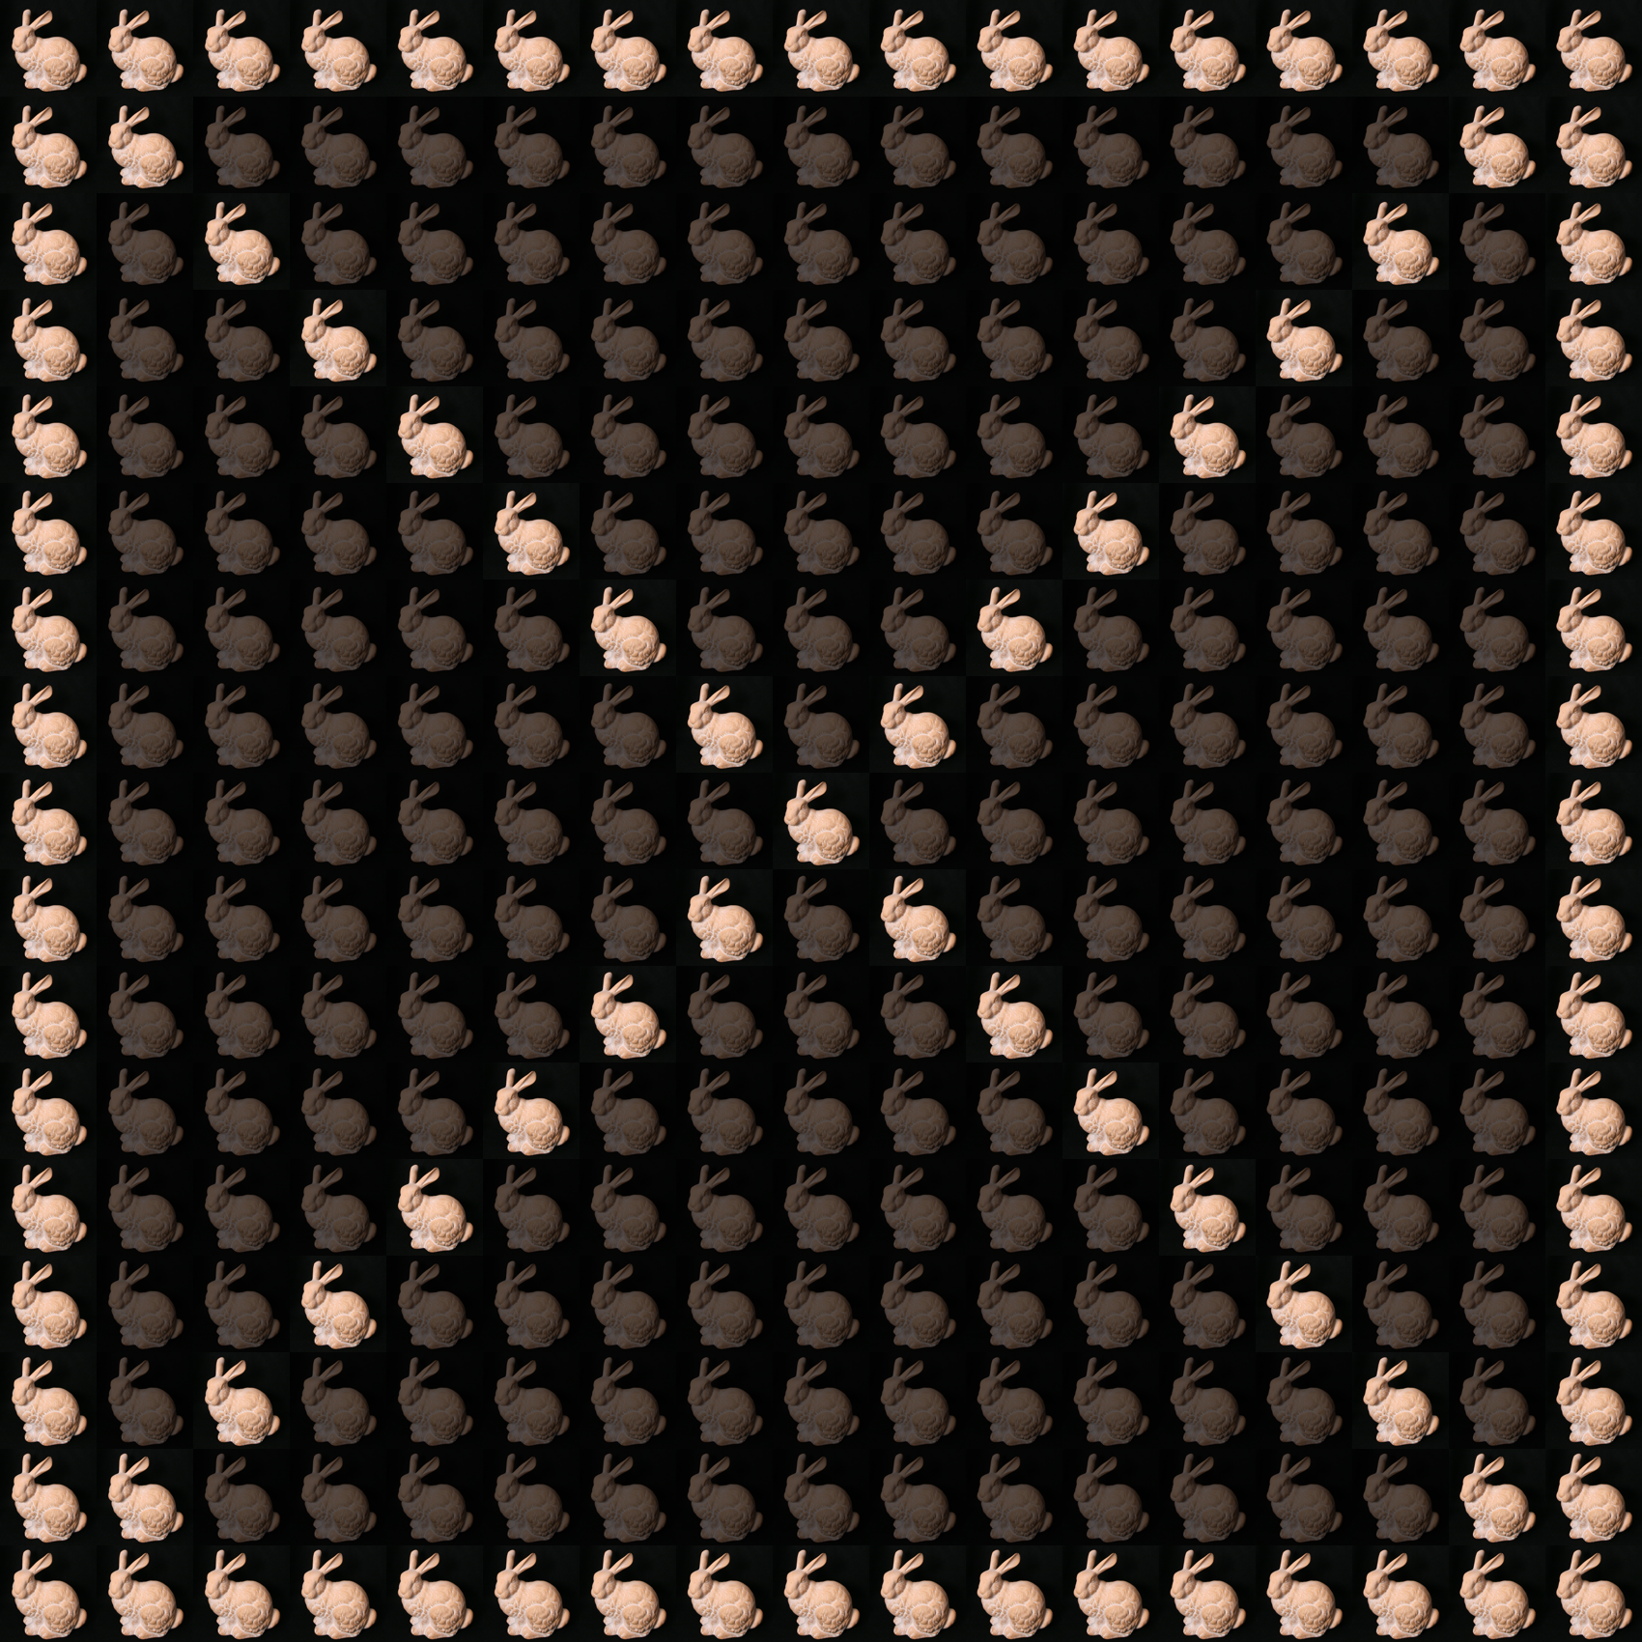
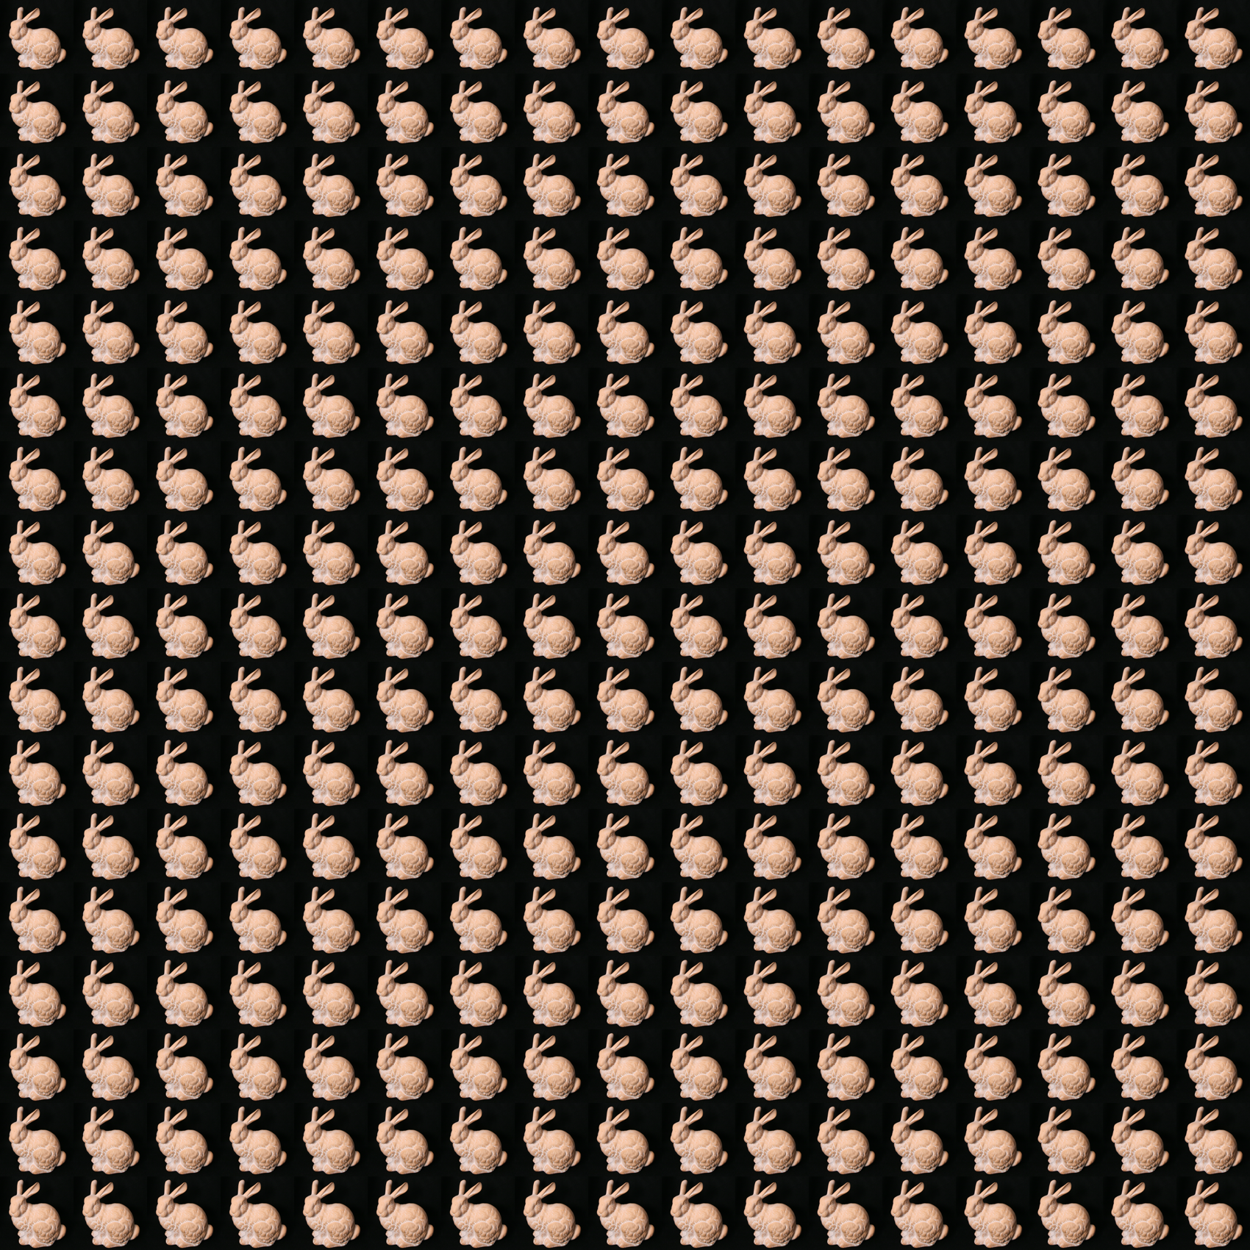
Reconstruction Results
Notes:
We ran our algorithm on standard data sets from the Stanford light field library. The data has a 17 by 17 array of dense viewpoints. We are going to take few of these viewpoints as input to our algorithm
--- In this case, we take the frame and diagonal as input. So all the viewpoints in between we do not have them and we are going to try to reconstruct them

Slide 35
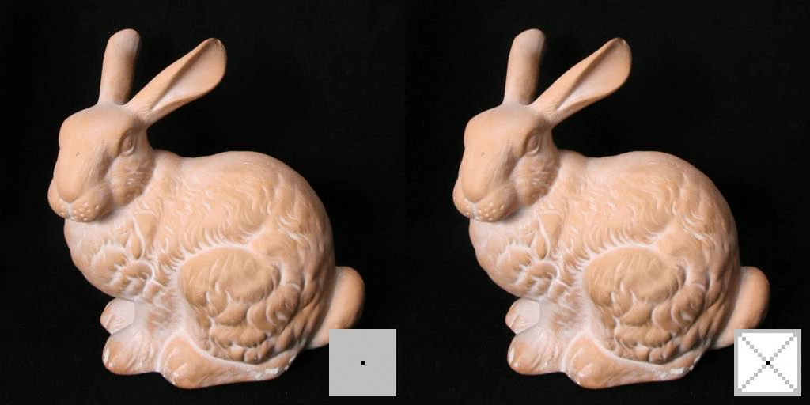
Original Captured Image
Our Reconstruction
Notes:
What I am going to show you here on the left you have the original images captured by the dense array and on the right you have our reconstruction of these images.
I am going to play through the different viewpoint so you can compare. The map on the bottom shows which viewpoint or angle we are looking at. The points in gray are viewpoints we already have and everything in white are viewpoints which we do not have and we reconstructed.
--- So here is the result, you can see that we achieve very good reconstruction of the missing images and we can do much better than simply applying sparse recovery.
… Ok this was a bit of an easy example because it was lambertian.

Slide 36
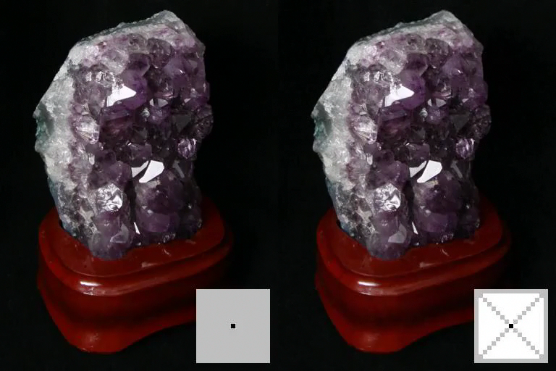
Original Captured Image
Reconstructed Image
Notes:
So let us take a non-lambertian example, this amethyst which has a lot of specularities and reflections. Again on the left you have the original and on the right you have our reconstruction. I am going to play through the different viewpoints and I want you to focus on the reflections and how they are changing.
--- You can see that we can reconstruct the specularities and reflections really well.

Slide 37
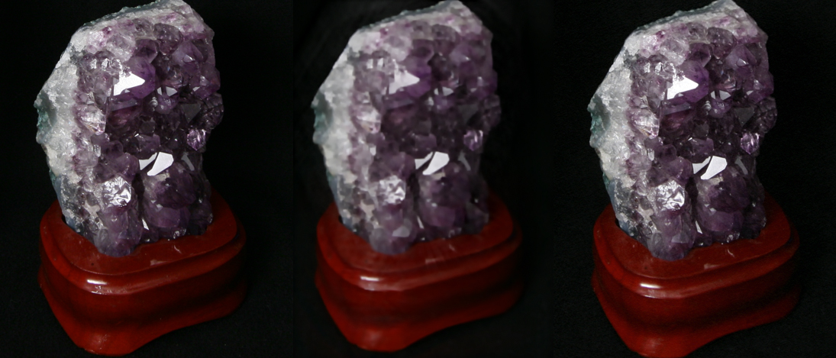
Comparison With Prior Work
Original Image
[Levin & Durand ’10]
Our Reconstruction
Notes:
So to compare this with prior work, here is one of the images which we reconstructed. On the left you have the original, in the middle we have the reconstruction by Levin and Durand and on the right our reconstruction. Now levin and durand assume the scene is lambertian and as a result they do not get a good reconstruction of this non-lambertian scene.

Slide 38
Comparison With Prior Work
Original Image
[Levin & Durand ’10]
Our Reconstruction
Notes:
To see it better, we can zoom in and you can see that because we do not assume Lambertian, we can reconstruct the specularities really well.

Slide 39

Original Captured Image
Our Reconstruction
Notes:
Ok now let us take an even hard example, this light field is highly non-lambertian and hard to reconstruct because it has the crystal ball, a big curved highly reflective surface.
--- Again here is our reconstruction results and you can see that we perform very good reconstruction.
So as you can see because we do not limit frequencies in our light field spectrum to lower dimensional subspace which means we do not assume lambertian, we can reconstruct this scene really well.

Slide 40

Focal Stack of Reconstructed Light Field
Notes:
And once we reconstruct the scene, we can compute the focal stack and refocus it to any depth we like.
So this is great but these are not the only benefits of our algorithm. Recovering the continuous frequencies allows us to do viewpoint denoising.

Slide 41
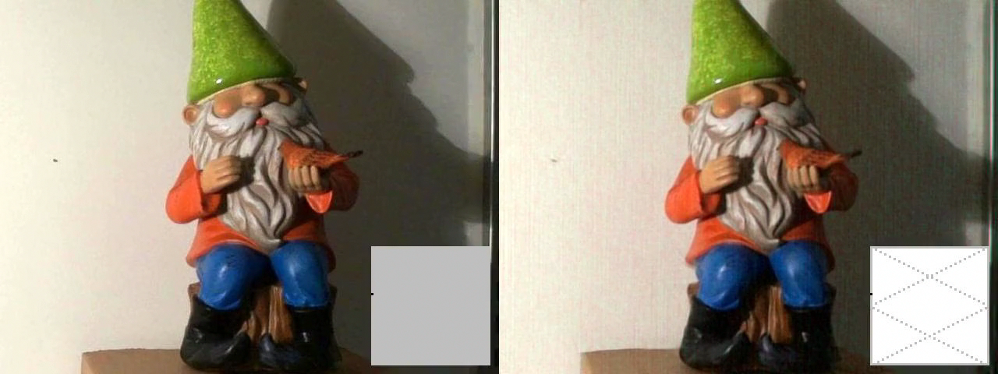
Viewpoint Denoising
Original Captured Image
Our Reconstruction
Notes:
Let me show you what I mean by that. Here on the left we have the original images and on the right we have our reconstruction. Now I am going to play this for different viewpoints. And as it plays I want you to focus on the original images, you can see that there is some kind of flickering going on which you do not see as much in our reconstruction.
--- Ok so what is going on here. When we capture the light field, we have some image registration errors which means the positions of the cameras are not very accurate, there is some jitter and they are slightly off. Now because we have this continuous frequency representation, we can evaluate the light field anywhere and so we can reconstruct the viewpoints at exact positions which corrects for these registration errors.

Slide 42
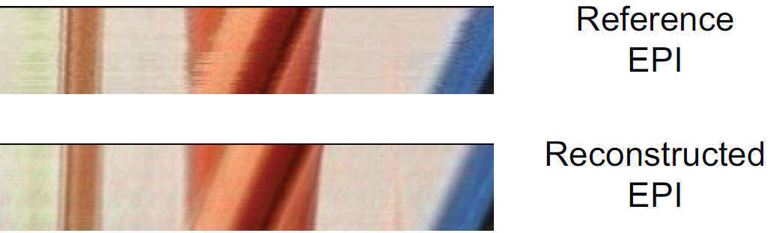
Viewpoint Denoising
Original Viewpoints
Pixels
Reconstructed Viewpoints
Pixels
Notes:
To see it better, let us look at an epipolar plot from this light field. What we are showing here is how few pixels are changing for different viewpoints. On the top you have the original and on the bottom you have out reconstruction. You can see that our reconstruction is much smoother and does not have this jitter.

Slide 43
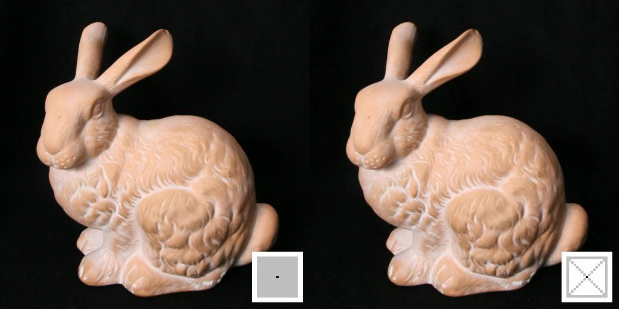
Extrapolating Views
Original Captured Image
Reconstructed Image
Notes:
Another added benefit of having a continuous representation is that we can start to extrapolate views which means we can render the light field from these continuous frequencies outside our initial array of input images.
---So here is the bunny example again but now we will start to construct views which we did not have initially in our dense array.

Slide 44
Conclusion
Sparsity in continuous vs discrete Fourier domain
Reconstruction algorithm
  Reduces capture cost by 70-90%
  Non-Lambertian scenes
  Viewpoint denoising
  Extrapolating views
Future: Additional Compression, Speed, Different Sampling Patterns, …
http://netmit.csail.mit.edu/LFSparseRecon/
Notes:
So to conclude,
--- we have shown that there is a significant difference between sparsity in the continuous and discrete Fourier domains.
--- Leveraging this observation we construct a light field reconstruction algorithm that
--- Reduce the cost of light field capture by 70-90%
--- Works for non-lambertian scenes
--- Enables view point denoising
--- And extrapolating views
--- Now of course there is a lot of future work like can we use this for compression, can we speed up the algorithm, can we use different initialization and sampling patterns,
And much more and for that we put the code online and we urge you to go and try it.
----- Meeting Notes (8/13/15 11:22) -----
better compression
say 4d reconstruction again before showing results
each coefficient is a 4D complex sinusoid
The worst case reduction we got was about
75M->1M rabbit
680M->3M Gnome
But that’s

Slide 45
Light Fields Are Cool
Us
4D!
Refocusing
Free viewpoint
Notes:
So light fields provide a very rich representation of scenes
That lets us do cool stuff like *refocusing and *viewpoint synthesis,
And this is especially relevant today as
*virtual reality is starting to get really compelling
But this is the
*fourth talk in a session that is CALLED “Light fields”
So I’ll assume that you’re all pretty much sold on their merits at this point

