Slide 1
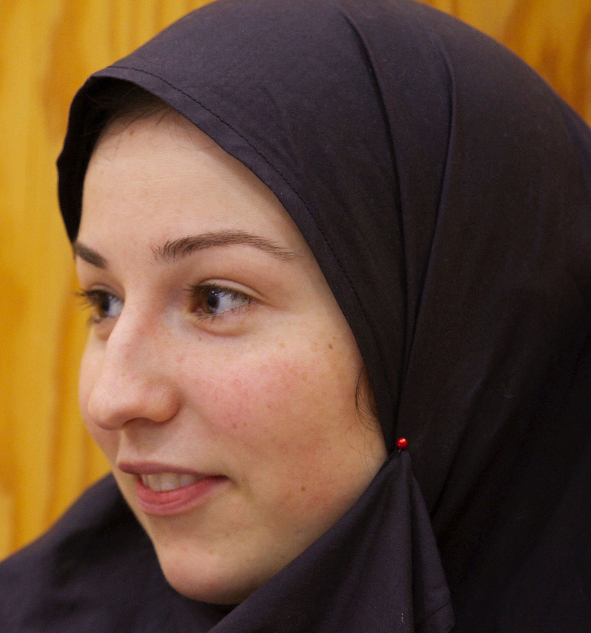
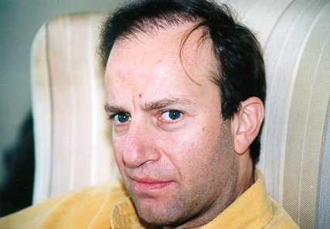
Peter Szolovits 70-th
(sort of)
December 2, 2019

Slide 2
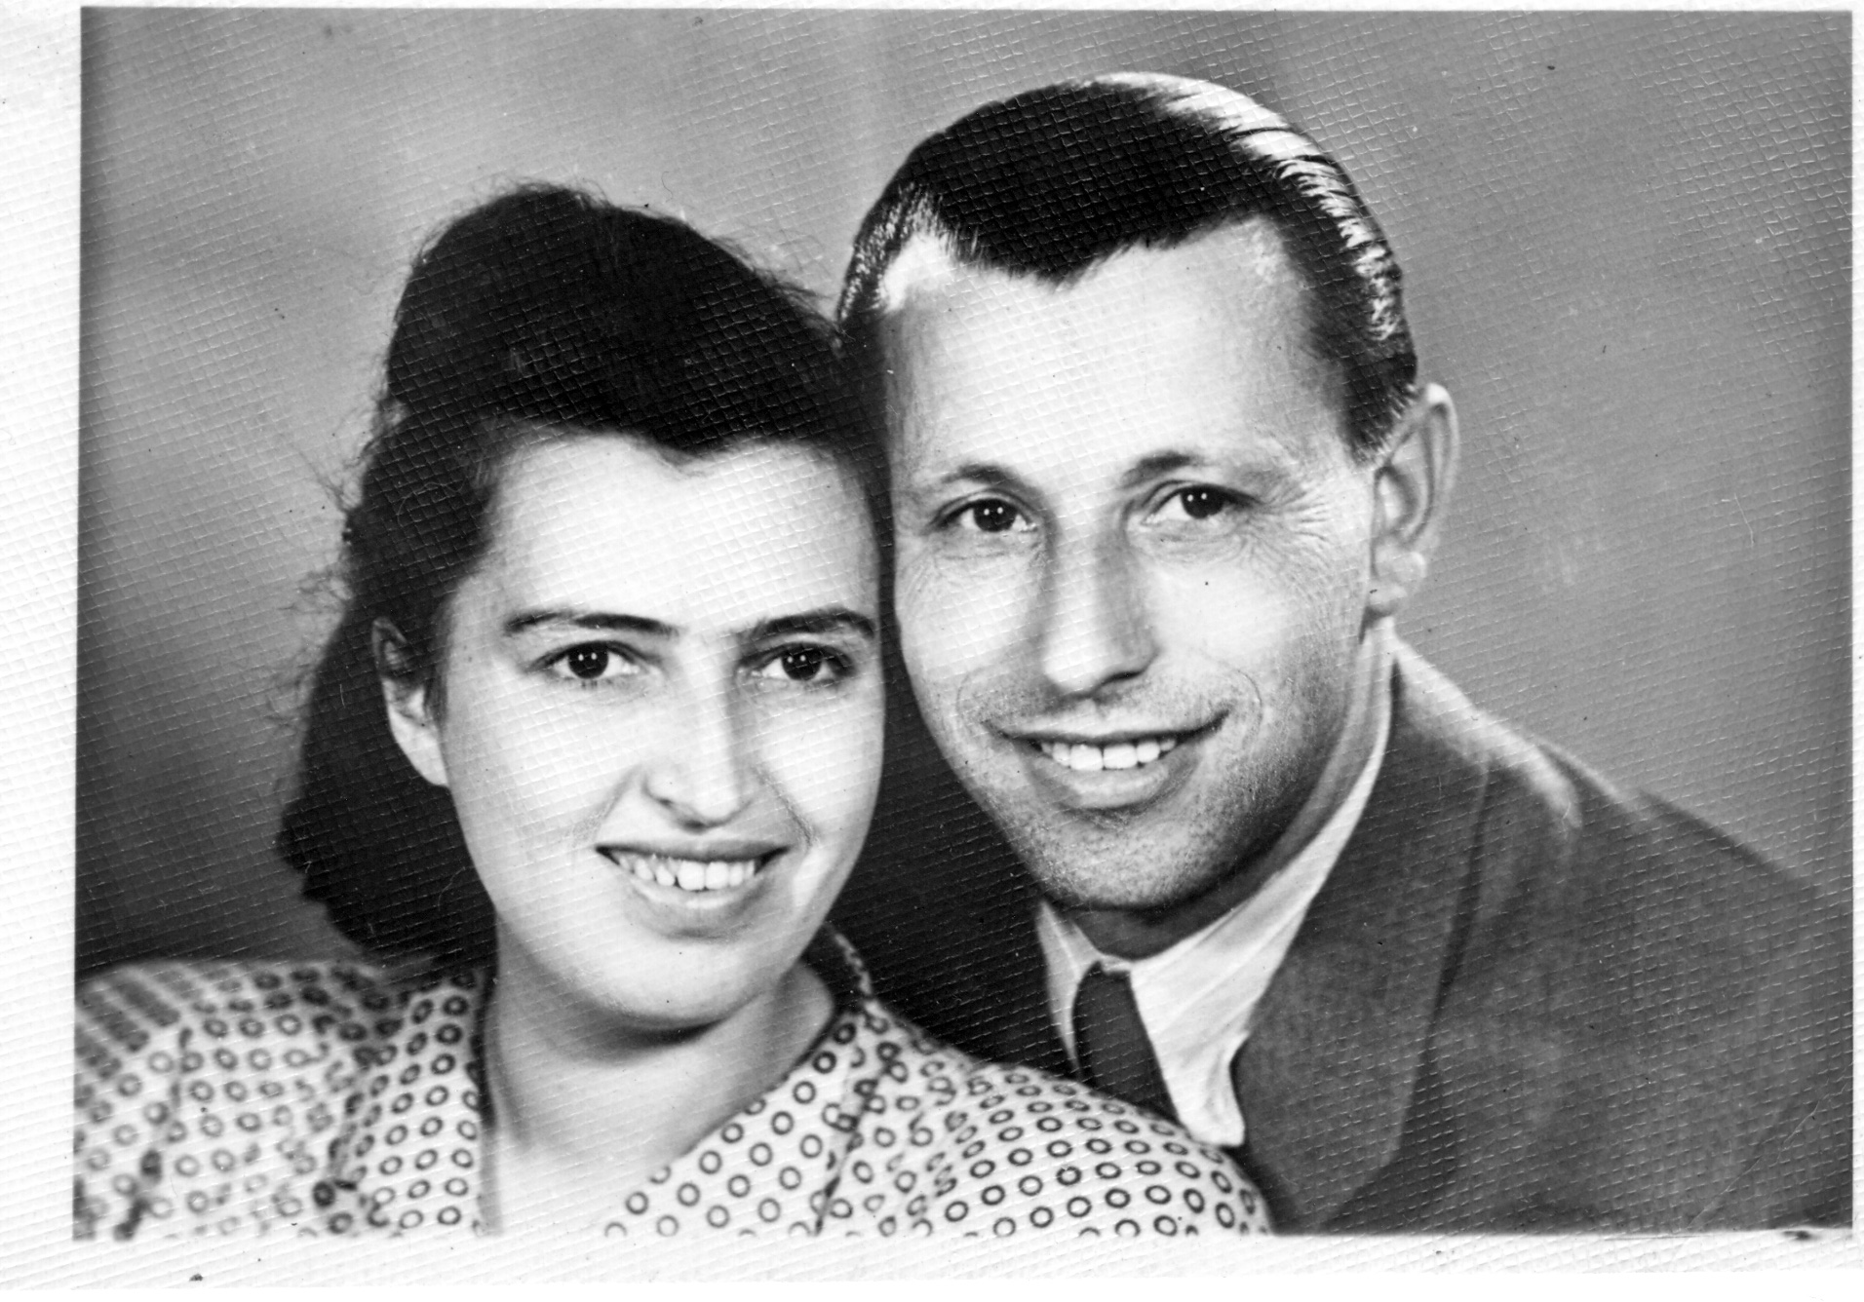
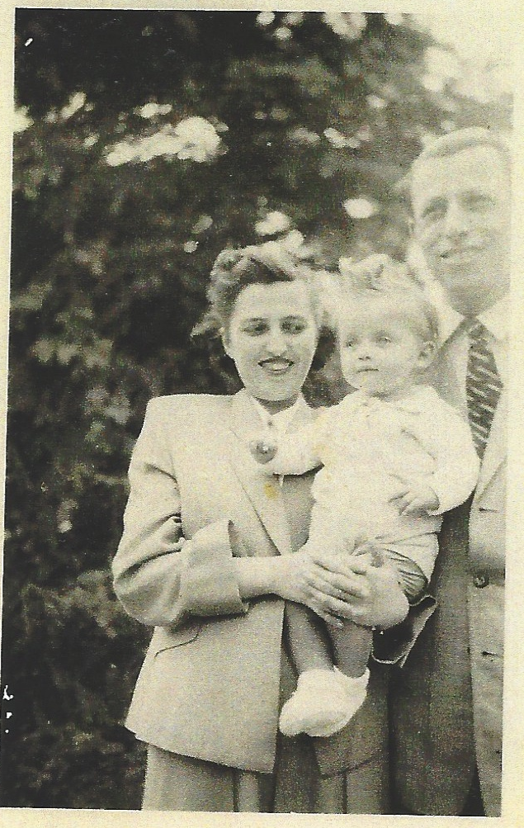
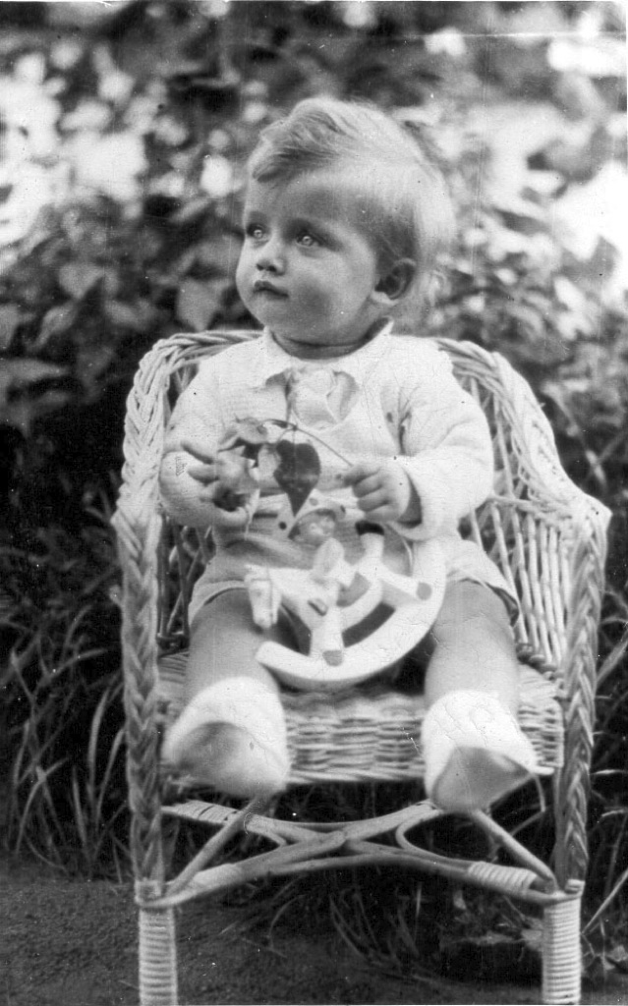

Slide 3
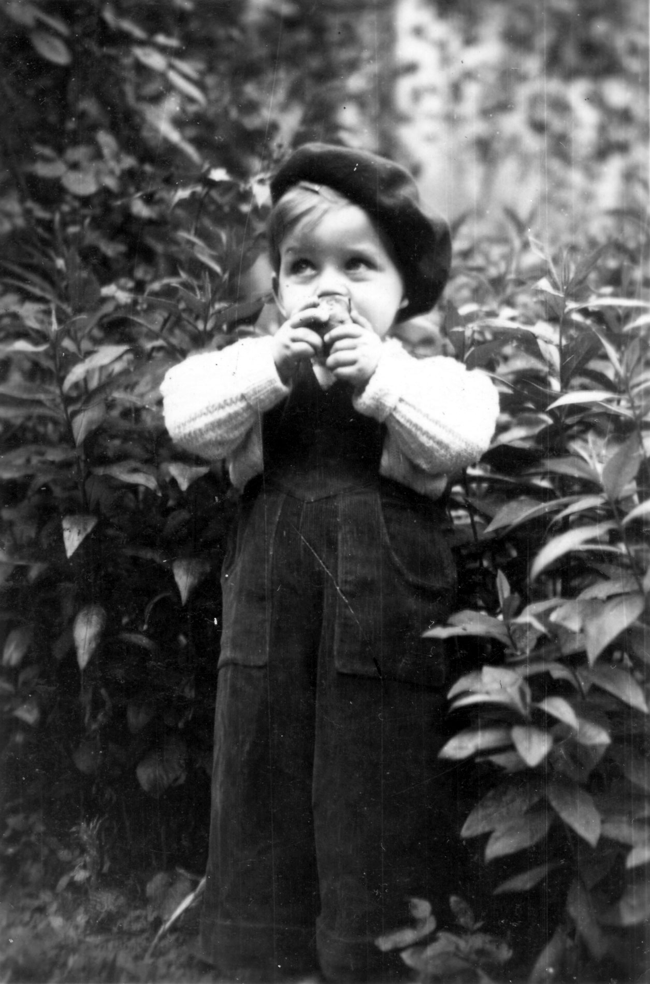
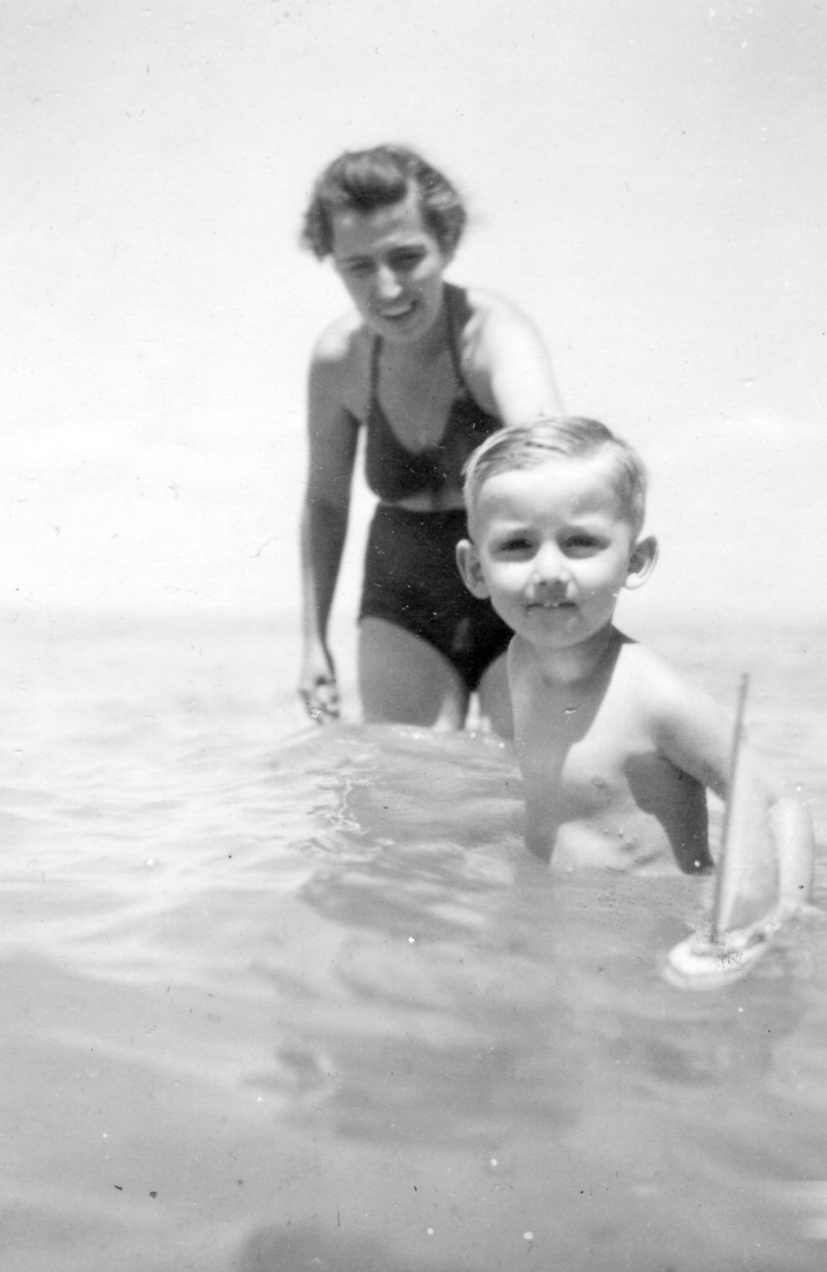

Slide 4
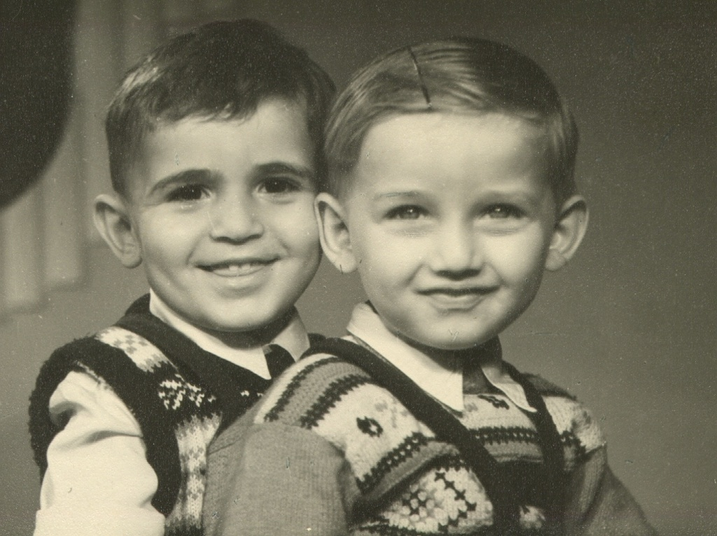

Slide 5
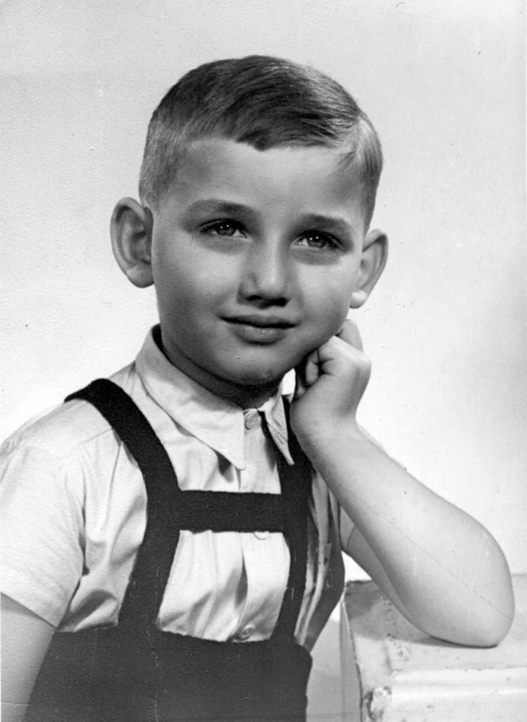
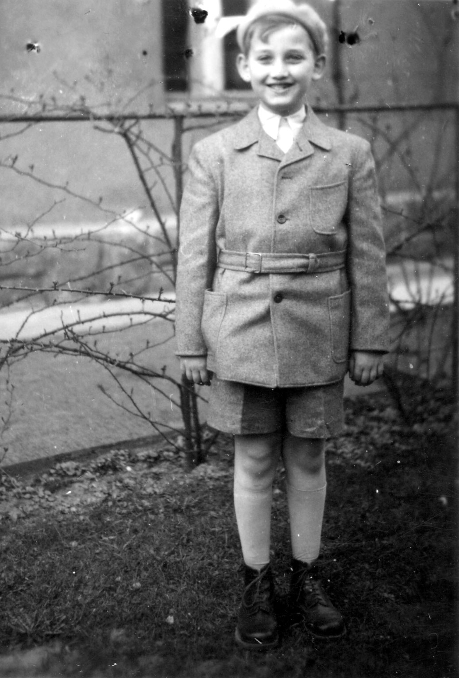

Slide 6
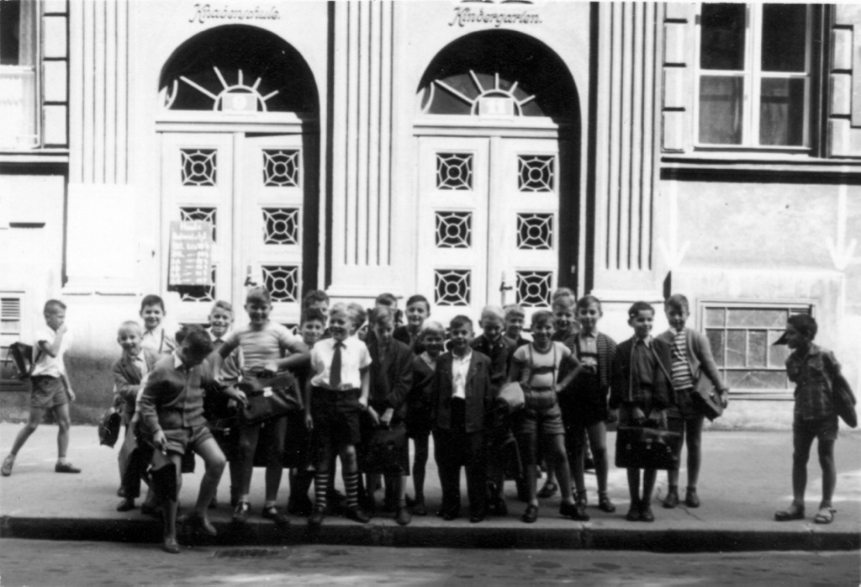

Slide 7
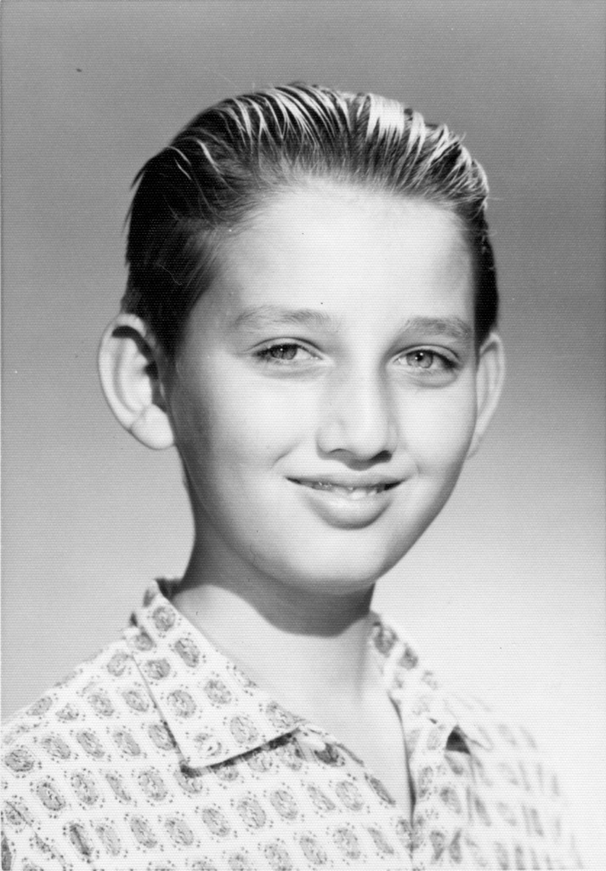
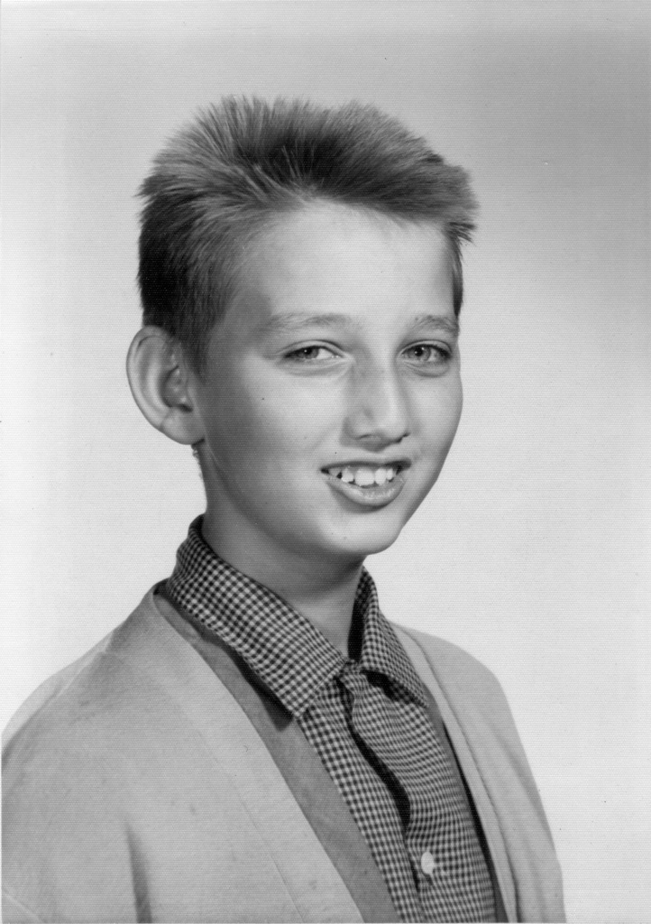

Slide 8
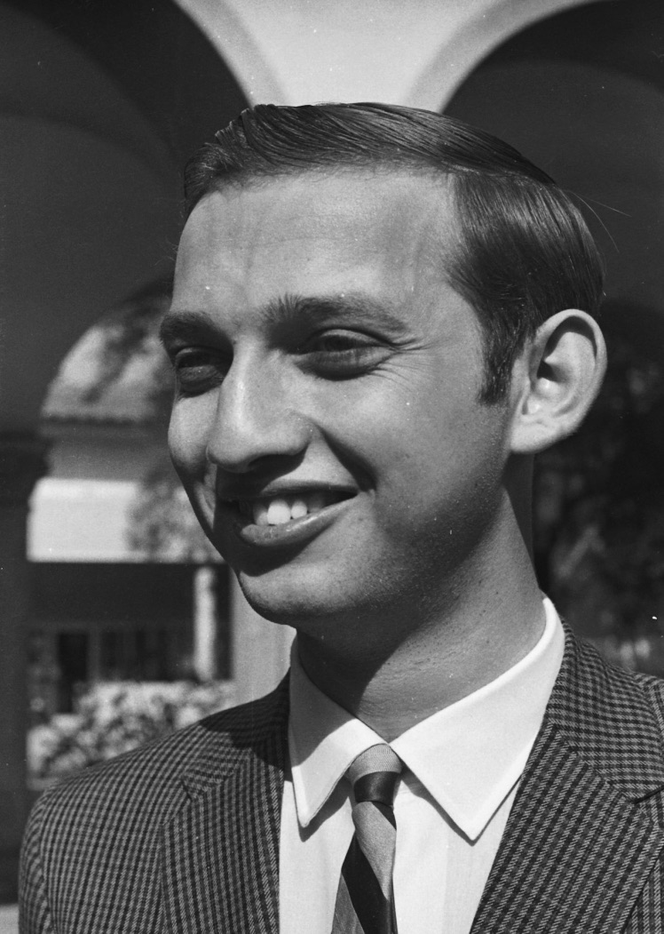
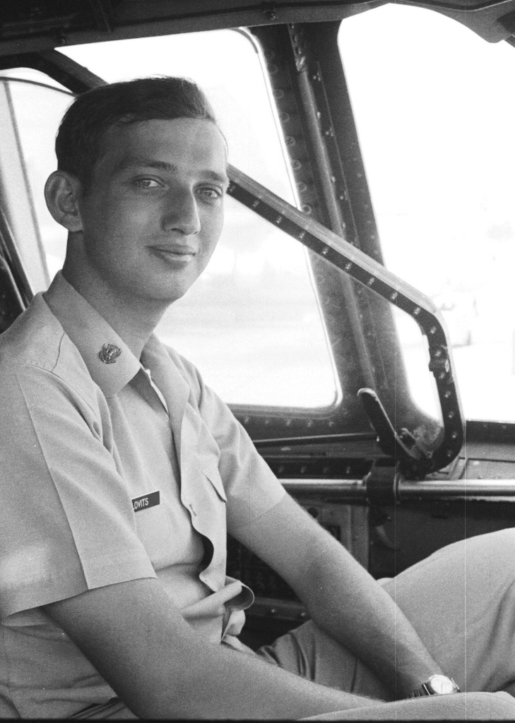

Slide 9
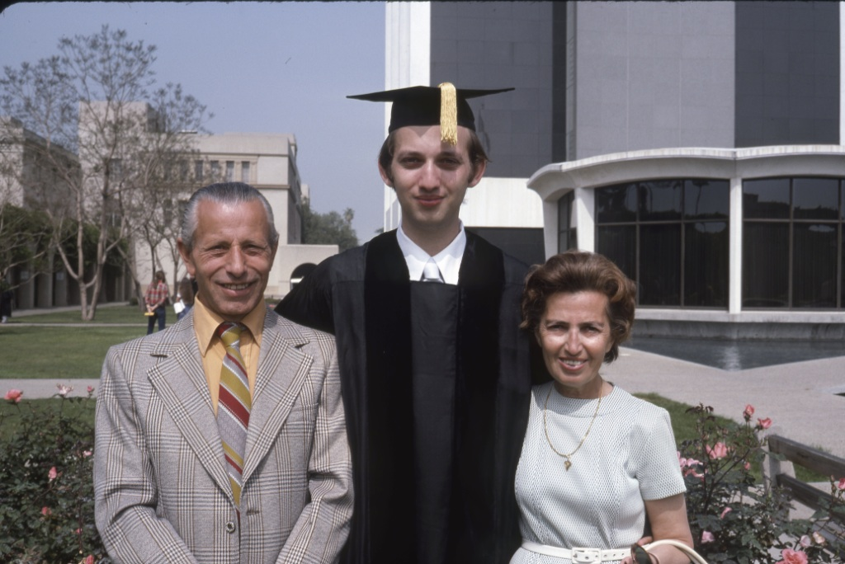

Slide 10
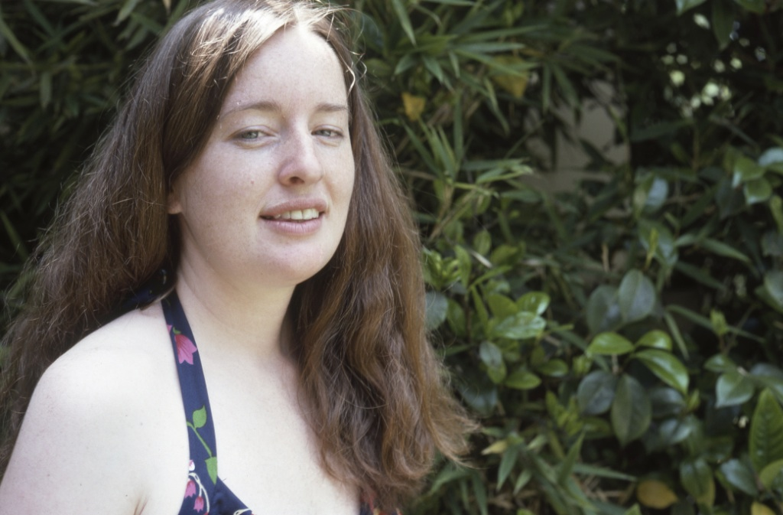
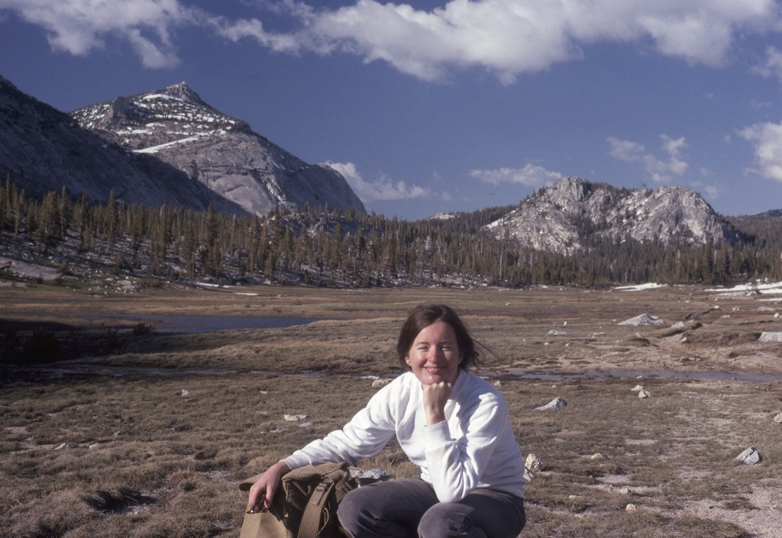

Slide 11
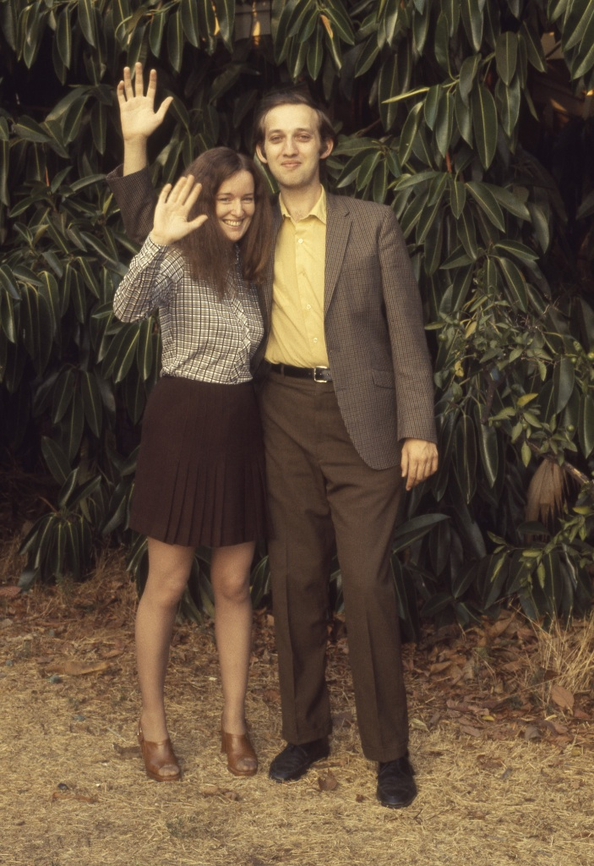
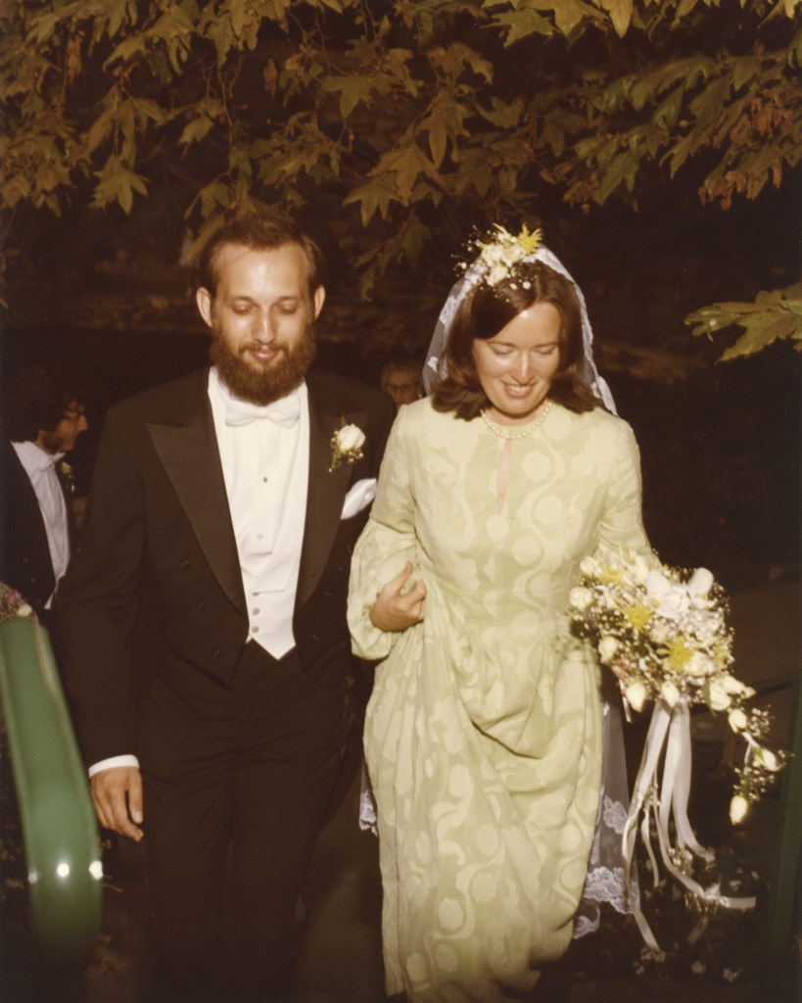

Slide 12
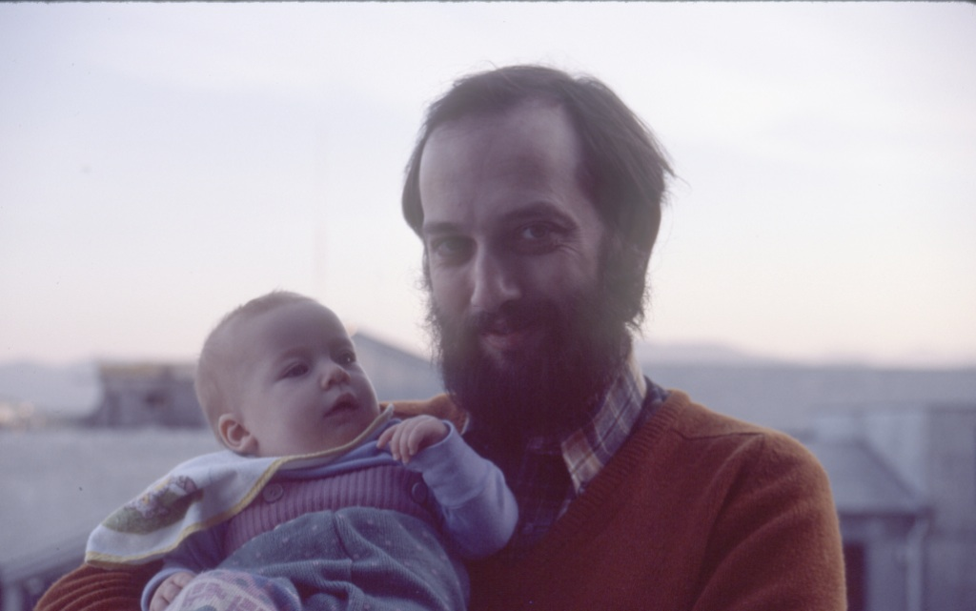
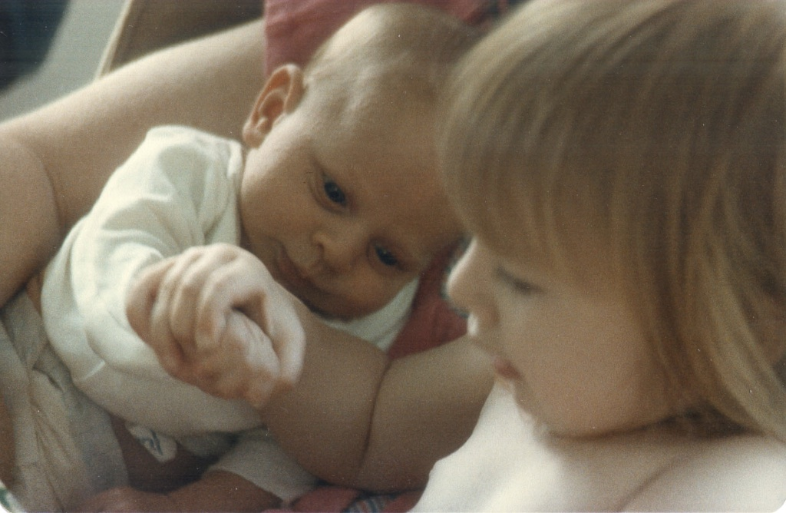

Slide 13
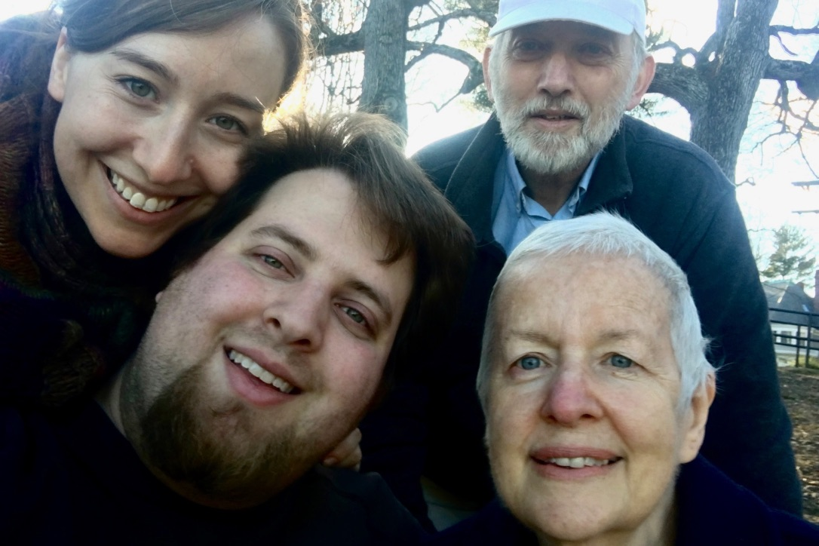

Slide 14
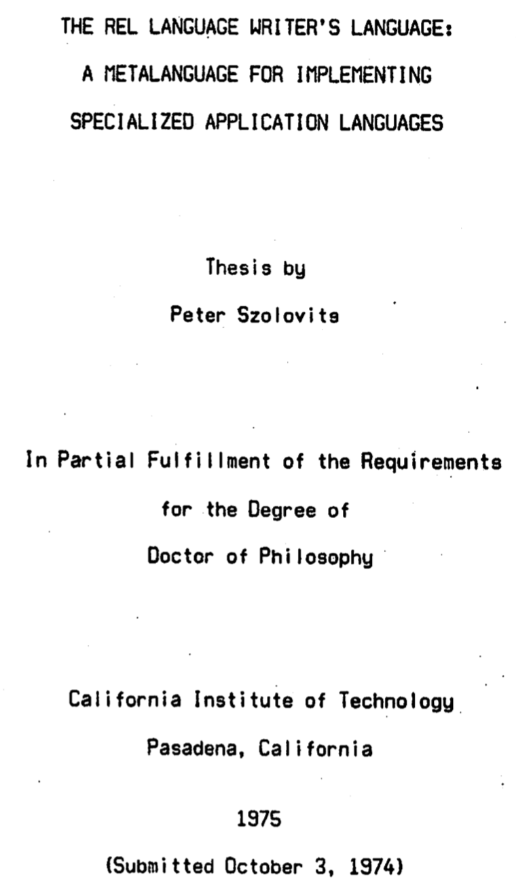
https://www.azquotes.com/quote/1038681
https://www.caltech.edu/about/news/frederick-b-thompson-43160

Slide 15
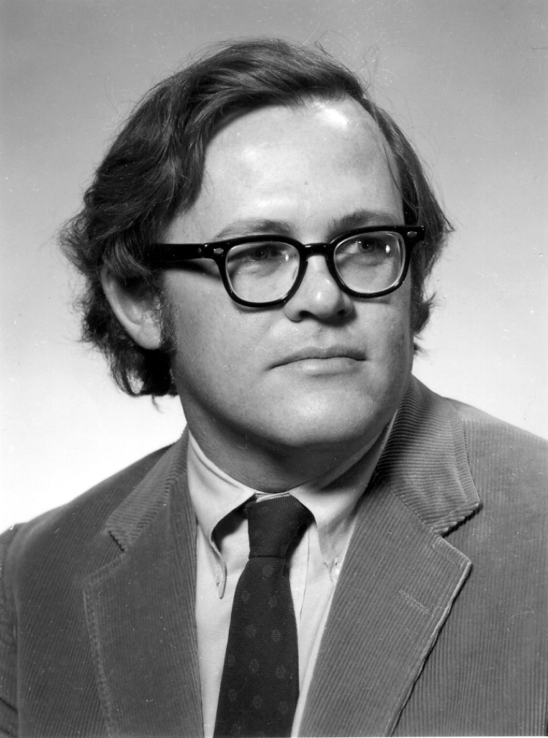
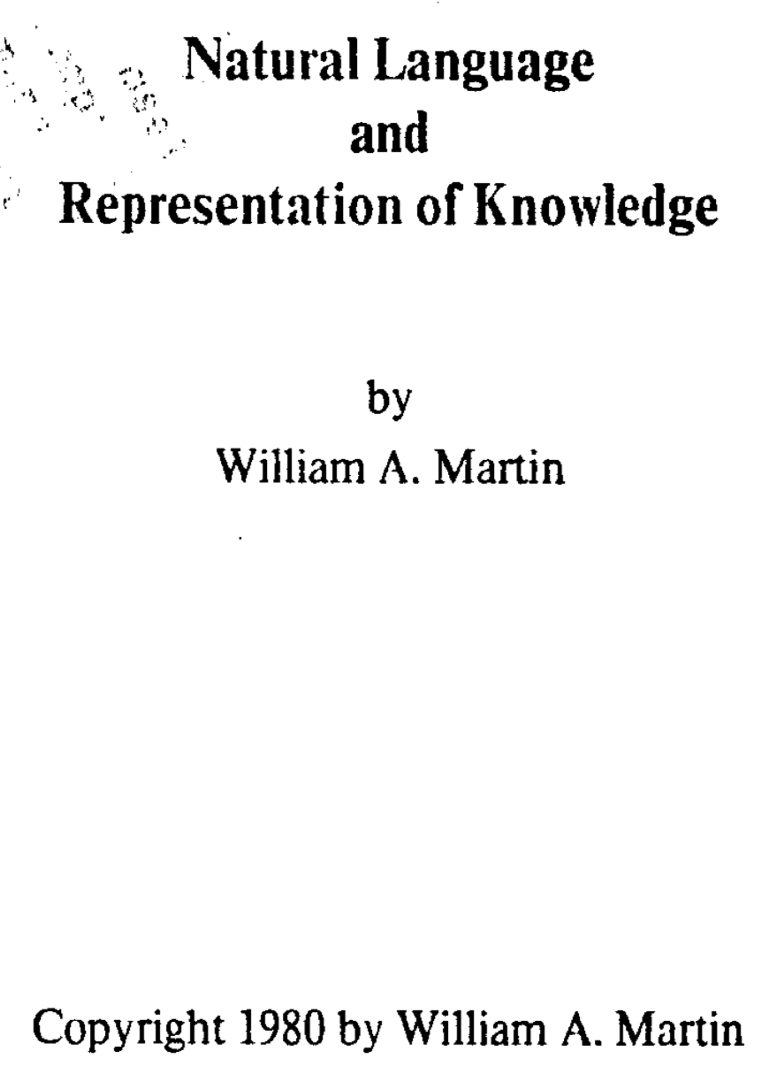
Notes:
Alan Newell, Raj Reddy @ CMU
Jack Schwartz at NYU/Courant
Terry Winograd vs. Gene Charniak

Slide 16
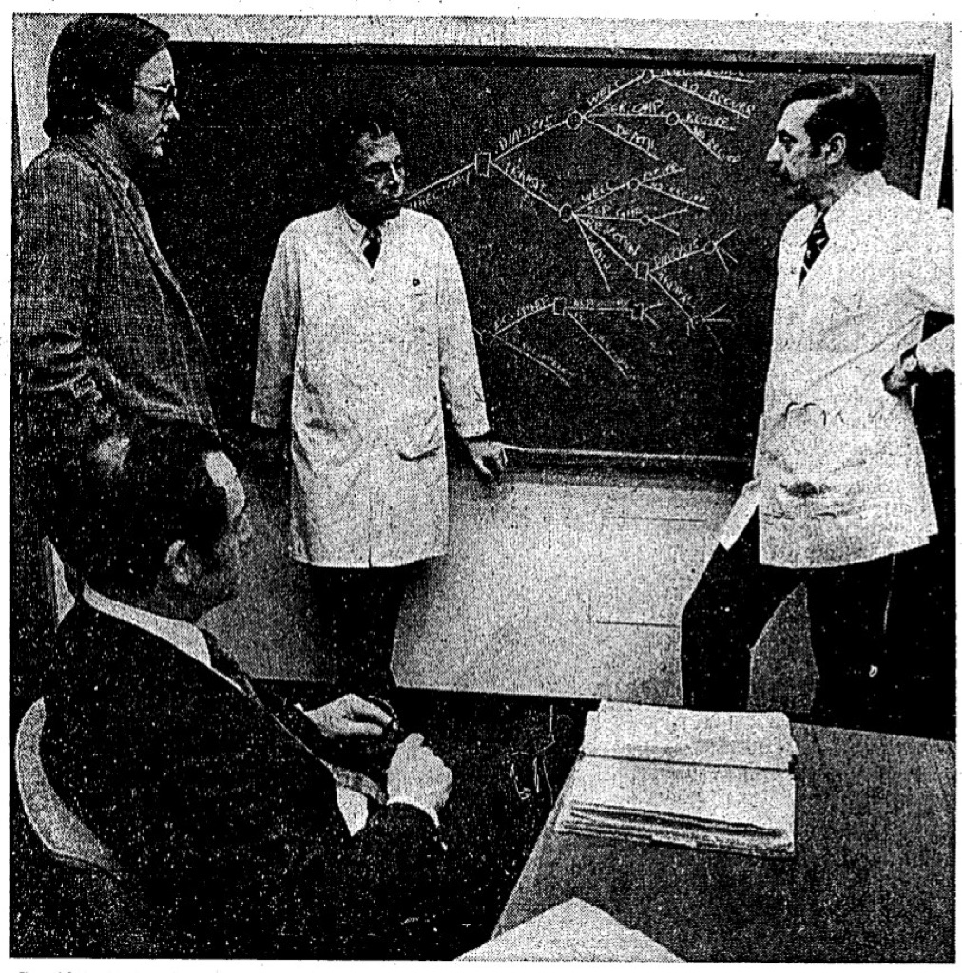
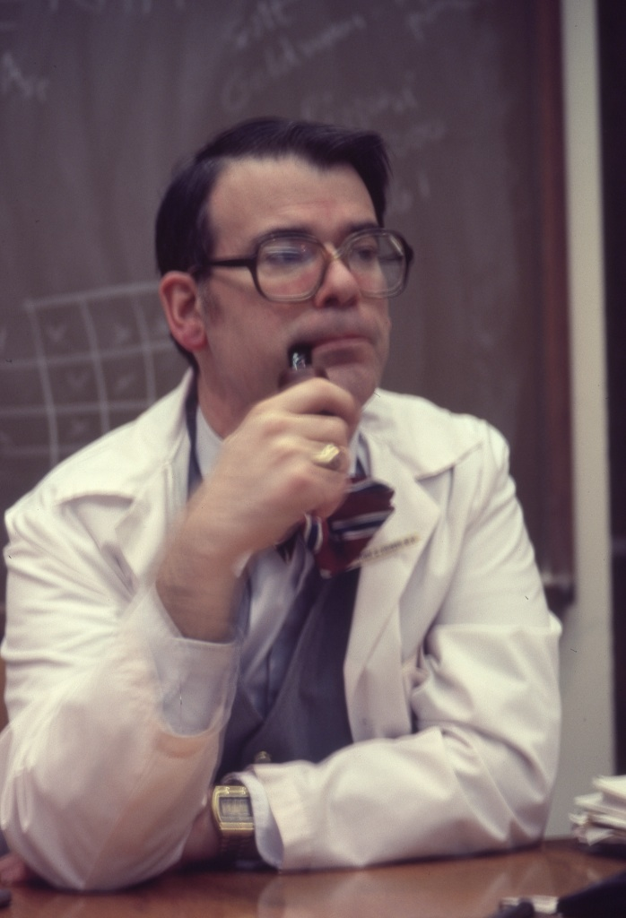

Slide 17
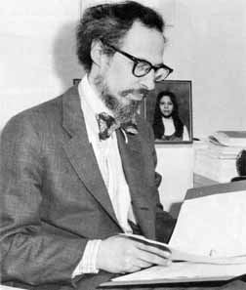
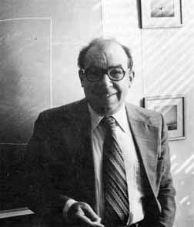
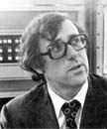
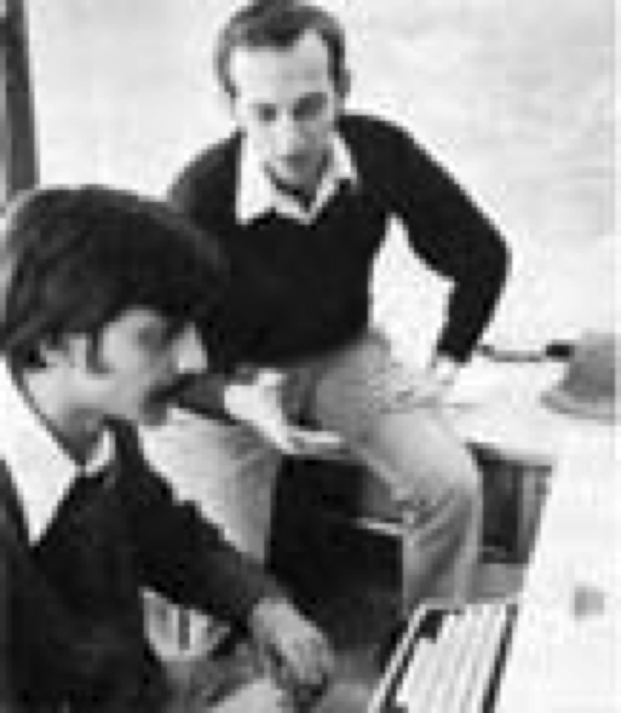
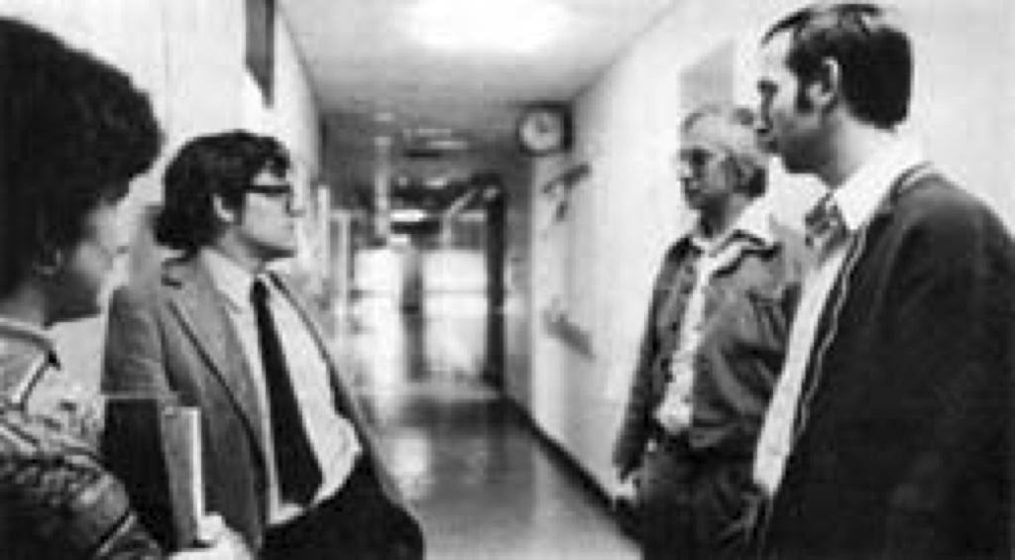
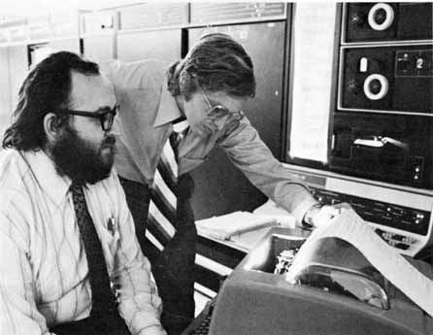

Slide 18
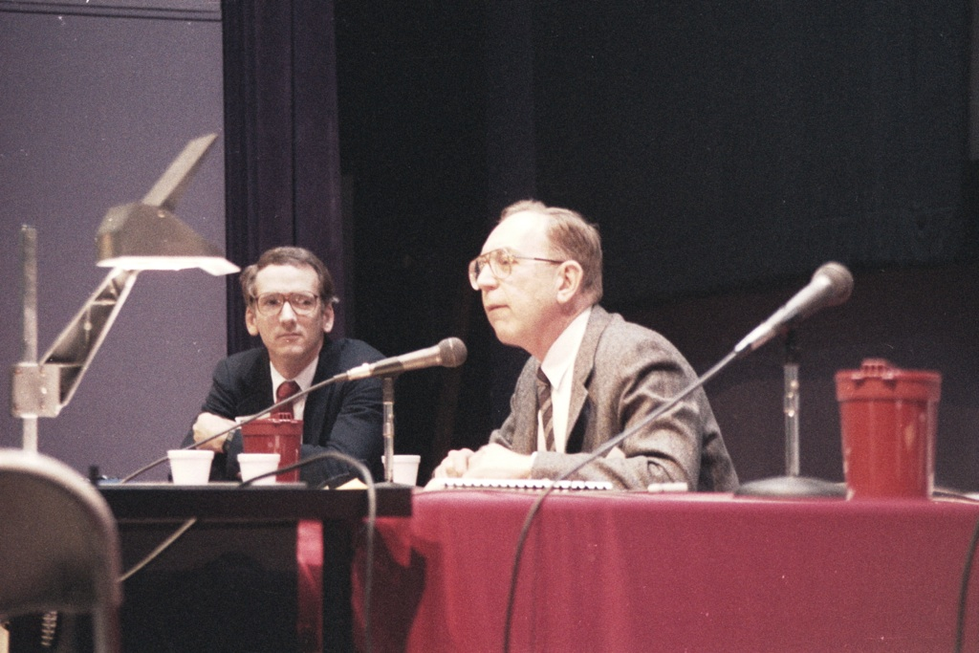
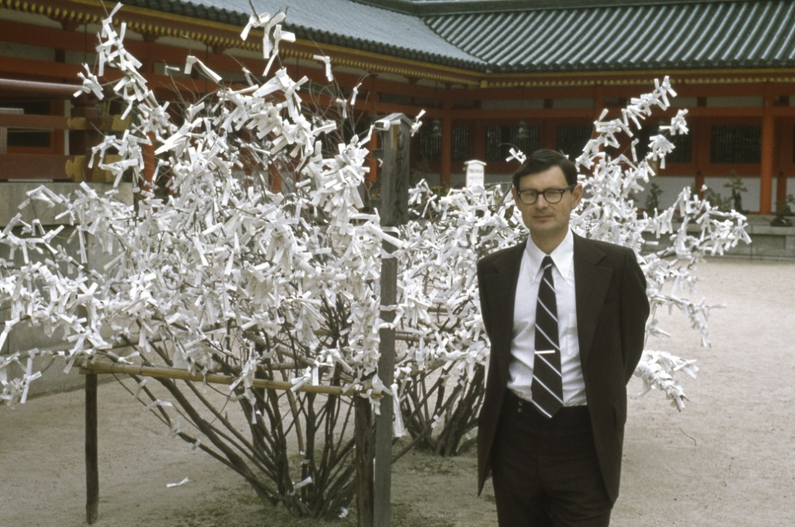
Notes:
Ted Shortliffe, Ed Feigenbaum, Kaz Kulikoswki, Harry Pople, Randy Miller, Greg Cooper, Eric Horvitz, David Heckerman, Larry Fagan, Mark Musen, Bruce Buchanan, Blackford Middleton

Slide 19
PSZ’s students & staff
My PhD Students | Other PhD Students | Other degrees | Staff & Postdocs
Bill Swartout 1980 | Candy Sidner 1979
Ramesh Patil 1981 | Sheldon Borkin 1979
Brian Smith 1982 | Jon Doyle 1980
Zak Kohane 1987 | Marius Fieschi 1983
Phyllis Koton 1988 | Ken Church 1983
Mike Wellman 1988 | Tetsutaro Shibahara 1985
Duane Steward 1988 | David McAllester 1987
Alex Yeh 1990 | Reid Simmons 1988
Tom Russ 1991 | Elisha Sacks 1988
Nick Groleau 1992 | Walter Hamscher 1988
Jon Amsterdam 1993 | Jeff Van Baalen 1989
Yeona Jang 1993 | Peter de Jong 1989
Ira Haimowitz 1994 | Howie Reubenstein 1990
Tze-Yun Leong 1994 | Tom Wu 1992
Milos Hauskrecht 1997 | Linda Wills 1992
Mojdeh Mohtashemi 2000 | Ron Rymon 1993
Christine Tsien 2000 | Carlos Rojas-Guzman 1995
Yao Sun 2001 | Chrysanthos Dellarocas 1996
Lik Mui 2002 | Abe Bernstein 2000
 | Latanya Sweeney 2001
 | Tom Lee 2002
 | Tim Chklovski 2003
 | Atul Butte 2004
 | Chris Varma 2005
 | Michael Sung 2005

Slide 20
PSZ’s PhD students
Supervisor
Reader
Bill Swartout 1980
Ramesh Patil 1981
Brian Smith 1982
Zak Kohane 1987
Phyllis Koton 1988
Mike Wellman 1988
Alex Yeh 1990
Tom Russ 1991
Nick Groleau 1992
Jon Amsterdam 1993
Yeona Jang 1993
Ira Haimowitz 1994
Tze-Yun Leong 1994
Milos Hauskrecht 1997
Duane Steward 1998
Mojdeh Mohtashemi 2000
Christine Tsien 2000
Yao Sun 2001
Lik Mui 2002
Delin Shen 2006
Stanley Trepetin 2006
Mike McGeachie 2007
John Perry 2007
Tom Lasko 2007
Chris Cassa 2008
Caleb Hug 2009
Bob Rudin 2011
Andreea Bodnari 2014
Yuan Luo 2015
Marzyeh Ghassemi 2017
Franck Dernoncourt 2017
Jenny Lee 2017
Tristan Naumann 2018
Emily Alsentzer ?
Heather Berlin ?
Willie Boag ?
Geeticka Chauhan ?
Sam Finlayson 2019?
Harry Hsu ?
Di Jin 2019?
Matthew McDermott ?
Elena Sergeeva ?
Wei-Hung Weng ?
Ying Zhang ?
Candy Sidner 1979
Sheldon Borkin 1979
Jon Doyle 1980
Marius Fieschi 1983
Ken Church 1983
Tetsutaro Shibahara 1985
David McAllester 1987
Reid Simmons 1988
Elisha Sacks 1988
Walter Hamscher 1988
Jeff Van Baalen 1989
Peter de Jong 1989
Howie Reubenstein 1990
Tom Wu 1992
Linda Wills 1992
Ron Rymon 1993
Carlos Rojas-Guzman 1995
Chrysanthos Dellarocas 1996
Abe Bernstein 2000
Latanya Sweeney 2001
Tom Lee 2002
Tim Chklovski 2003
Atul Butte 2004
Vikram Kumar 2004
Chris Varma 2005
Michael Sung 2005
Kurt Steinkraus 2005
Ronilda Lacson 2005
Stephen Peters 2006
“Ziggy” Blair 2007
Vinay Pulim 2008
Joaquin Blaya 2008
Allen Bryan 2008
Yuan Kui Shen 2011
Nathan Palmer 2011
Jeff Klann 2011
Mark Finlayson 2011
Chih-Yu Chao 2011
Christina Sauper 2012
Ian Eslick 2013
Fuming Shih 2015
Rimma Pivovarov 2015
Ashley Mateus 2015
Raj Manrai 2015
Robert Altshuler 2015
Tong Wang 2016
Niaja Nicole Farve 2016
Bryce Kim 2017
Bryan Haslam 2017
Matthew Gombolay 2017
Ehimwenma Nosakhare 2018
Siong Thye Goh 2018
Yevgeni Berzak 2018
Yonatan Belinkov 2018
Hongyu Yang 2019
Varesh Prasad 2019
Notes:
Many co-supervised with others!
As supervisor: 33 completed, 11 in progress
As reader: 56

Slide 21
PSZ’s Master’s Students
David Aghassi
Cheewee Ang
Irwin J Asbell
Hiba Awad
Annamarie Elizabeth Bair
Silvia Baptista
Edward Barton
Neha Bhooshan
William Boag
Ronald J Bodkin
Andreea Bodnari
Nathaniel Rockwood Bogan
Melanie Bomke
Erich Bracht
Robert Bruccoleri
Steven M Bull
Atul J Butte
Christopher A Cassa
Leo Anthony G Celi
Daniel Chamberlain
Rachel Chasin
Geeticka Chauhan
Michelle W Chen
Kenneth W Church
Patrick M Cody
Catherine Maria Coury
Penelope H Cuevas
Mary DeSouza
Joseph Driscoll
Michael Patrick Frank
Sherry Fu
Robert Gens
Cosmin Gheorghe
Uma Girkar
Manish Goyal
Robert Granville
Burkay Gur
Ralph Harik
Nomi Harris
Joseph R Hastings
Tian Ye He
Matthew Robert Hofmann
Scott Thomas Hofmeister
Stephanie Hope
Caleb Hug
Hooman Katirai
Wonsik Kim
Waikit Koh
Phyllis Koton
Kanak Kshetri
Katherine Kuan
Robert Kunstaetter
Ronilda Lacson
Jeremy Lai
Sen-Hao Lai
Philip Le
Tze-Yun Leong
Silke C Lieber
Jervis Lui
Kartik M Mani
Brij Masand
Nadeem A
Michael McGeachie
Matthew Merlino
Jason C Miller
Rajesh Mishra
Donald Misquitta
Andrew Nakrin
Daniel J Nigrin
Ini Oguntola
Boon Teik Ooi
Divya Pillai
Kendra Pugh
Howie B Reubenstein
Alex Rothberg
Robert Rudin
Tom Russ
Russel Ryan
Elisha Sacks
Jiri Schindler
Ashish Sharma
Howie Sherman
Jennifer Shu
Tawanda Sibanda
Brian Cantwell Smith
Tejas Sundaresan
Harini Suresh
William R Swartout
Latanya Sweeney
Arya Tafvizi
Francisco Tanudjaja
Michael P Wellman
David C Wu
Jennifer W Wu
Min Wu
Yi Wu
Christine Yang
Susan S Yeh
Xiaoran Zhang
Ying Zhang
Ruilin Zhao
Notes:
101

Slide 22
PSZ’s Bachelor’s Students
Leola A Alfonso
Hiba Awad
Silvia Baptista
Neha Bharghava
Brad Block
Melanie Bomke
Erich Bracht
Tyler Callahan
Bill Conklin
Greg F Cooper
Joseph Driscoll
Christy Eng
Uche Enuha
Sherry Fu
Robert Gens
Cosmin Gheorghe
Rohit Gupta
David C Halbert
Reshma Khilnani
Wonsik Kim
Matthew Merlino
Aye Moah
David W Pachura
Rocco Pigneri
Alvin Carter Powers, III
Kendra Pugh
Alex Rothberg
Tom Russ
Benjamin A Schmeckpeper
Jonathan Schmick
William P Stewart
Tom Sullivan
Jennifer Y Sun
Qian Wang
Michael P Wellman
David C Wu
Yi Wu
Ed Yampratoom
Christine Yang
Xiaoran Zhang
Notes:
101

Slide 23
PSZ’s Staff, Postdocs, Visitors, …
Peter Adlassnig
Gil Alterovitz
Cungen Cao
Jon Doyle
Hamish Fraser
Harold Goldberger
John Halamka
Saeed Hassanpour
Jeff Klann
Isaac Kohane
Ronilda Lacson
Bill Long
Kenneth Mandl
Michael McGeachie
Mojdeh Mohtashemi
Oksana Senyk
Özlem Uzuner
Rohit Joshi
Keith Berkoben
Anna Rumshisky
Joshua Williams
…
Notes:
101

Slide 24
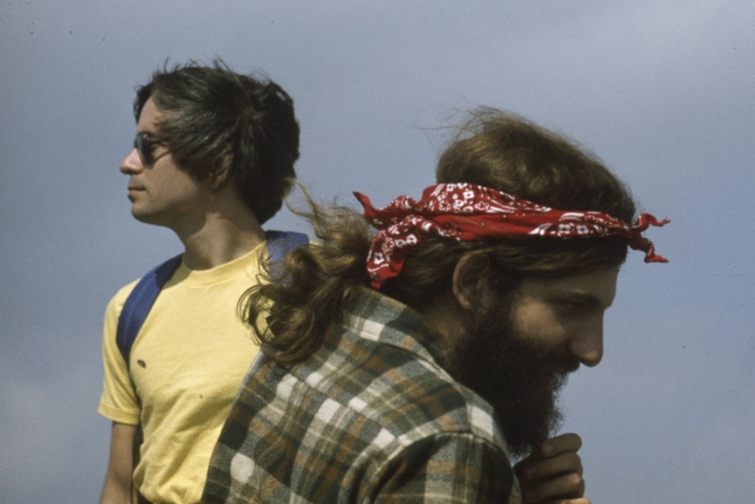
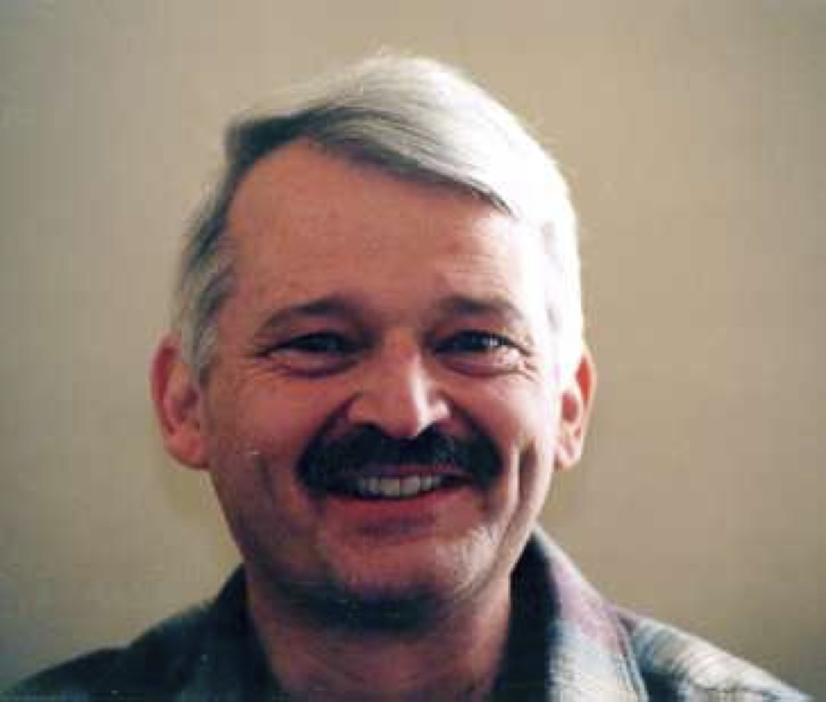
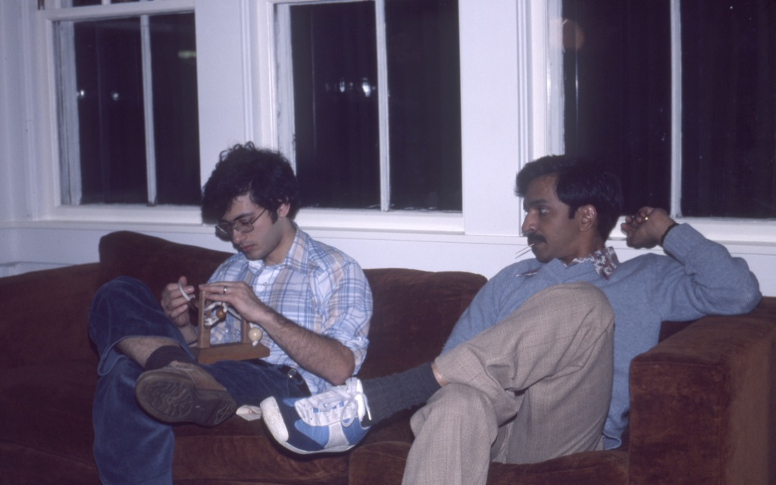
Notes:
Bill Swartout, Ken Church, Brian Smith, Byron Davies, Bill Long, Bob Frankston & Dan Bricklin, Charlie Safran, Bob Bruccoleri, Ramesh Patil

Slide 25
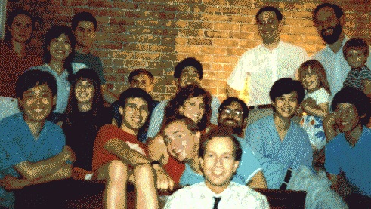
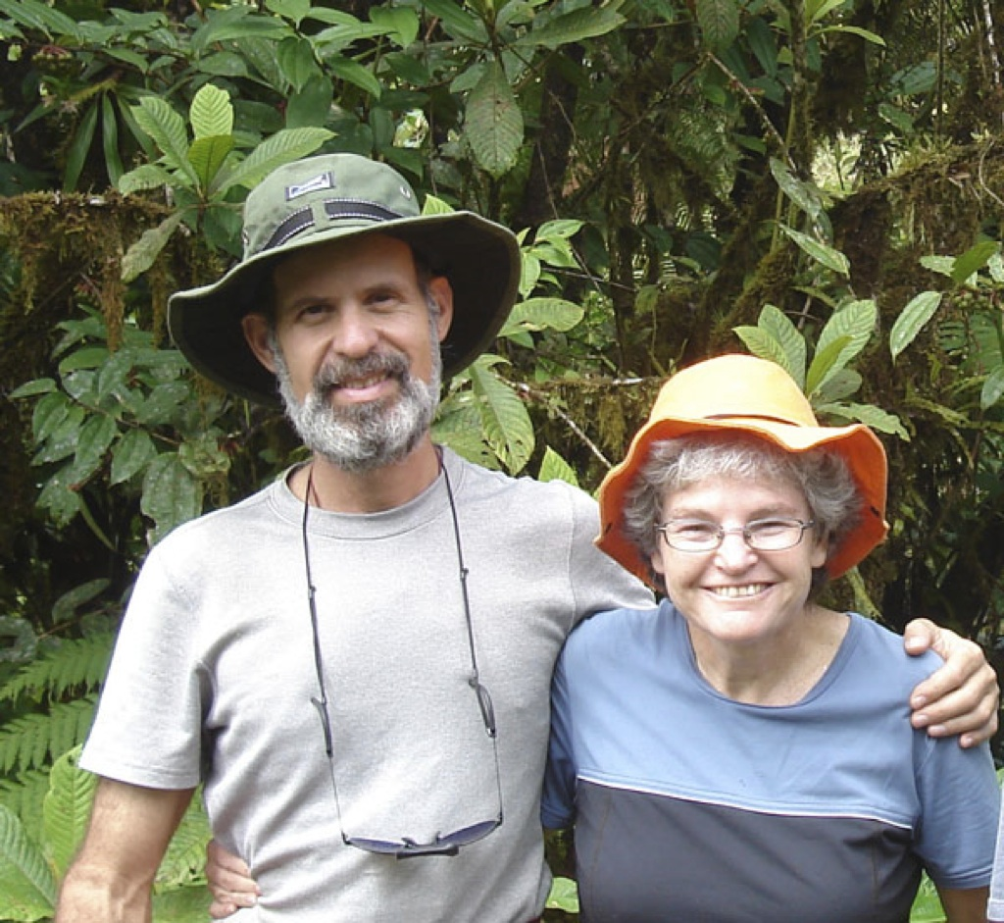
Notes:
1980s to early 1990s
Mike Wellman, Phyllis Koton, group, group, Bob and Daisy Kunstaetter, Chris Tsien and friends, group

Slide 26
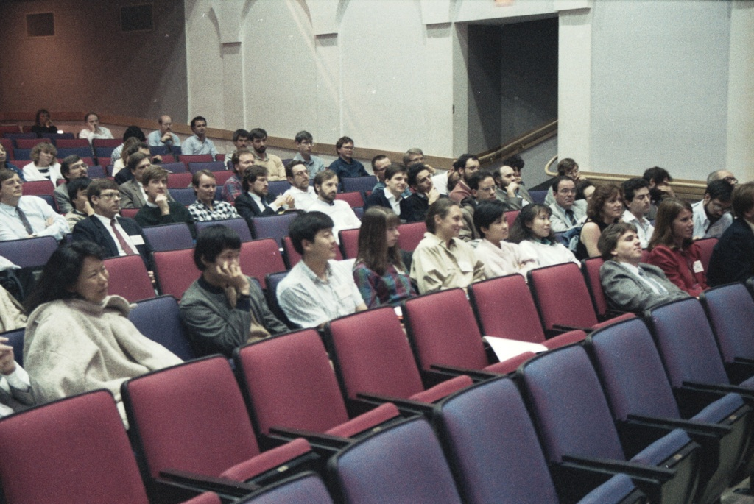
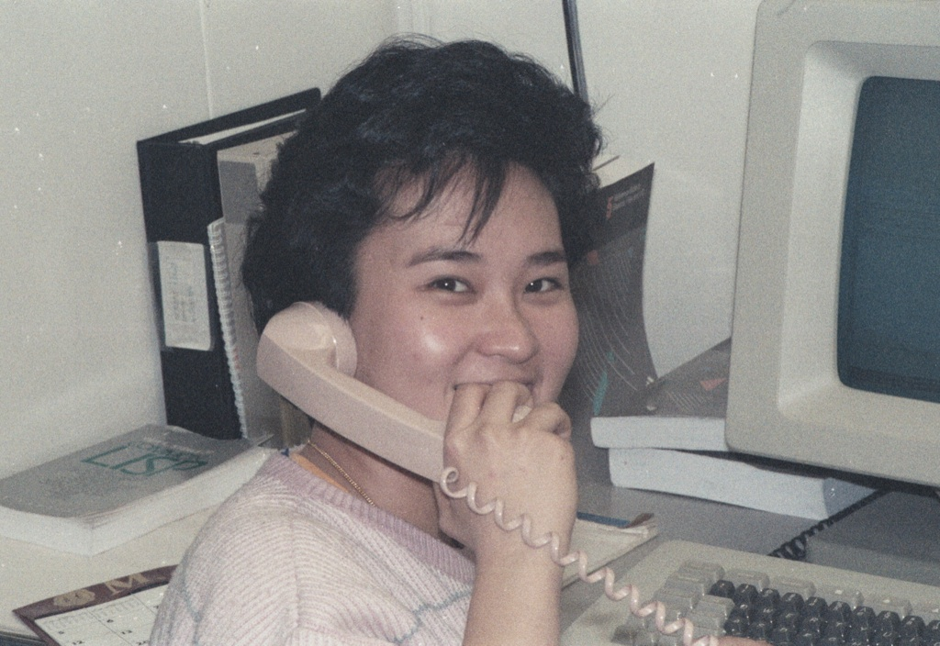
Notes:
Audience at Stanford AIM meeting, 1988

Slide 27
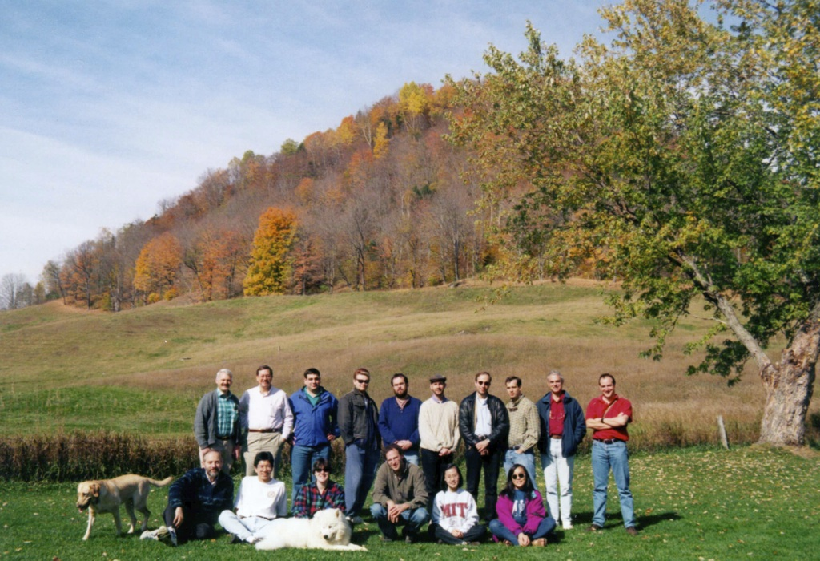
Notes:
1997 Talbot House
We had been there in 1977 (IIRC) for a national AIM meeting

Slide 28
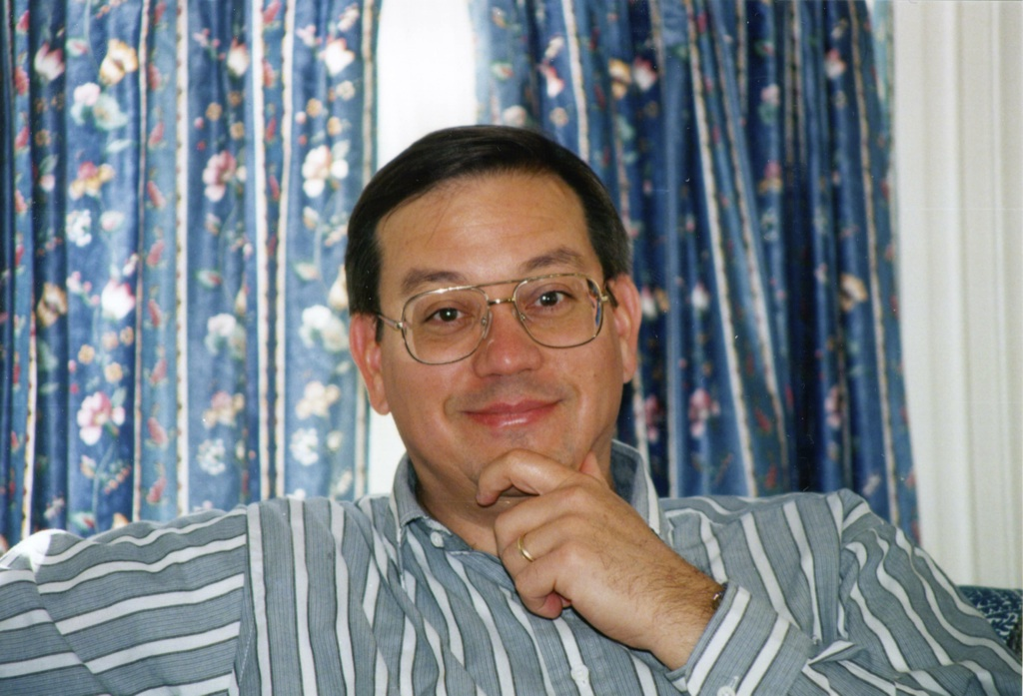
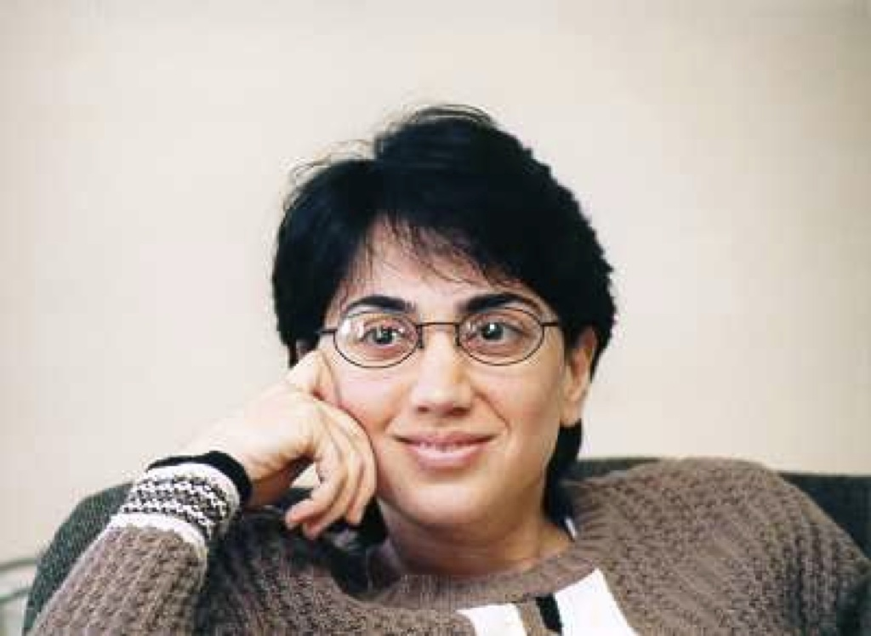
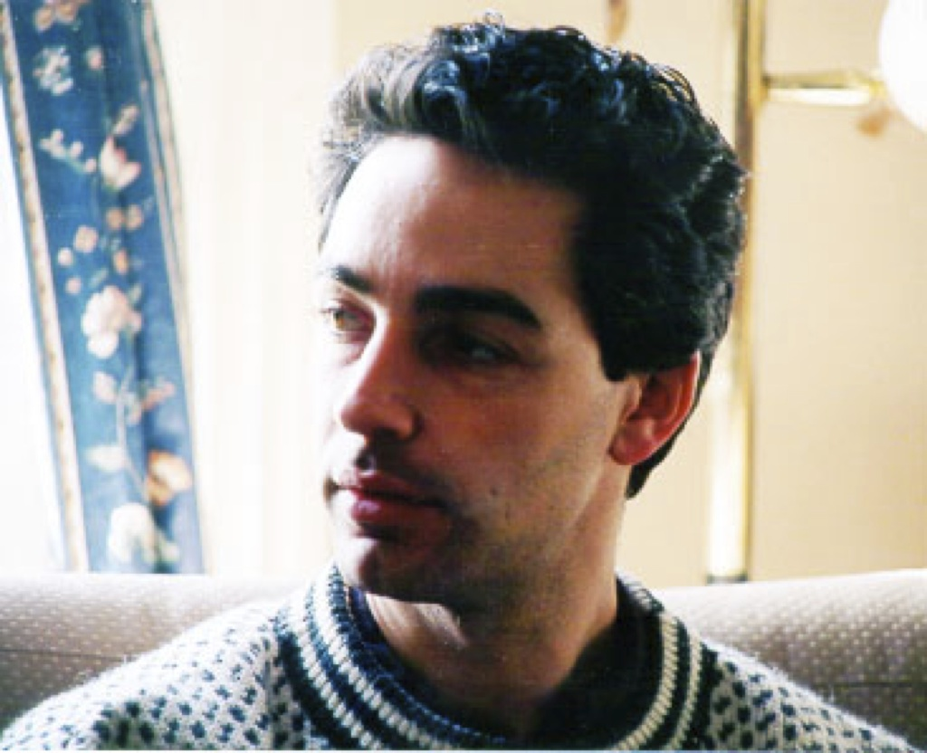
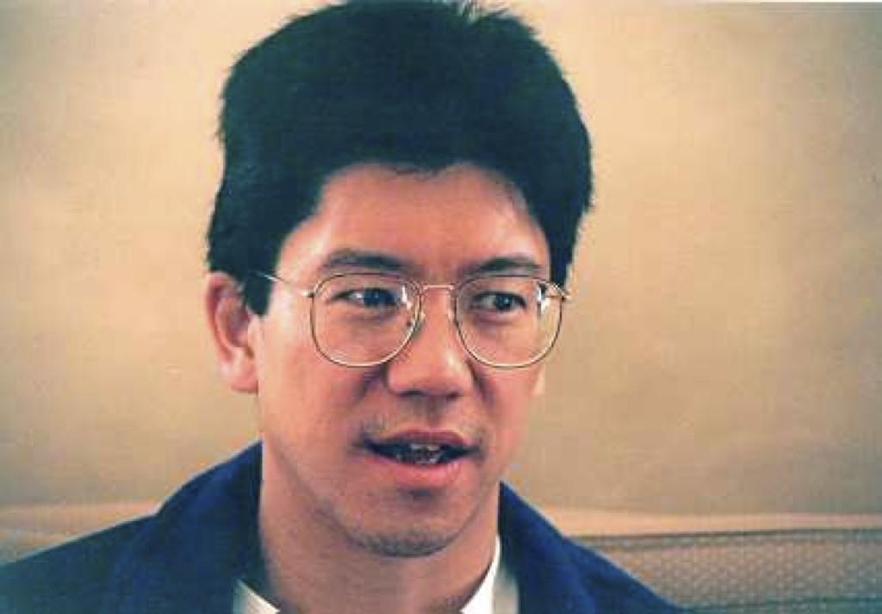
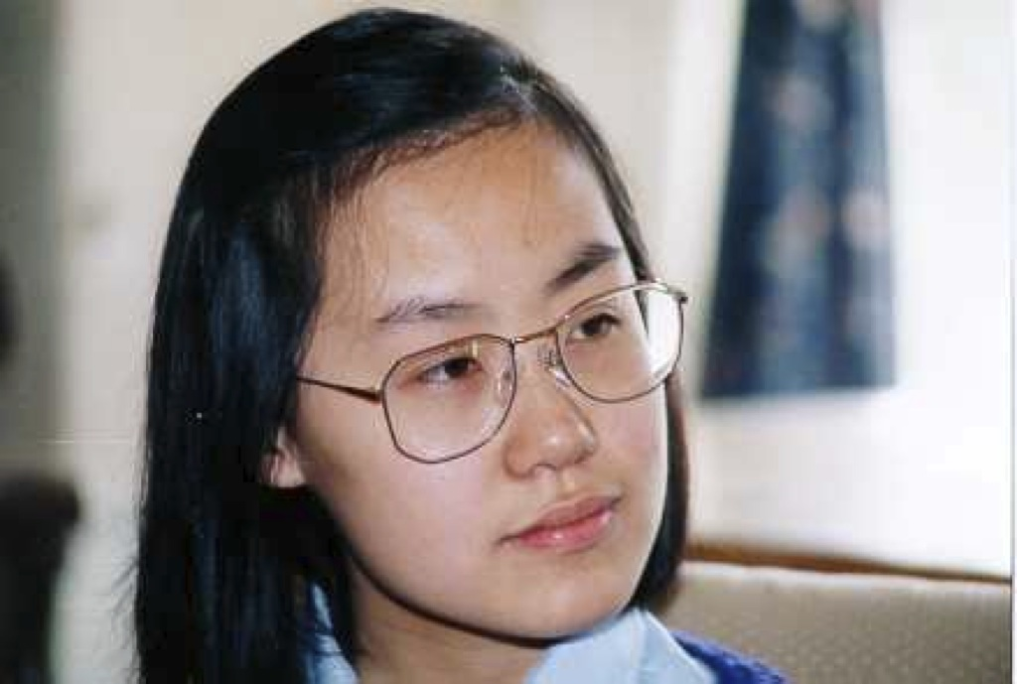
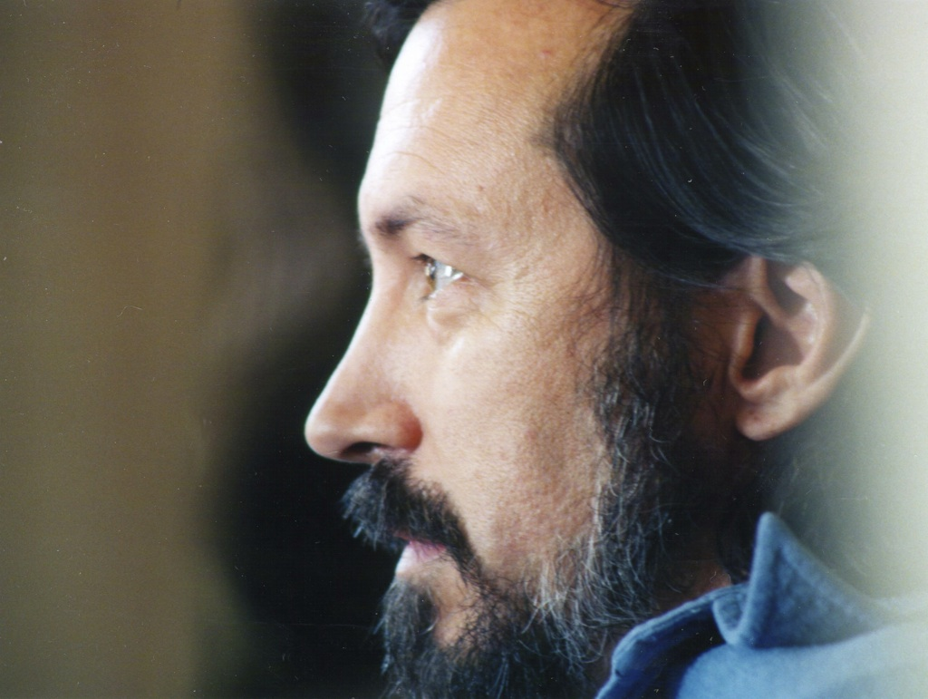
Notes:
Jon Doyle, Mojdeh Mohtashemi, Dan Nigrin, Yao Sun, Ying Zhang, Duane Steward, Chris Tsien, Robert Franck?, Peter Szolovits

Slide 29
Notes:
Caleb Hug, Bob Rudin, Andreea Bodnari, Rohit Joshi
Elisha Sacks, Reid Simmons, Walter Hamscher, Jeff van Baalen

Slide 31
Thank you!!!

