Slide 1
The Video Mesh: A Data Structure for Image-based Three-dimensional Video Editing
Jiawen “Kevin” Chen¹, Sylvain Paris², Jue Wang², Wojciech Matusik¹, Michael Cohen³, Frédo Durand¹
¹MIT CSAIL
²Adobe Systems, Inc.
³Microsoft Research
Notes:
<prime video playback>
Hi, my name is Kevin Chen, and today, I will be talking about the video mesh,
A new data structure for video editing

Slide 2
Motivation
Notes:
I’ll start off with a motivating example.
Suppose we have this simple input video of my friend here

Slide 3
Notes:
We want to be able to control the camera post-exposure, and achieve effects such as
changing the depth of field and interactively moving the focal plane
<pause>
or inserting volumetric smoke that has the right attenuation.

Slide 4
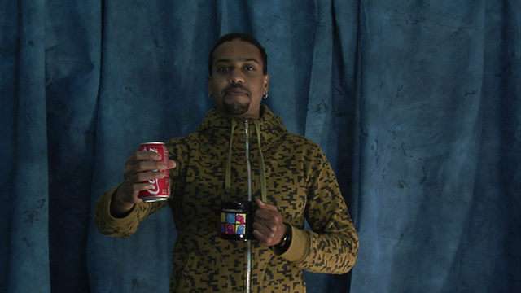
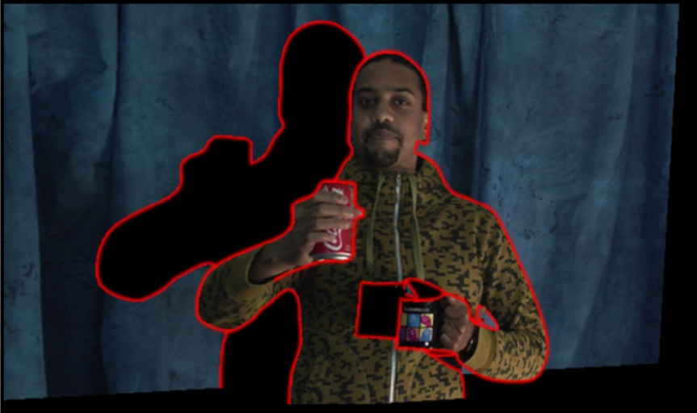
Overview
Video mesh data structure
Encodes motion, depth and texture
“Paper cutout” model
Complex occlusions with proper topology
User driven system for post-exposure effects
input frame
paper cutout
Notes:
We propose a user-driven system that makes effects like
manipulating depth of field, inserting objects, and changing the viewpoint easier
Instead of having dedicated algorithms for each effect,
Our approach is to construct a data structure that captures the necessary information
such as motion, depth, and texture
We focus on the data structure.
The algorithms needed for various effects naturally fall out as operations on this data structure
At a high level, we model the world as cutouts from a sheet of paper like you see on the right.
The big difference between the video mesh and previous mesh-based representations is that,
we model the occlusions as they exist in the scene, with the proper topology
<pause>
But before I go on to describe the components of the video mesh
Let’s look at some related work in representing video

Slide 5
Related work
Layers [Wang and Adelson ‘94]
Simple and intuitive
Only simple occlusions
Video cube [Wang et al. ’05]
Oversegment video
Scribble-based object selection
Long preprocess
Notes:
A classical representation used extensively in commercial products is layers
Layers are simple and intuitive, but can only represent simple occlusions
We’d like to support more complex types of occlusion
Jue Wang (who is not the same Wang as in layers),
introduced the video cube interface in his Interactive Video Cutout system.
He over-segments a video as a preprocess
and has a volumetric,
scribble-based interface for cutting and pasting objects in space-time
In contrast, our system doesn’t use any preprocessing,
and lets the user work completely in image space

Slide 6
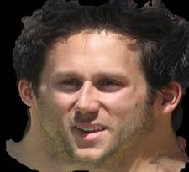
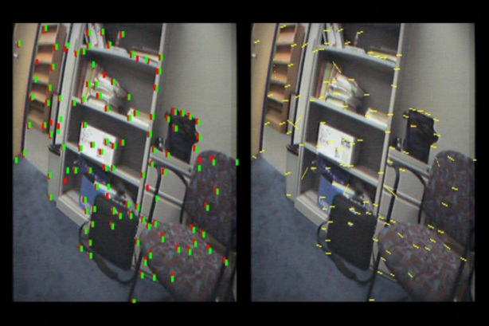
Related work
Unwrap Mosaics [Rav-Acha et al. 2008]
Texture map from video
Per-pixel data
Dense optical flow
Depth maps
input frames
Unwrap Mosaic
dense flow
point tracks
Notes:
More recently, Alex Rav-Acha and colleagues introduced the very cool concept of an unwrap mosaic
where they use sophisticated energy minimization to compute an editable
texture parameterization of an object from a video
An unwrap mosaic lets the user edit an object’s texture and have it propagate through the sequence
Our method is not nearly as automatic, but runs interactively and can handle more complex geometry.
Finally, I want to talk a little bit about data density.
There’s been extensive work done in estimating dense optical flow and depth maps
But as I’ll soon discuss, we decided to encode both optical flow, and depth sparsely
as vertices in a mesh and instead rely on interpolation
We argue that a sparse representation is much easier to edit than a dense image
Let’s go on and review a few of our design goals

Slide 7
Design goals
Editable
Sparse motion and depth
2D user interface
Complex occlusions
Sparse boundary representation
Per-pixel alpha
GPU rendering
Notes:
First and foremost, our system is for users to edit video
As I just mentioned, dense optical flow and depth maps are hard to edit,
so we’re going to use a sparse representation
We also want a 2D user interface: a video cube is just a bit too difficult to use
Next, we want to support the full complexity of real-world occlusions,
<wave>
without doing things like arbitrarily cutting the actor’s arm somewhere when it overlaps his torso
In the same vein of keeping things editable,
we will also use a sparse boundary representation
and rely on per-pixel alpha to refine them
Finally, we want to keep everything interactive,
which means we have to be able to render our representation
with 3D graphics hardware

Slide 8
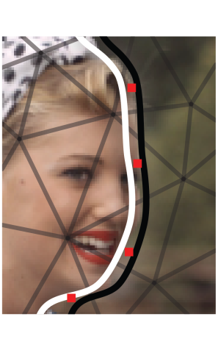
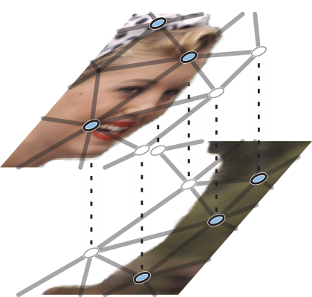
The Video Mesh
Triangular mesh
Vertices encode motion, depth
Faces interpolate
Textured from video
2.5D “paper cutout”
Overlapping triangles with alpha
Manifold connected
Mesh at simple boundary
After cutting and matting
Notes:
Given these constraints, our data structure is in the end just a standard mesh
And it looks like the figure on the right
The mesh contains vertices that are feature tracks, which sparsely encodes motion and depth
It has triangular faces interpolate data stored at vertices
And it’s texture mapped from the input video
The video mesh is a 2.5D representation
Unlike layers, where occlusions force objects to be cut into separate pieces,
We handle occlusion with overlapping faces
which have an alpha texture that resolves fine details
However, the video mesh isn’t quite a 3D model either
It’s structured more like overlapping sheets of paper, which don’t form closed surfaces
One important point is that it *is* manifold connected,
which lets us use standard meshing algorithms

Slide 9
Workflow
boundary splines
input video
Track
Mesh
Cut
“Manipulate”
Estimate depth
Matte
image-based modeling
Notes:
The rest of this talk is structured as a walk through the user workflow.
We will go through the steps a user would take as he builds up the pieces of data structure.
Starting from an input video, we first estimate a sparse motion description
By tracking some point features, which are then automatically meshed
to interpolate motion across the image plane.
Next, we rely on the user to label occlusion boundaries,
which are used to *locally* cut the mesh into layers.
These layers are then *locally* matted to separate the texture components.
Finally, we compute the depth of objects, either automatically using structure-from-motion,
Or using a variety image-based modeling tools.
With a complete video mesh, the user is free to do all sorts of manipulations.
Although this figure is a pipeline, I want to emphasize that
the editing process is iterative and the user can pretty much jump around
For instance, at any point, he can go back and correct a vertex track because he didn’t notice the error until much later.
So, let’s look at the steps in detail

Slide 10
Notes:
<don’t screw this up: pause after 3-4 seconds>
Like I said, the first thing we do is track features
we used a commercial tracker that's based on corner detection to automatically find and track points.
We provide a UI to correct any errors,
and the user can also click anywhere to try and track that point.
Getting a good density of points is important to ensuring a high quality motion description
One thing to note is that we don’t assume long-range tracks
<pause>
Ok, so now we have a sparse description of the motion in the scene
To get motion everywhere,
we compute a Delaunay triangulation over the tracked points at each frame,
which is essentially a piecewise-linear interpolation of the motion.
Let’s take a closer look at the motion model
// we can use a constrained delaunay triangulation to enforce edges

Slide 11
Motion model
frame t
frame t+1
Notes:
Say we have this triangle at frame t
<animate>
The vertices are our feature tracks and represented as linked lists in time
In other words, every vertex has a predecessor and a successor
At each frame, we have a standard index list mesh, which covers the image plane
Say we have this point here
<animate>
which has to lie inside *some* triangle
to determine its motion, we simply find its barycentric coordinates in the current frame
<animate>
*Construct* the triangle formed by the successors of its vertices in the next frame
<animate>
And do barycentric interpolation
Note that with this scheme, the topology does not have to be the same between frames
But if it is, the forward and backward optical flow will match

Slide 12
Notes:
This is what it looks like
If you notice, the linear motion interpolation actually does a pretty good job where the motion is smooth
Where we run into trouble is at occlusion boundaries:
These three points
<point>
were all tracked correctly:
The points on his arm move with it, and the point on his background is stationary
the issue is that we can't linearly interpolate across occlusion boundaries

Slide 13
Occlusion modeling
Geometry
Cut mesh along occlusion boundary
Duplicate faces and create virtual vertices
Estimate motion
Texture
Local alpha matting
Notes:
The way we model occlusions is to cut the mesh, like a piece of paper
So what does that mean?
It means we need to separate two components, the geometry and the texture, along the boundary
We cut the geometry by duplicating the faces along the boundary, which will then overlap
These faces will have *virtual vertices*, whose motion needs to be estimated
And for texture, we’ll locally compute alpha mattes
Let’s look at each of these steps

Slide 14
foreground layer
foreground
background
background
layer
real vertex
virtual vertex
Notes:
This is the standard case:
let's say these triangles near my friend’s arm spans an occlusion boundary
<animate>
The user draws an oriented curve that straddles the boundary
and we "cut" the mesh by duplicating
<animate>
each face that the curve intersects into foreground and background copies,
and creating a set of “virtual vertices”
We assign the existing real vertices to the copy of the face
which corresponds to the side of the curve they’re on.
Virtual vertices are the ones on the “wrong side”:
For example, the vertex on the foreground copy, but on the background side of the boundary, is virtual
The “real” vertices are the ones that have motion information: they each have a successor
However, we need to estimate motion for our new virtual vertices

Slide 15
Motion estimation
frame t
frame t+1
real vertex
virtual vertex
Notes:
We use a pretty basic motion model:
Each duplicated triangle either has 1 or 2 known motion vectors
if it's just 1 <animate>
we set the two virtual nodes to have the same translation
if it's two, we fit a rotation and translation so that it's assumed to move rigidly
<animate>
Notice that a virtual node can be shared by multiple triangles
<animate>
so we just average together all the estimates and create a new successor virtual node
<next>

Slide 16
Motion estimation
frame t
frame t+1
real vertex
virtual vertex
Notes:
Once we have the right motion,
we can use it to advect the splines to other video frames,
/*
Maybe?
or perform retiming effects such as slow motion or motion magnification,
simply by warping the triangles, looking up the texture, and blending,
like traditional mesh-based morphing
*/

Slide 17
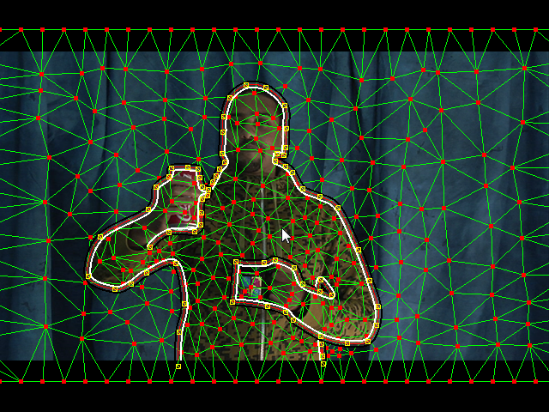
Special cases
Loop
Cusp
T-junctions
Notes:
Now beyond the standard cut, there are actually a whole bunch of
topological cases, such as t-junctions, loops, and cusps
and they all happen in a real video sequence
These cases are actually nontrivial and unlike previous work,
which tries to re-mesh the boundary and ends up with a non-manifold mesh,
we have a scheme that handles all these cases while remaining manifold connected
Manifold connectivity is important because it lets us use standard mesh
processing for a number of editing operations such as inpainting when we move the camera
To show you one special case, let’s look at a cusp

Slide 18
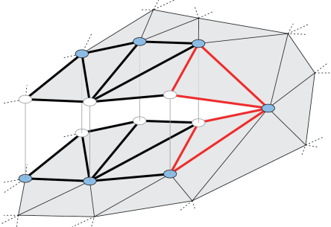
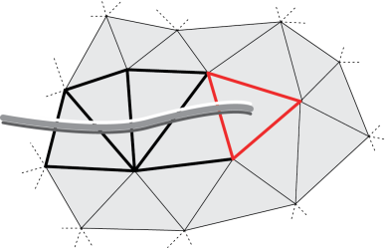
Cusps
initial mesh and spline
mesh after cutting
Notes:
One example of a cusp is at my friend’s arm here
If you follow the occlusion boundary, it simply stops
It’s like cutting a piece of paper and stopping in the middle
In our cutting scheme, the mesh will look something like the figure on the right,
which is still nicely manifold connected.
Now that we’ve cut the geometry,
Let’s look at how we handle the texture

Slide 19
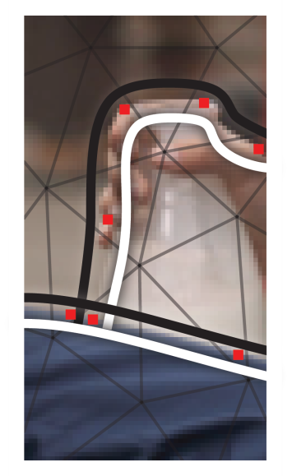
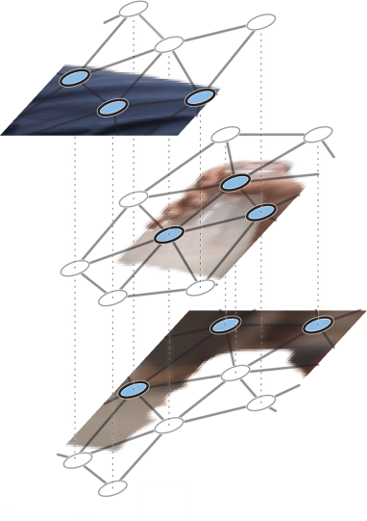
Texture decomposition
Natural image matting [Wang and Cohen ’07]
Local layer decomposition
Tiled texture
T-junction (two layers)
after cutting and matting
Notes:
For the texture, we use natural image matting to separate the layers
Notice that our splines are thick, and have a black and white border
we rasterize these thick splines to use as a trimap,
and feed it to any number of matting backends
Notice that we only locally separate the texture near the boundary,
and that we need an multi-layer decomposition at t-junctions.
Each time we matte, we locally duplicate the image, which overlaps in space
We use a tiled storage scheme to efficiently store the texture and is discussed in the paper
once we did all that work, we can actually manipulate our video as a paper cutout
as a simple form of depth modeling
/*
one major difference between our application and the typical use of matting is that we need to this once per spline:
for each spline, we need a foreground with alpha, and a background
and at a t-junction, we need to matte it again
this means it's an n-layer decomposition, which, when composited back together, needs to form the original image
current matting software doesn't actually do this!
*/

Slide 20
Notes:
for simple objects such as our favorite actor, we can simply drag the mouse
When the user clicks and drags the mouse, he sets a depth constraint on a vertex
We solve a laplace equation for the depth over the mesh domain
And the z-values are assigned as temporal keyframes

Slide 21
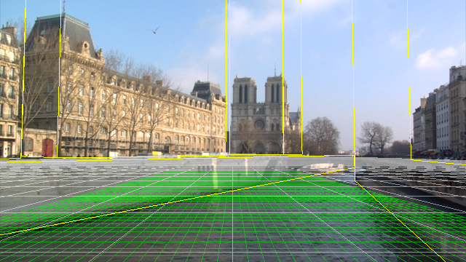
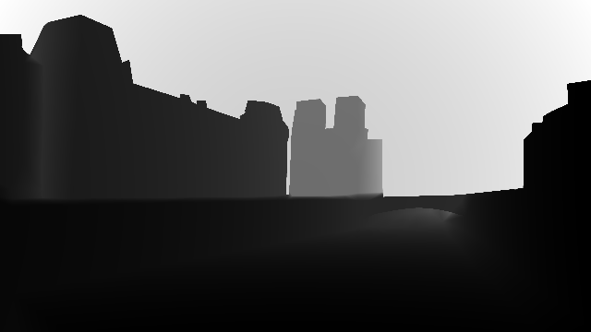
Depth modeling
Image-based modeling [Horry et al. ’97, Oh et al. ’01]
Ground plane
Façades
Structure-from-motion [Hartley and Zisserman ’00]
Camera path
3D Vertex position from rigid motion
Image-based modeling
Depth map
Notes:
For scenes with a static camera, we can use image-based tools
to model large-scale objects such as the ground and buildings
For a moving scene where the majority of objects are moving rigidly
We can use structure-from-motion to compute the camera path
And also 3D vertex positions on each object since we’ve already cut the geometry

Slide 22
Notes:
Here’s quick sequence showing image-based modeling
This sequence has a static camera with some pretty complex occlusions between the columns
We track the points, and label just the primary occlusion boundaries
We can insert a ground plane, and model the columns as vertical facades
Once we have depth at the vertices, we can move the camera,
in the style of tour into the picture.
Because we rotoscoped the actor, he actually forms a single connected component in space-time
We can easily select him and drag to do copy/paste.
In this case, I added a random space and time offset to make the copies not look identical
Notice the perspective foreshortening as the character is dragged around.
And since we have 3D information, we can refocus and move the camera
or combine them to create the classic vertigo effect
And finally, since the scene is fairly diffuse,
we can do some cheap relighting by using the input texture itself as the material
and add some artificial light sources to make it look like a foggy night
That was a bit short, I’ll show it again

Slide 24
Notes:
The depth and the camera path for this scene was computed automatically using structure from motion.
We did add some vertices manually by clicking on two points in different frames and verified that they were stable.
The chassis and lid of the copier were cut out and registered together into the came coordinate system.
We added a bunch of little characters onto the copier glass and can interactively move the camera.
It looks ok if we don’t move too far from the original viewpoint,
But it does get distorted if we move too far as you can see here.
The input sequence is shown on the top right

Slide 25
Notes:
This sequence has some pretty complex occlusions, especially under the bridge
The video quickly jumps through the various steps in creating a video mesh:
We track a bunch of points,
create the mesh
cut out the various buildings and the bridge with splines
and model the geometry with two horizontal planes and vertical walls
As a result, we can move the camera quite far,
all the way onto the roof of the boat as it sails down river
A nice bonus we get from being able to move the camera is we can render things in stereo.
I rendered most of our results in red/blue 3D,
Please come see me after the talk for a demo.
I have glasses.

Slide 26
Limitations and future work
Complex scenes
High frequency motion
High depth complexity
Robust construction
Labor intensive corrections
Integration with automated tools
Notes:
A big limitation of our work, which stems from our design decision to use
a sparse representation for motion and depth, is its ability to handle complex scenes
with high frequency motion of high depth complexity.
For example, this field of grass probably has thousands of individual blades
randomly waving around, which makes it difficult to represent using a video mesh.
One possibility is to compute dense optical flow or depth maps using computer vision
and augment the video mesh with additional texture channels.
We also have trouble representing transparent, volumetric phenomena such as this puff of smoke.
The other big issue is that building the video mesh
can be fairly labor intensive, depending on the complexity of the scene,
We may have to tweak quite a few vertex tracks where automatic tracking failed,
or adjust a large number of splines where the motion advection was wrong
I see better integration with automated tools as the most useful avenue of future work
/*
How long does it take?
High frequency motion and high depth complexity
Motion and depth estimates are a tradeoff
Sparse makes it editable
Future work:UI to integrate multitude of tools
Better motion and depth
From vision
Scribble based techniques
Inflate objects
*/

Slide 27
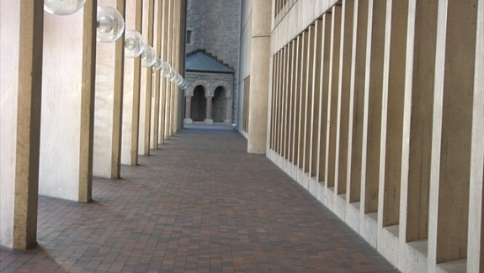
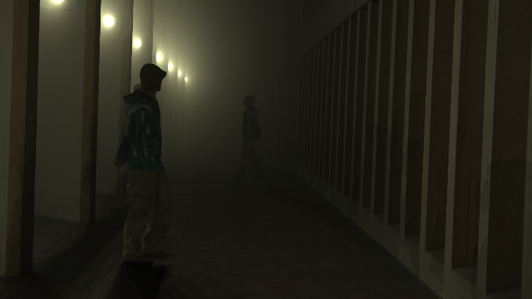
Summary
Video mesh data structure
“Paper cutout” model with proper topology
Editable sparse representation
Effects from simple manipulations
Notes:
To summarize, we presented the video mesh, a data structure that models the world
as paper cutouts whose topology reflects that of the underlying scene.
I’ve highlighted a number of our design decisions in making it a sparse, editable representation
and showed how once we have a video mesh, we can achieve a number of special effects
as simple manipulations of the data structure
Thank you and I’ll take any questions

Slide 28
Summary
Data structure that mixes sparse and dense data, where we need it
Depth and motion specified sparsely
User in the loop: “difficult to create data structure”? It’s the “right” representation that offers tons of useful features
Once you have the data structure, lots of effects are now super easy
Notes:
Full post-exposure camera control
Remind them that once built, it’s still a standard mesh
These effects are easy, but are pretty awesome if you didn’t know that the data structure was there

Slide 29
Motivation
Video editing is hard
Some tasks
Benefit from a central data structure
All kinds of manipulations
Teaser: it’s a space-time mesh and looks like paper cutouts (image on next slide?)
Notes:
Motivation:
[this one: we want to do these kinds of effects]
[we propose a system that makes tasks such as A, B, C easier]
[it’s user driven … (not magic)]
[show one of the demos]
[Instead of dedicated algorithms for each of these,
the way we address it (what we actually do, at a high level is)
a new data structure that encodes … at the same time.
We focus on the data structure, the algorithms are very simple on it]
[Algorithms operate naturally on the data structure]
It’s a paper cutout
It’s editable and fast, and has all the information we need for these effects

Slide 30
Cusps

Slide 31
T-junctions
Notes:
first, what happens if a spline intersects another?
well remember splines model occlusion boundaries: discontinuities in depth
they can't actually intersect except at a point, which we call a t-junction
we explicitly model these: the splines form a directed acyclic graph which knows "what's on top of what“
Then, all we have to do is cut from front to back
when processing the one in the back, we make sure to only duplicate the one that is behind

Slide 32
Representation requirements
Encodes texture, motion, depth, layering
Workflow
2D interactions
Real-time

Slide 33
Related work
Video representations
Layers
Video cube
Unwrap mosaics
[we wanted something more general, and less insane to edit…]
Meshes in video processing
Video compression
Regularizing motion (Particle video)
After effects?
Notes:
[just point out a few things, what’s different
broad categories?]
[also add per-pixel optical flow? And depth maps: difficult to edit / visualize
We need it, but hard to work with]

Slide 34
Related work
Motion description
Dense optical flow vs. feature tracking
Image-based modeling
Tour into the picture, mok
sfm
[We use these tools extensively]
Stereo
Multi-view stereo for depth recovery
We have 3D information, so we can render 3D
Notes:
[design principles?]
[tools that we use?]
[cite these as we go along, avoid the discussion]

Slide 35
Mesh representation
frame t
frame t+1
Notes:
[fix slide to show no temporal coherence]
We say we have these two triangles in frames t and t+1
Their vertices are our feature tracks and represented as linked lists in time
In other words, every vertex has a predecessor and a successor
At each frame, we have a standard index list mesh, which covers the image plane
Say we have this point here, which has to lie inside *some* triangle
to determine its motion, we simply find its barycentric coordinates in the current frame
*Construct* the triangle formed by the successors of its vertices in the next frame
And do barycentric interpolation
Note that with this scheme, the topology does not have to be the same between frames
But if it is, the forward and backward optical flow will match

Slide 36
Motion estimation
frame t
frame t+1
real vertex
virtual vertex
Notes:
We use a pretty basic motion model:
Each duplicated triangle either has 1 or 2 known motion vectors
if it's just 1, we set the two virtual nodes to have the same translation
if it's two, we fit a rotation and translation so that it's assumed to move rigidly
now a virtual node can be shared by many triangles,
so we just average together all the estimates and create a new successor virtual node
Once we have the right motion,
we can use it to advect the splines to other video frames

Slide 37
Texture decomposition
simple boundary
after cutting and matting
T-junction (two layers)
after cutting and matting
Notes:
[cite matting papers?]
We use previous work in natural image matting to separate the layers
notice that our splines are thick, and have a white and black border
we rasterize these thick splines to use as a trimap,
and feed it to any number of matting backends
Notice that we only locally separate the texture near the boundary
And that we need an multi-layer decomposition at t-junctions.
each time we matte, we locally duplicate the image, which overlaps in space
We use a tiled storage scheme to efficiently store the texture and is discussed in the paper
once we did all that work, we can actually manipulate our video as a paper cutout
as a simple form of depth modeling
/*
one major difference between our application and the typical use of matting is that we need to this once per spline:
for each spline, we need a foreground with alpha, and a background
and at a t-junction, we need to matte it again
this means it's an n-layer decomposition, which, when composited back together, needs to form the original image
current matting software doesn't actually do this!
*/

Slide 38
Special cases
Cusp
T-junctions
Notes:
Beyond the standard cut, there are actually a whole bunch of
topological cases, such as t-junctions, loops, and cusps
and they all happen in a real video sequence
These cases are actually nontrivial and unlike previous work,
which tries to re-mesh the boundary and ends up with a non-manifold mesh,
we have a scheme that handles all these cases while remaining manifold connected
Manifold connectivity is important because it lets us use standard mesh
processing for a number of editing operations
To show you one special case, let’s look at a cusp
[Inpainting, rendering, subdivision, etc?]
[text?]
[Write down manifold on slide somewhere?]

Slide 39
Occlusion modeling
Geometry
Cut mesh along occlusion boundary
Duplicate faces and create virtual vertices
Estimate motion
Texture
Local alpha matting
Notes:
The way we model occlusions is to cut the mesh, like a piece of paper
So what does that mean?
It means we need to separate two components, the geometry and the texture, along the boundary
We cut the geometry by duplicating the faces along the boundary, which will then overlap
These faces will have *virtual vertices*, whose motion needs to be estimated
And for texture, we’ll locally compute alpha mattes
Let’s look at each of these steps

Slide 40
Cusps
initial mesh and spline
mesh after cutting
Notes:
One example of a cusp is at my friend’s arm here
If you follow the occlusion boundary, it simply stops
It’s like cutting a piece of paper and stopping in the middle
In our cutting scheme, the mesh will look something like the figure on the right,
which is still nicely manifold connected.
Now that we’ve cut the geometry,
Let’s look at how we handle the texture

